Slide 1
WMO Data Sharing Infrastructure
WIS 2.0 Overview
Kenneth Kerr (Science & Technology Officer)
CMO Headquarters Unit Trinidad & Tobago

Slide 2







Evolution of WMO data exchange
1963
World Weather Watch
1970s
Global Telecommunication System (GTS)
2007
WMO Information System (WIS)
2019
WMO Reform (Earth System Approach)
2021
WMO Unified Data Policy (Core, Recommended)
WIS 2.0
  … collaborative system of systems using Web-architecture and open standards to provide simple, timely and seamless sharing of trusted data and information …
  Open Standards (OGC, W3C, IETF, …)
  Free and Open Source tooling
  Data sharing through Web and real-time notifications with publication/subscription (pub/sub) protocols
  Cloud ready (turn-key solutions)
  Web services and APIs (Application Programming Interface)

Slide 3



WIS2 node and Global Services
Global Services
Discovers data from
Each WMO Member shall implement at least one WIS2 node to share data in WIS2
A WIS2 node replaces the GTS Message Switching System
Data and metadata are shared through a WIS2 node
A WIS2 Node shares data via an HTTPS service and sends notifications to MQTT subscribers
A WIS2 node shares notifications with Global Broker
Subscribes to
Receives notifications of new data from
Downloads data from
Downloads data from
Receives notifications of new data
Subscribes to
WIS2 node

Slide 4






WIS2 Components: Global Services
Global Services
Data users
Global Monitoring
Discovers datasets
Subscribes to topics
Downloads core data
Global Discovery Catalogue
Global Broker
Global Cache
Downloads recommended data
Downloads recommended data
Downloads recommended data
  Provides an API to discover datasets and services
  Sends notifications of new data to be downloaded from Global Caches or WIS2 nodes
Provides users HTTP download of core data cached from WIS2 nodes
WIS2 node
WIS2 node
WIS2 node
Scale to highly-available, global data sharing

Slide 5
WIS2 Global Service instances
Brazil
France
China
USA
Global Discovery Catalogue
Canada
China
Germany
Global Broker
China
Germany
Japan
Korea
Saudia Arabia
USA/UK
Global Cache
Global Monitoring
China
Morocco

Slide 6


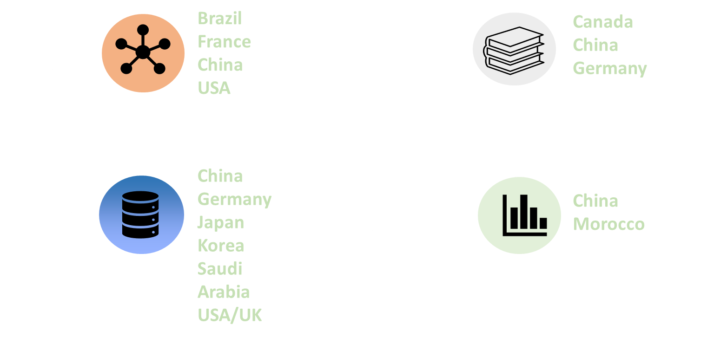
WIS2 Implementation plan
Pilot Phase
Pre-operational
2030
2033
Operational
2025
Pilot Global Broker
Pre-oper Global Brokers
Global Brokers operational
90% of Members migrated to WIS 2.0
Stop gateways and GTS transmission
Pilot Global Cache
Pre-oper Global Caches
Global Caches operational
2024
2023
Pilot Global Discovery Catalogue
Pre-oper Global Discovery Catalogue
Global Discovery Catalogue operational
Q1
Q2
Q3
Q1
Q2
Q3
Workshops and training
WIS 2.0 Tech- Reg approved
Guidelines for WIS 2.0 implementation published
Technical guidance in Guide to WIS
Report on WIS2 progress
NCs/DCPCs may stop GTS functions if migrated to WIS2
GISCs contributing to Global Services may stop WIS1

Slide 7
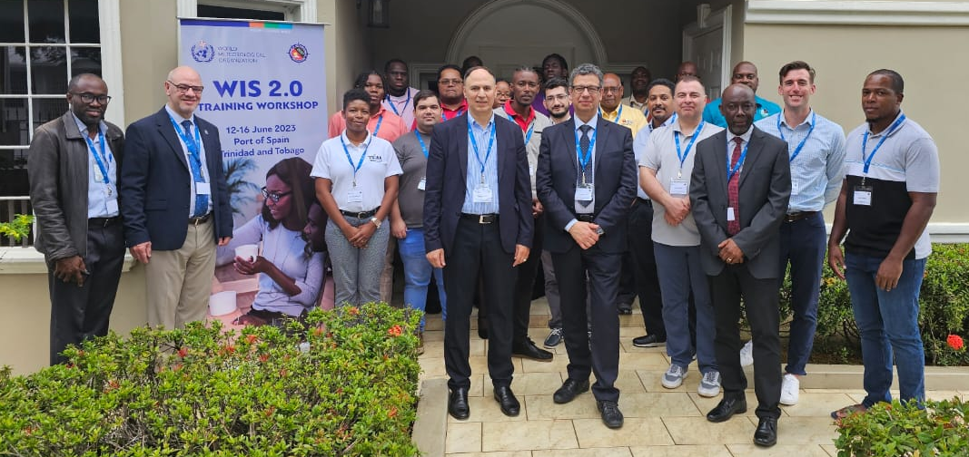
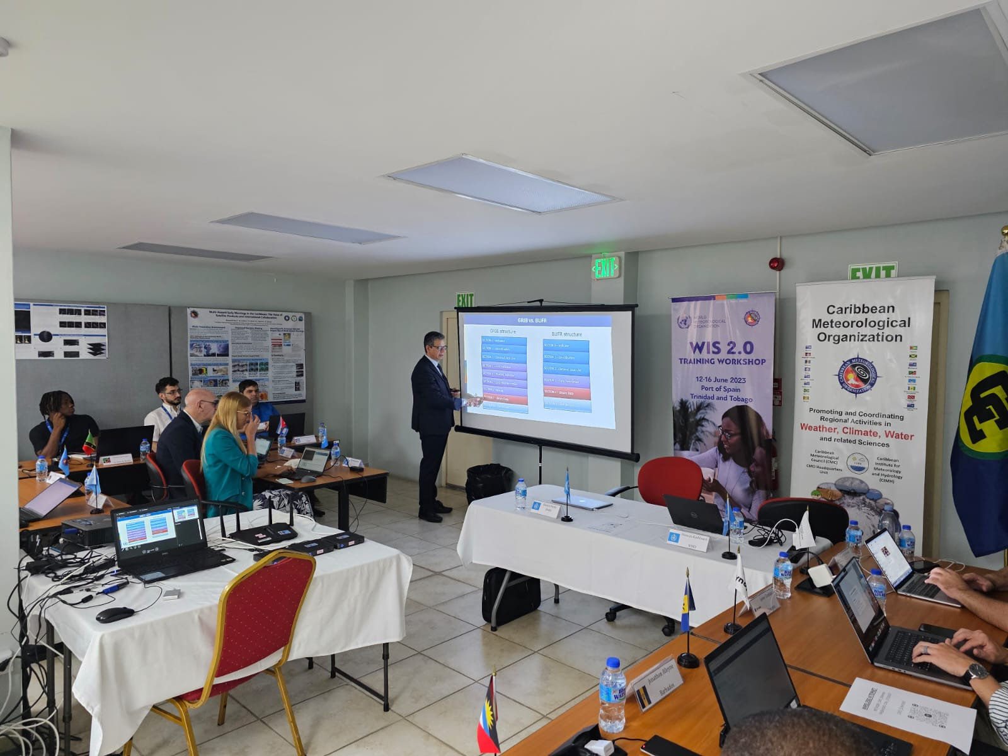
June 2023, Port of Spain, Trinidad and Tobago
  Antigua and Barbuda
  Argentina
  Barbados
  Belize
  Cayman Islands
  Dominica
  Guyana
  Jamaica
  Saint Lucia
  Sint Maarten
  Trinidad and Tobago
  Turks and Caicos Islands
  Cuba
  Grenada
  St. Kitts and Nevis
  St. Vincent and the Grenadine

Slide 8
Letter of Agreement WMO - CMO
WMO
WIS2 in a box (CAP composer to be added)
5 years cloud services (8000 CHF)
20 days FTE per year
CMO
advertise the initiative with Members
coordination between the 11 countries
ensures that each country participates in the installation, configuration, administration and daily operation

Slide 9
CMO Wis2box Users
CMO Caribbean Cloud based Wis2box:
Onsite Wis2box Setup:
Guyana
Jamaica
Montserrat
St Kitts and Nevis
Saint Lucia
Sint Maarten
Turks and Caicos
St Vincent and the Grenadines
Anguilla
Antigua and Barbuda
Bahamas
British Virgin Islands
Cayman Islands
Dominica
Grenada
Belize
Barbados
Trinidad and Tobago

Slide 10
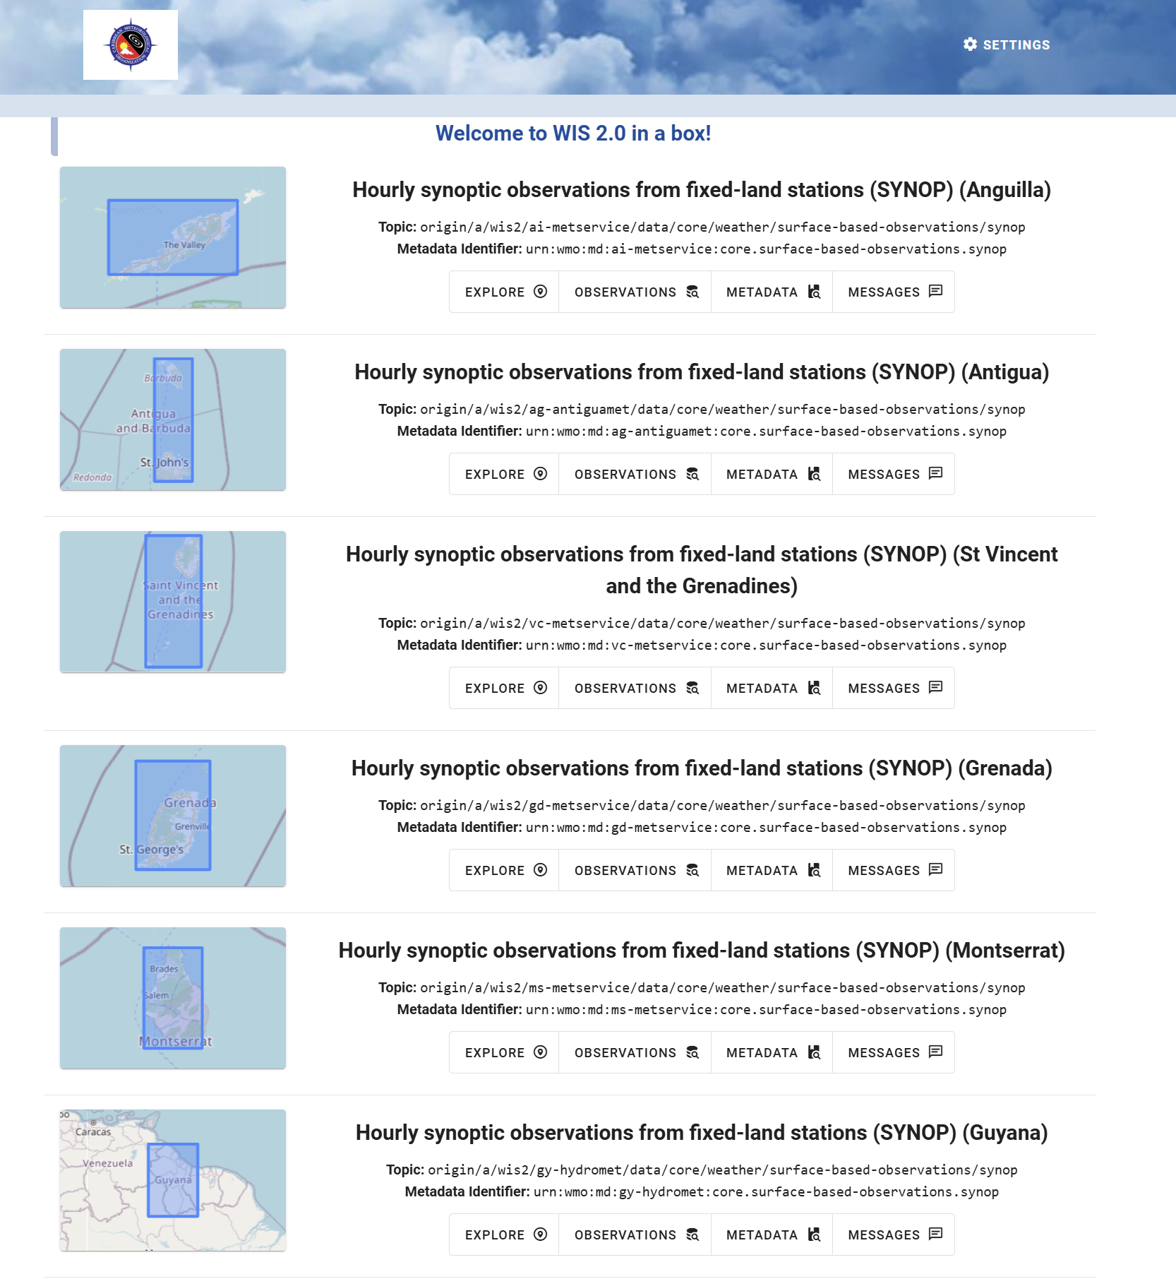
Wis2box in a Cloud – CMO
https://wiscaribbeancmo.org

Slide 11
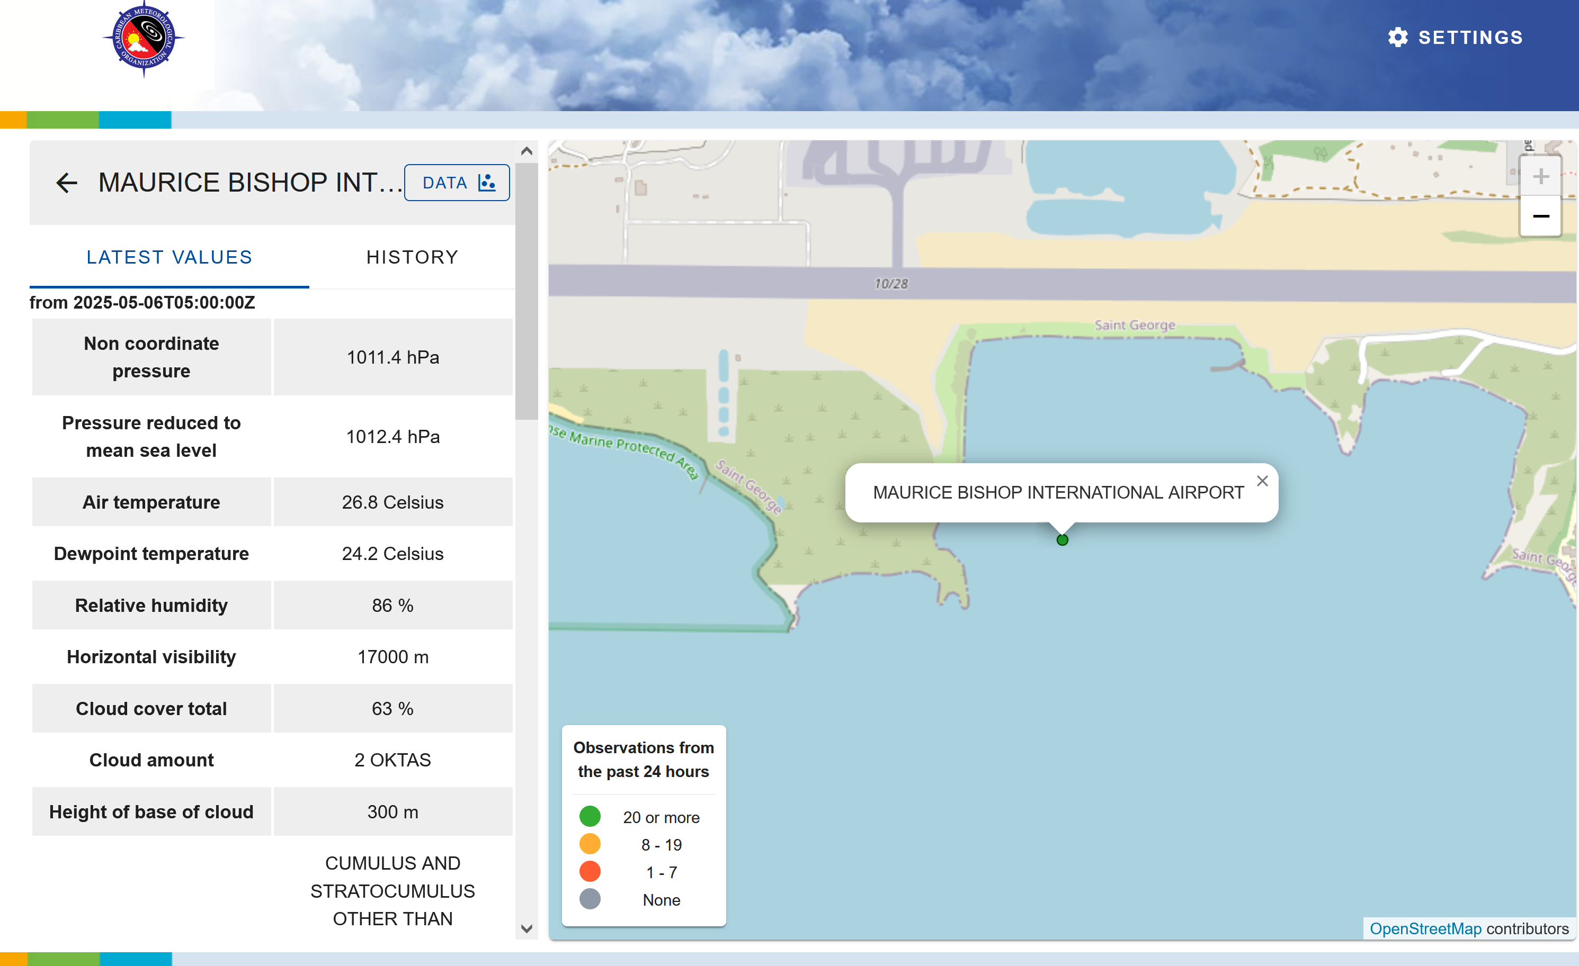
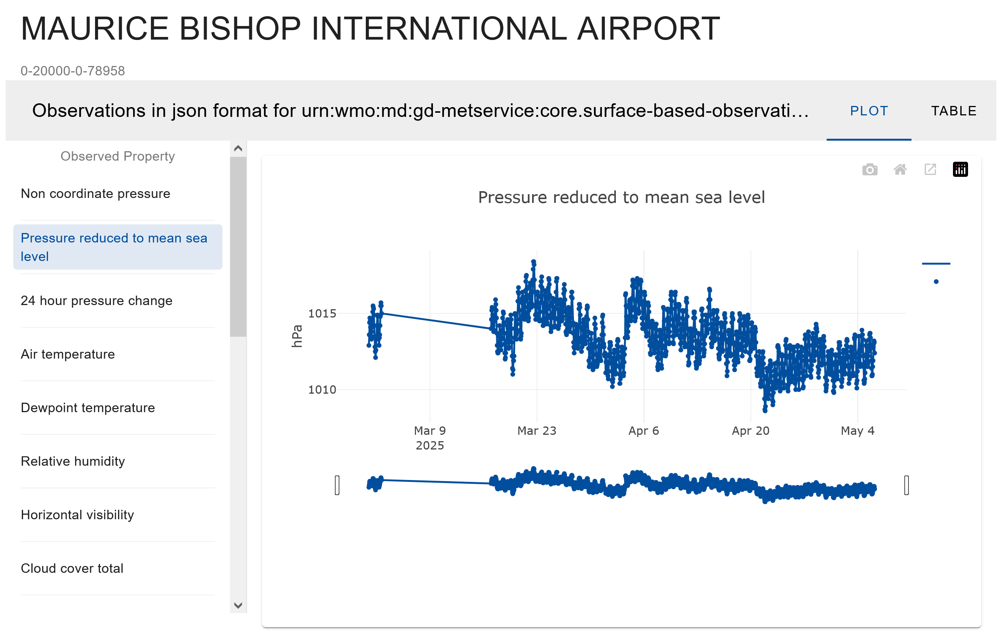
Wis2box in a Cloud – CMO
https://wiscaribbeancmo.org

Slide 12
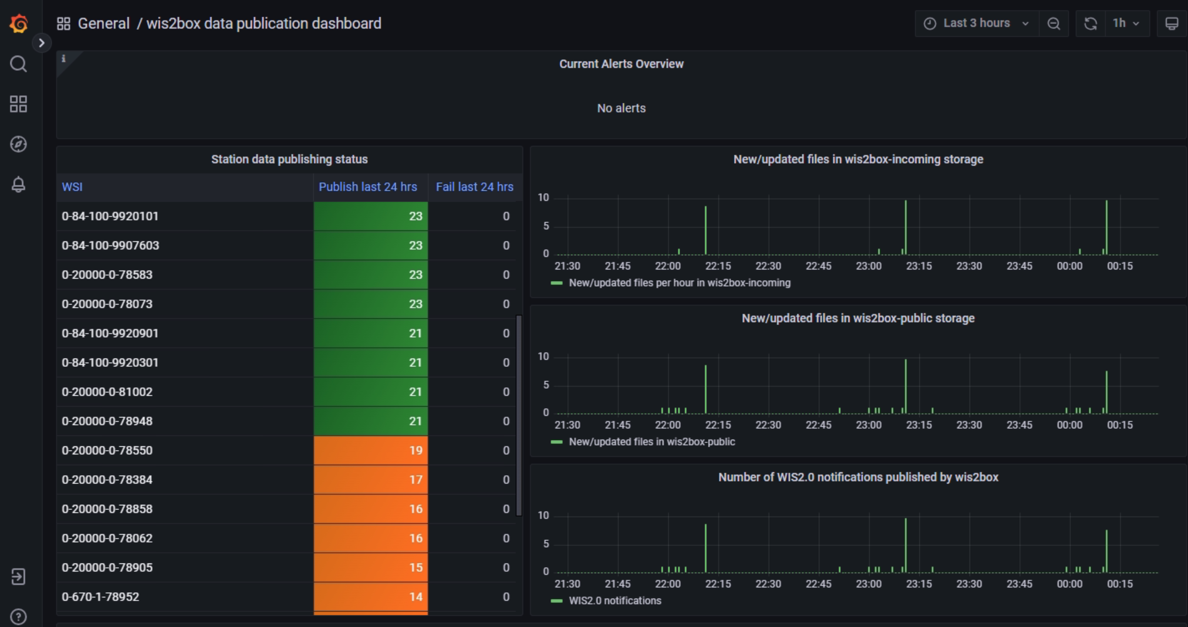
Grafana Monitoring Dashboard

Slide 13
Thank you

