Slide 1

GBON Data Flow
Data Users
Internal, local or International
Raw Data from weather stations
WIS2.0
OSCAR
Website
Mobile App
Early warning
Central Data
Storage
Realtime
Ingestion
99% uptime
C.D.M.S.

Slide 2
Current Problems
No established realtime data flow and management
Duplication of message transmissions i.e. GTS and WIS2.0
Wide range of weather station formats - some countries have up to 5 different formats
Strange data logger programming choices
No centralized database
No automated message generation and publishing on WIS2.0

Slide 3
Belize Example
Data Users
Internal, local or International
S.U.R.F.A.C.E.
Realtime
Ingestion
99% uptime
WMO msgs.
DayCLI, SYNOP, CLIMAT
WIS2.0
OSCAR
Website
Mobile App
Early warning
Central Data
Storage
Raw Data from weather stations
Manual
Or
Automatic
STATION METADATA
C.D.M.S.
REST API – realtime data

Slide 4
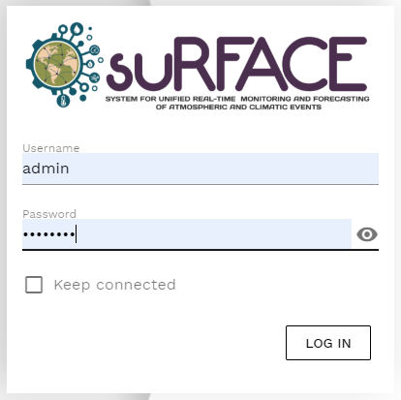
SURFACE
System for Unified Real-time monitoring and Forecasting of Atmospheric and Climatic Events
Supports realtime data ingestion – LRGS, FTP
Multiple data entry methods(key entry, excel, AWS files)
Aggregates Sub-hourly data intervals to: Hourly, Daily, Monthly, Yearly data
Monitors weather station performance & data flow
Stores metadata for stations, instruments and maintenance reports
Automatic QC Procedures
  Range, Step and Persistence AQC checks
WMO compliance
  Generates WMO messages from database(Synop, CLIMAT, DayCLI)
  Automatic data push to WIS2box/WIS2.0 node
  Integrates with WMO OSCAR for metadata management
Open Source Application
  Project - https://github.com/opencdms/surface
  Test site – https://dev.nms.gov.bz
Tech Stack – Docker/Postgres with TimescaleDB/Python/Django Framework/VueJS frontend/Restful API

Slide 5
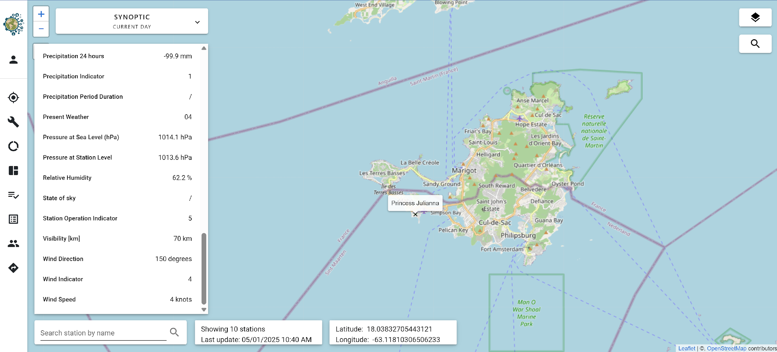
Map View – Sint Maarten – Princess Julianna

Slide 6
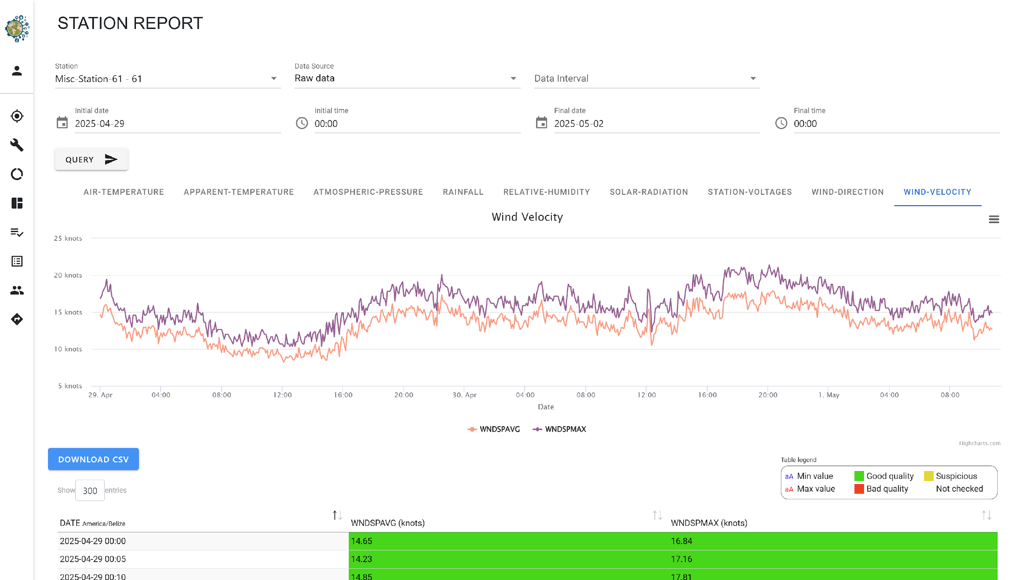

Slide 7
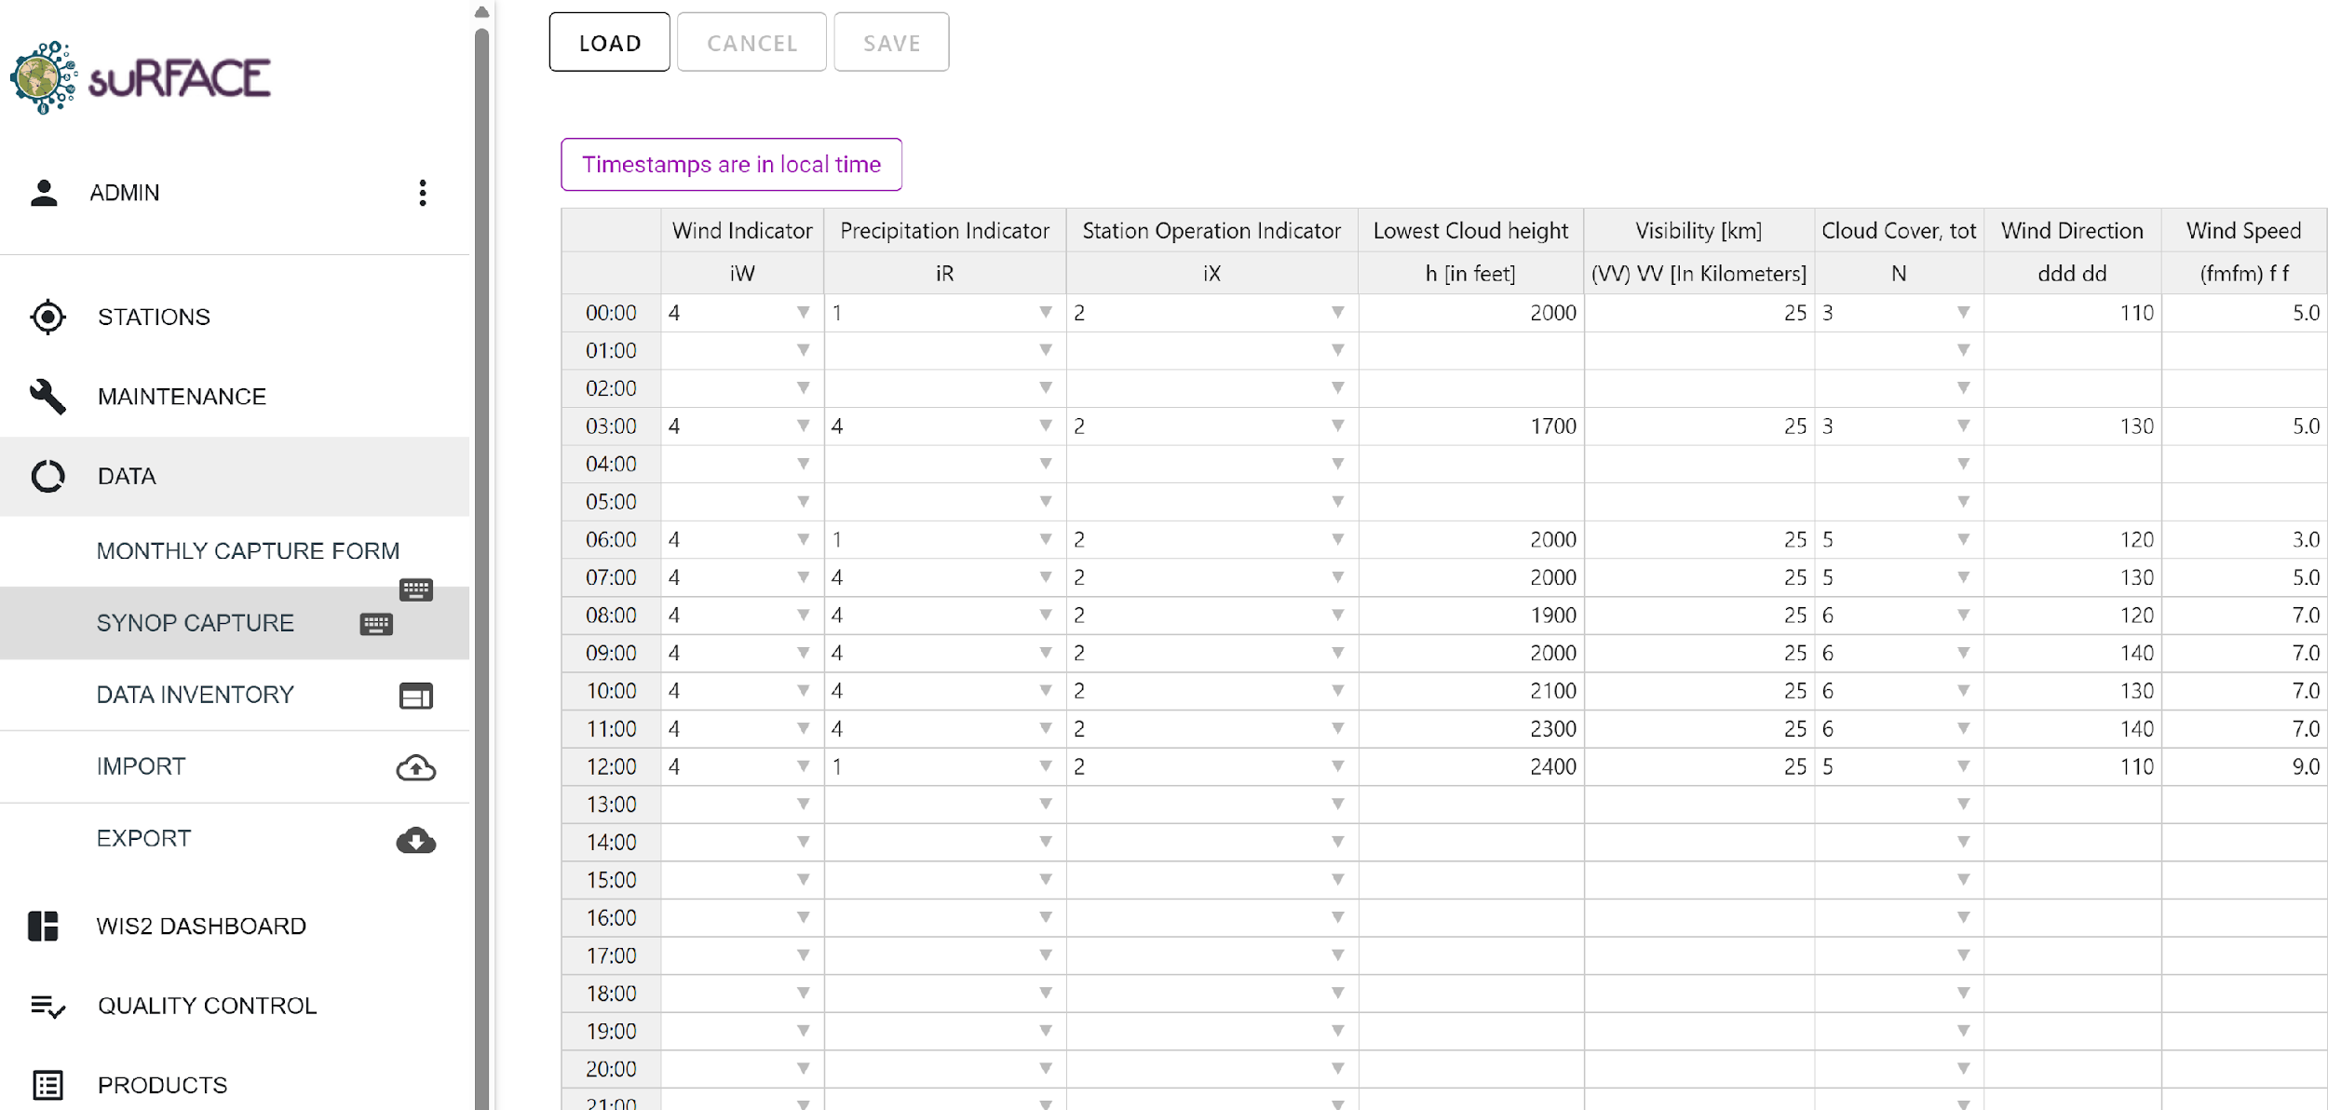
Manual data Entry Form for SYNOP

Slide 8
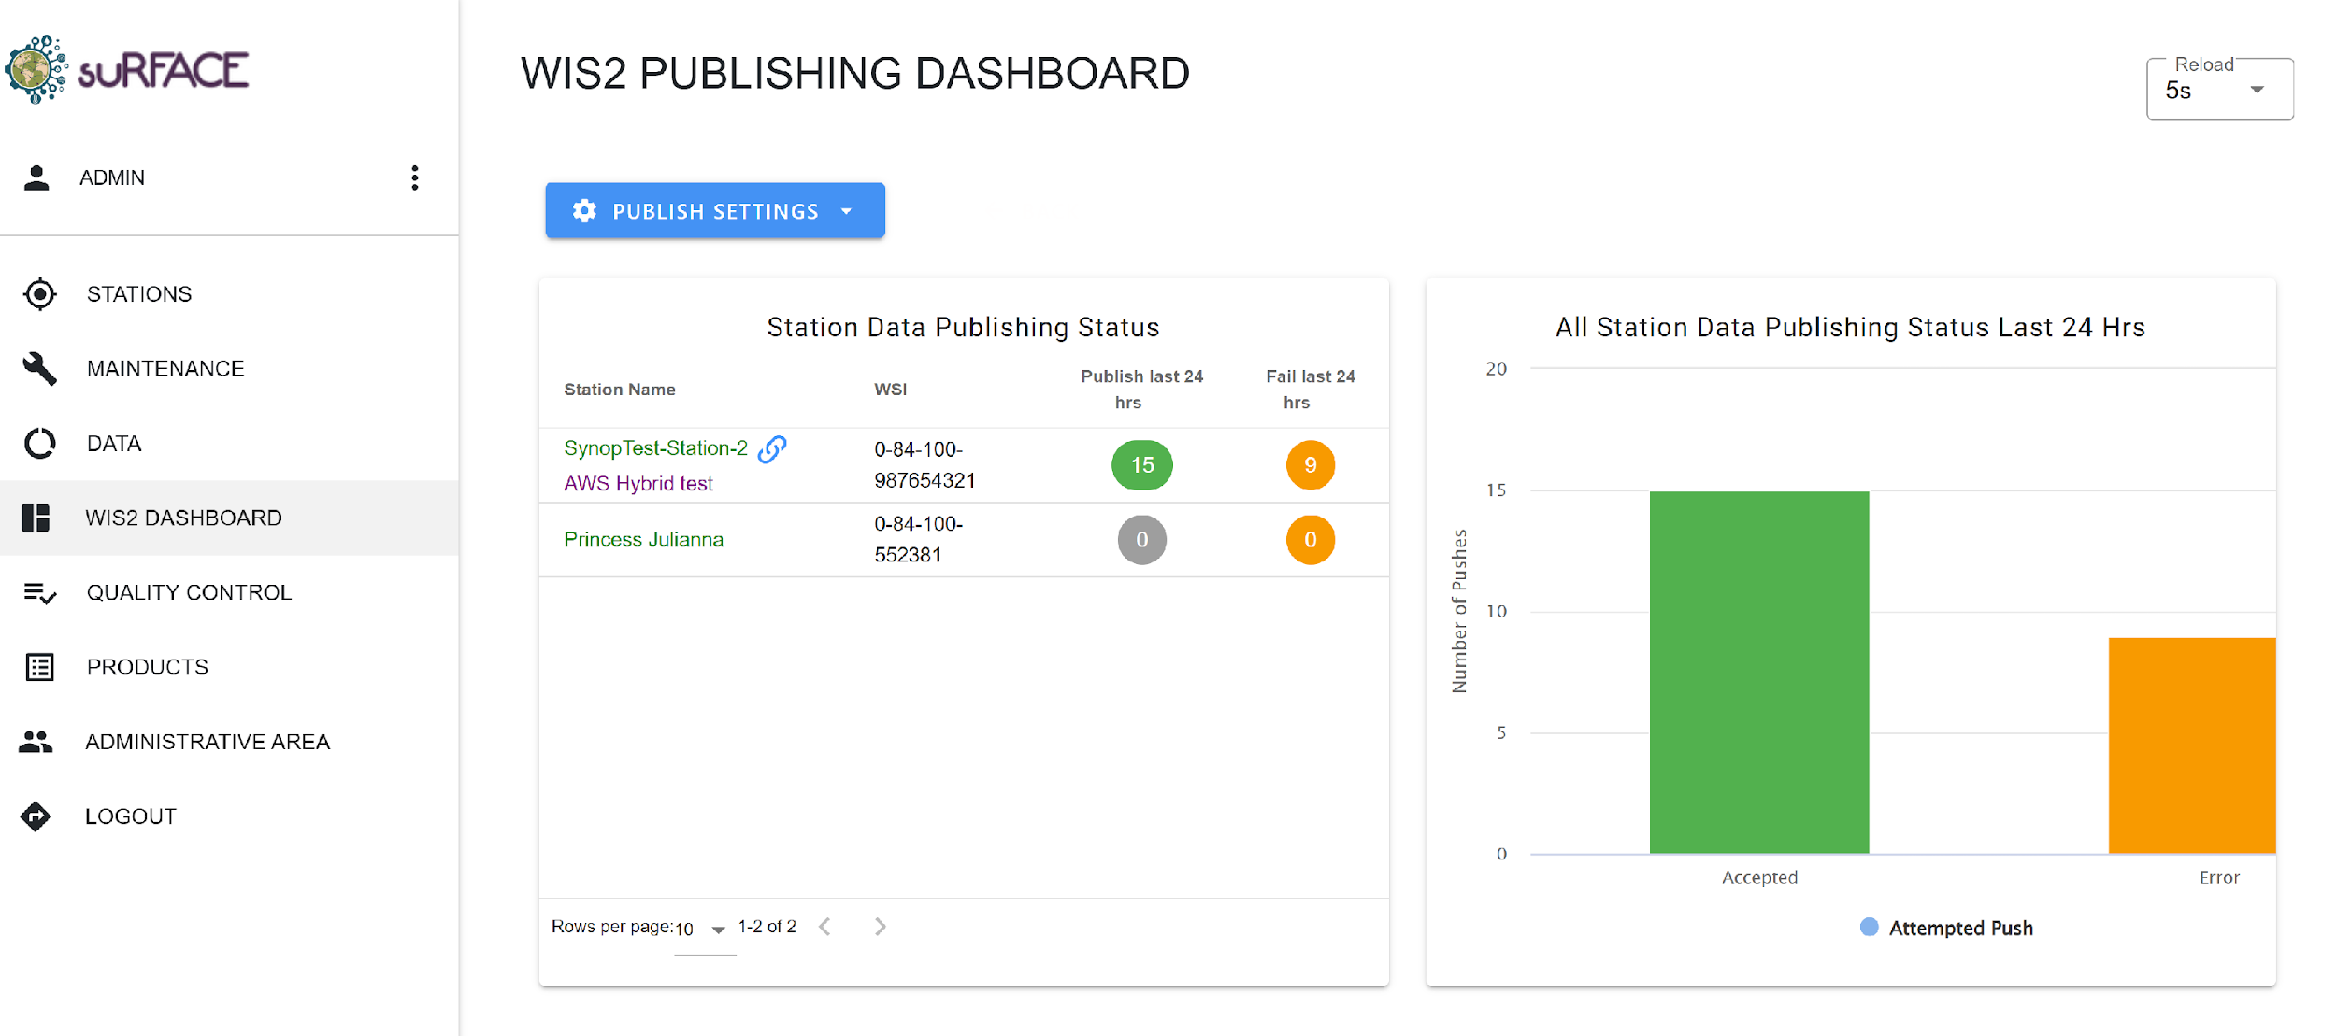

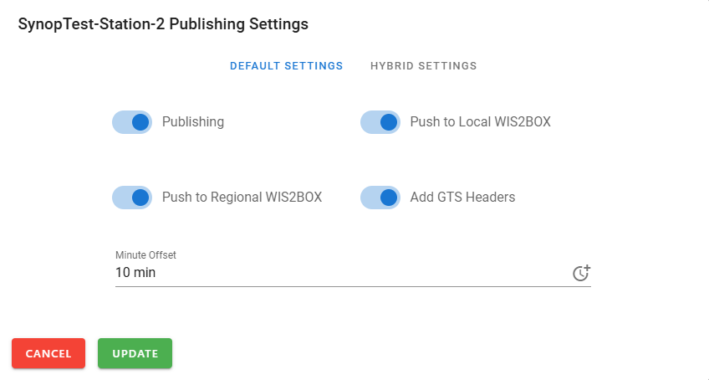
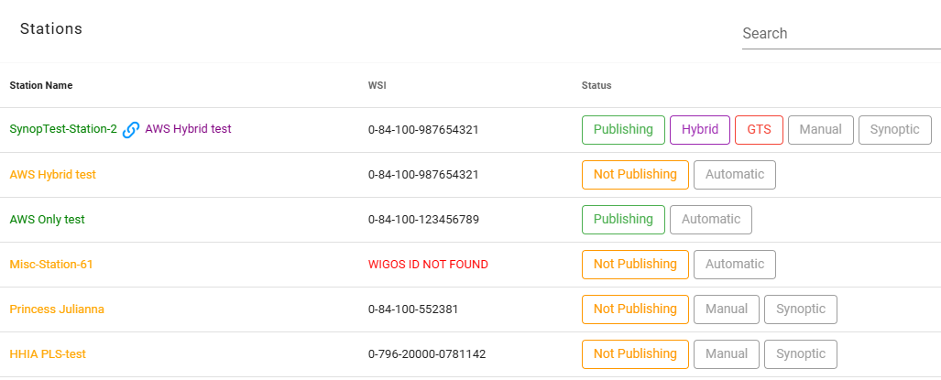
WIS2
Dashboard

Slide 9
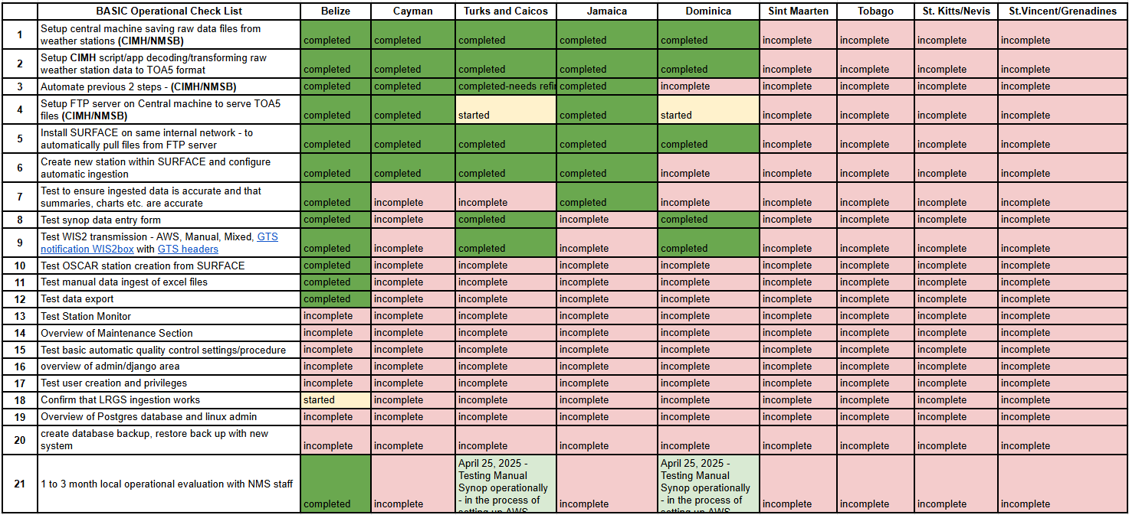
REGIONAL ADOPTION OF SURFACE AUTOMATION

