Slide 1
Session 5: Regional Approaches and Implementation Opportunities in the Caribbean
SOFF-IDB-CREWS Regional Workshop in the Caribbean - May 5 – 7 Kingston, Jamaica
Data Quality, Monitoring and Incident Management – RA IV Regional WIGOS Centers
Daniel Alejandro Vila Espigo (presenter)
Technical Coordinator of Infrastructure – Regional Office for the Americas, WMO

Slide 2

RWC Structure in RA IV
The components of RWC in RA IV :
Canada (Ln/Canada):
Leading Node (Ln) for metadata management
USA (Ln/USA):
Leading Node (Ln) for quality monitoring
Costa Rica (Cn/Costa Rica):
Contributing Node (Cn) for Spanish speaking countries for both metadata management and quality monitoring
Trinidad & Tobago(T&T) (Cn/T&T):
Contributing Node (Cn) for English speaking countries for metadata management
British Caribbean Territories/Caribbean Meteorological Organization (BCT/CMO) (Cn/BCT-CMO):
Contributing Node (Cn) for English speaking countries for quality monitoring
 | 2

Slide 3
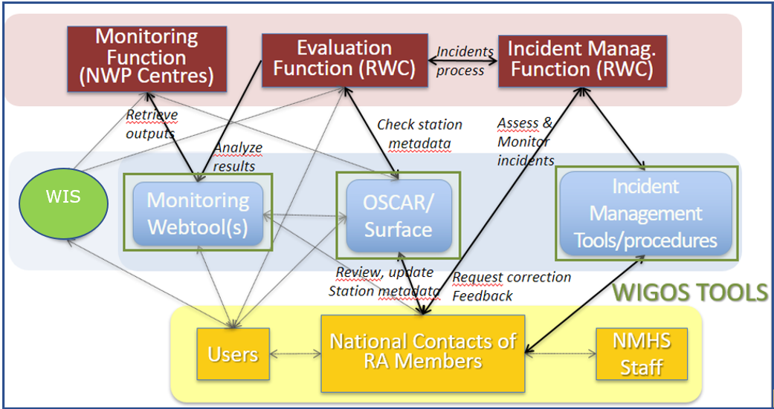
WORKFLOW-Quality Monitoring
WDQMS Process:
A) Monitoring Function; B) Evaluation Function; C) Incident Management Function
Monitoring Function/
Monitoring of the stations in RA IV by WIGOS Quality Monitoring Centres (WQMCs), i.e. Numerical Weather Prediction (NWP) Centres, DWD, ECMWF, JMA and NCEP.
The results of monitoring of surface land and upper air stations WDQMS web tool.
WQMCs
RWCs
 | 3
WDQMS Process

Slide 4
WORKFLOW-Quality Monitoring
Identification of an issue;
Creation of a ticket;
Any user; Ln: Cn
Confirmation
Ln/USA
Confirmation
Cn/Costa Rica (Spanish)
Cn/BCT-CMO (English)
Members (WDQMS NFP)
Receipt Confirmation from Member?
NO (reminding)
Acknowledge by NFP
Evalauate/Follow the issue before initiating IMP
NO (long silence)
Search and find the cause of incident
YES
Need to be raised as an incident?
Update Ticket Status as "Under Investigation"
Regular Reporting on Actions to Cn
NO
Update Ticket Status as "in progress"
YES
Resolving incident
Initiate IMP
Select Cn
Incident Resolved?
YES
NO
Explanation if incident cannot be resolved
 | 4
Close the ticket
Update Ticket Status as “Won’t Fix"
Escalate the ticket to WMO Secretariat

Slide 5
WORKFLOW-Metadata Management
Identification of an issue;
Creation of a ticket;
Any user; Ln: Cn
Confirmation
Ln/Canada
Confirmation
Cn/Costa Rica (Spanish)
Cn/T&T (English)
Members (WDQMS NFP)
Receipt Confirmation from Member?
NO (reminding)
Acknowledge by NFP
Evalauate/Follow the issue before initiating IMP
NO (long silence)
Search and find the cause of incident
YES
Need to be raised as an incident?
Update Ticket Status as "Under Investigation"
Regular Reporting on Actions to Cn
NO
Update Ticket Status as "in progress"
YES
Resolving incident
Initiate IMP
Select Cn
Incident Resolved?
YES
NO
Explanation if incident cannot be resolved
 | 5
Close the ticket
Update Ticket Status as “Won’t Fix"
Escalate the ticket to WMO Secretariat

Slide 6

I. Background and status of RWC operations and functions performed
RWC Trinidad and Tobago
Operation Status | □ Operational □ Pilot Mode □ Start up phase
type | □ RWC operating in single mode □ RWC operating in distributed mode
Affiliated Members | English Speaking Caribbean Countries
Functions | Metadata Management □ Monitoring, Evaluation and incident Management Optional functions (to be developed)
RWC Manger and structure | Mr. Oscar Lovell
Human resources allocated | Varies (No dedicated staff at present)
Financial resources allocated | □ Sufficient □ Insufficient □ Internal (by the met service) □ External
Quality Management System | □ No □ Yes, only for the entire Met service/Aeronautical processes □ Yes, for the Met service including RWC
Continuous trainings for your staff or for the NFPs in your area of responsibility | Training required for additional staff as to ensure operational continuity.

Slide 7
I. Background and status of RWC operations and functions performed
RWC Canada
Operation Status | □ Operational □ Pilot Mode □ Start up phase
type | □ RWC operating in single mode □ RWC operating in distributed mode
Affiliated Members | USA (co-lead node), British Caribbean Territories, Costa Rica, Trinidad and Tobago (contributing nodes)
Functions | Metadata Management □ Monitoring, Evaluation and incident Management Optional functions (to be developed)
RWC Manger and structure | Thinesh Sornalingam, Data Management
Human resources allocated | 1 FTE
Financial resources allocated | □ Sufficient □ Insufficient □ Internal (by the met service) □ External
Quality Management System | □ No □ Yes, only for the entire Met service/Aeronautical processes □ Yes, for the Met service including RWC
Continuous trainings for your staff or for the NFPs in your area of responsibility | Yes, as new staff are added .

Slide 8
I. Background and status of RWC operations and functions performed
RWC BCT/CMO
Operation Status | ⊠ Pilot Mode
type | ⊠ RWC operating in distributed mode
Affiliated Members | English- speaking Caribbean Members
Functions | Monitoring, Evaluation and incident Management
RWC Manager and structure | Kenneth Kerr, Science and Technology Officer
Human resources allocated | 1 staff member
Financial resources allocated | ⊠ Sufficient ⊠ Internal (by the Met Services)
Quality Management System | □ No
Continuous trainings for your staff or for the NFPs in your area of responsibility | Most NFPs require additional training Significant gains: All 17 Members have functioning NFPs OSCAR, WIGOS, WDQMS

Slide 9
I. Background and status of RWC operations and functions performed
RWC – Costa Rica
Operation Status | □ Operational □ Pilot Mode □ Start up phase
type | □ RWC operating in single mode □ RWC operating in distributed mode
Affiliated Members | Costa Rica, Cuba, Dominican Republic, El Salvador, Guatemala, Honduras, México, Nicaragua, and Panamá
Functions | □Metadata Management □ Monitoring, Evaluation and incident Management □ Optional functions (Data analysis, Quality Control and support IT)
RWC Manger and structure | Manager, Technical Scientific Staff and Collaborators.
Human resources allocated | From the NMI of Costa Rica (Meteorological Network and Data Processing Department) with the support of RWC-Argentina
Financial resources allocated | Sufficient □ Insufficient □ Internal (by the mest service) □ External * Point to consider, we are just assuming the role.
Quality Management System | □ No □ Yes, only for the entire Met service/Aeronautical processes □ Yes, for the Met service including RWC
Continuous trainings for your staff or for the NFPs in your area of responsibility | A list is being compiled with Region IV members regarding their capabilities and requesting support from WMO, RWC-Argentina and/or their own Meteorological Service.

Slide 10
Short summary of activities developed and success stories
Canada
Metrics for RWC Canada
· 39 tickets opened
· 27 tickets closed
· 12 tickets open/in progress
Issues with Station Metadata:
deployment information, identification validation, …
Issues with Station Availability:
temporary closures, decommissioned stations, …
Trinidad and Tobago
· A few data availability issues have been raised and resolved since launch
· Provided guidance to members on use of the WIGOS tools and other WIGOS related issues
· Facilitated stations in transmitting their Synop message hourly
· A number of issues are currently being monitored and may be raised as tickets soon
CMO/BCT
· Assistance with Members observational data management
· Assistance with the coordination of sub-regional and national WIGOS projects: Created and distributed WSI –Template.
· Significant gains: All 17 Members have functioning NFPs OSCAR, WIGOS, WDQMS
· 16 stations < 80% data available in 2023. Only 9 stations in 2024
Costa Rica
Until October 2024, RWC-Argentina was in charge of RWC-Costa Rica, and we have been gradually assuming. The most important steps has been: knowing the capacities and needs of the area, in order to develop the work plan.
In relation to (i) metadata, (2) quality or availability and (3) more observations shared
In accordance with the three points mentioned above, we have been meeting with RAIV Spanish-speaking countries: Dominican Republic, Panama, Cuba and Mexico. Pending: El Salvador, Guatemala, Honduras, Nicaragua.

Slide 11
Short summary of activities developed and success stories
7 stations < 30% data available in 2023. Only 2 stations in 2024
16 stations < 80% data available in 2023. Only 9 stations in 2024

Slide 12
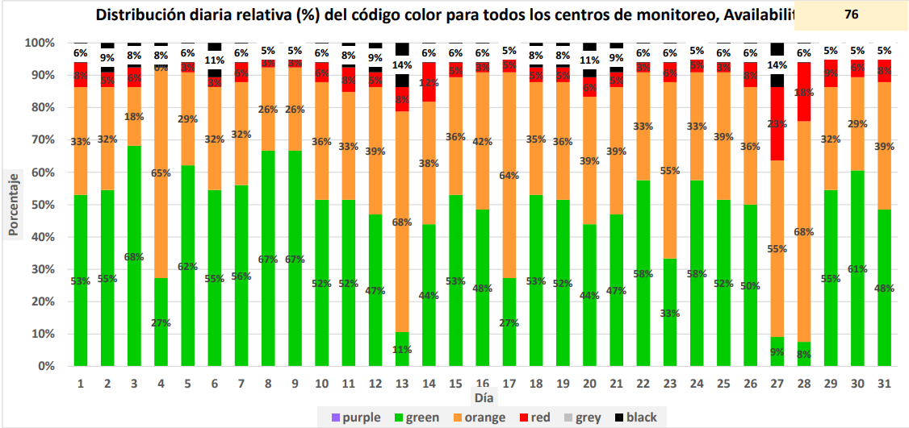
Short summary of activities developed and success stories

Slide 13
Main Challenges
Data availability issues: Difficult to track GTS bound products to investigate data availability issues -> WIS 2.0
Lack of National Focal Points (NFP) and contact persons for OSCAR/Surface, WDQMS and WIGOS. Difficult to find out the capacities and needs of the personnel.
Low priority for WIGOS implementation in some NMHS
HR constrains for small met services: are not always dedicated 100% to RWC functions-> competing priorities: WIGOS, WIS 2.0, SOFF, GBON, RBON
Difficult for Members to transition from manned observation 3-hourly to manned hourly observations exchange -> GBON compliance

Slide 14
Main Opportunities
Recent restructuring of the Expert Team on WIGOS Tools presents an opportunity for better direct collaboration. Looking forward to the work of these Task teams.
Recent and proposed enhancements to the WIGOS tools: WDQMS 1.5.2, WMO hosted IMS and Oscar/Surface enhancements should make for better connectivity between platforms -> funding challenges!
Establishment of the Caribbean CMO WIS 2.0 Node provides automatic exchange of hourly observational data from Members , which enable 24 hourly observations, once integrated and accessible to NWPs
CREWS 2.0 Caribbean Project has an activity to provide WIGOS Tools capacity building workshop. What about the rest of RA IV? -> looking for other opportunities

Slide 15
Suggested improvements/changes
Improve OSCAR Web Client Tool (under funding constrains with Meteoswiss)
More documentation on the use of the WDQMS API will help increase the usability of the tool
GBON compliance tool: ability to download stations by country and status
A more robust coupling between Oscar/Surface and WDQMS.
WMO to keep database up to date. PRs are providing WMO with NFPs, but WMO databases are not up to date.
The RA IV RWC model of Lead Nodes/Contributing Nodes may need to be revisited
Would like to see representatives from the NWPs having a greater role in the process

Slide 16
Back Up Slides

Slide 17
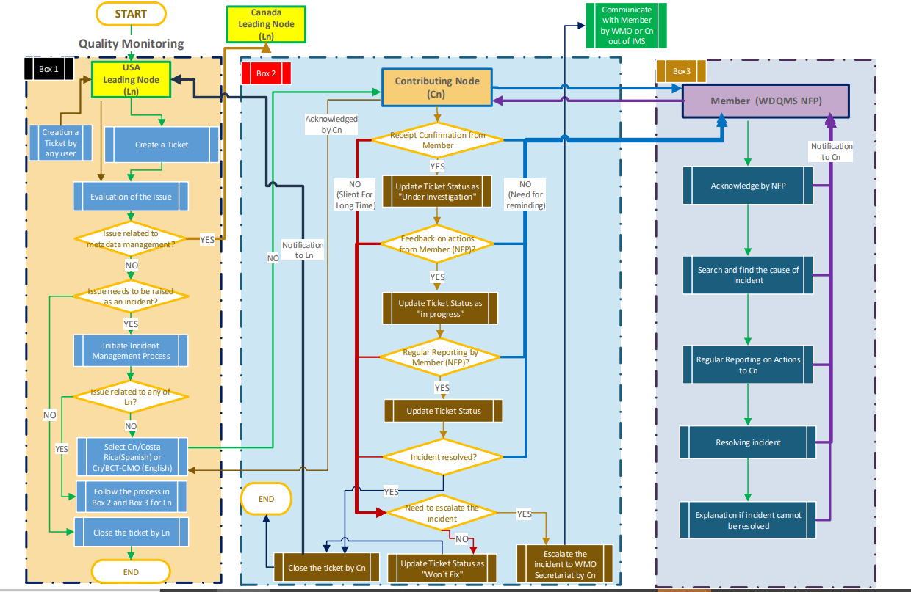
WORKFLOW-Quality Monitoring
 | 17

Slide 18
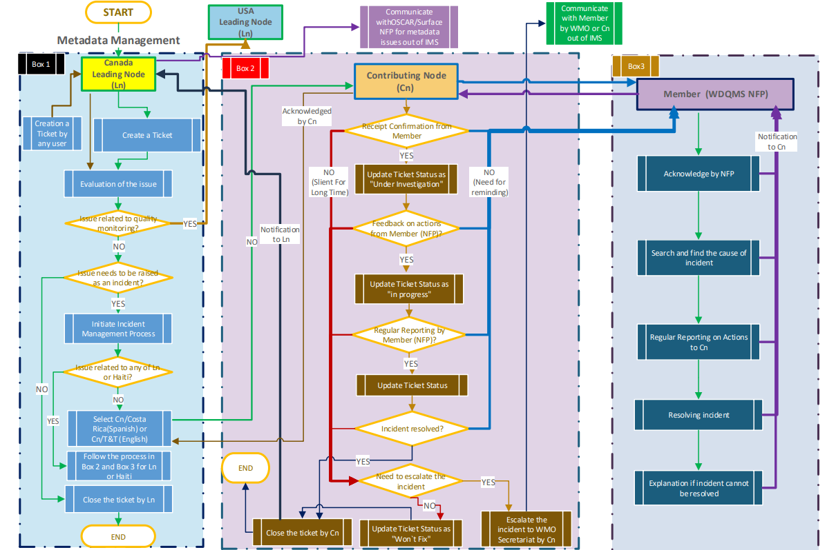
WORKFLOW-Metadata Management
 | 18

