Slide 1
Closing the Basic Weather and Climate Data Gaps in the Caribbean: SOFF regional implementation and creating synergies Antigua and Barbuda Update
5 - 7 May 2025

Slide 2
Antigua and Barbuda SOFF Update
Presented by Dale C. S. Destin, Director
Antigua and Barbuda Meteorological Service (ABMS)
Weather and Climate for Living
@abmetservice

Slide 3
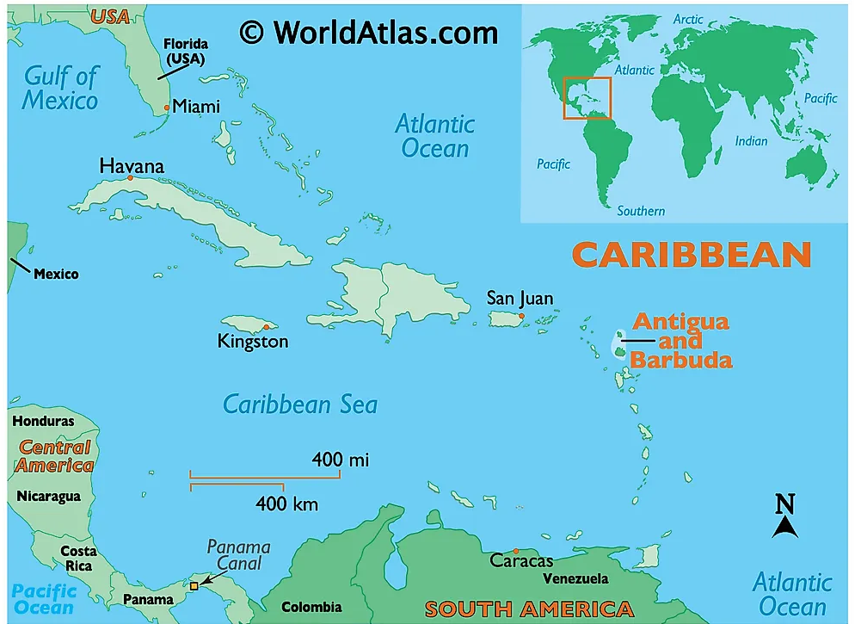

Slide 4
Brief Introduction to the ABMS
ABMS
Established in 1965 under the Gov. of A&B, but dates back to 1941 under the UK Air Ministry Met Service.
Department: Min of Tourism, Investment, Civil Aviation & Transportation (TICAT)
Staff complement of 30 (22 meteorological)
The “authoritative national institution responsible” for monitoring, forecasting and providing information and early warnings on weather, climate and hydrological (floods, droughts) hazards.
Formed to support aviation but has the added responsibilities without the necessary resources to support disaster risk reduction, water resource management, agriculture, health, etc.

Slide 5
Area of Responsibility

Slide 7
Status of A&B Meeting GBON Requirements
Status
Is this being met?:
Using two stations a mile apart (middle and threshold of the runway)
Stations are 25 and 8 years old, respectively
The mask of the 25-year-old station is badly corroded; it fell flat in Jan 2020
No calibration has ever been done
We have not been able to use WIS2.0 as required.
We aspire to establish at least two GBON land stations — one on Antigua and one on Barbuda (48 km north of Antigua)

Slide 8
SOFF Implementation Update & Lessons Learnt
SOFF Implementation Update:
Readiness phase completed (GBON Gap analysis, National Contribution Plan & Country Hydromet Diagnostic)
Project proposal submitted; Investment phase funding requested
Lessons learned:
Peer Advisor role is invaluable
The process is not quick
Time intensive
ABMS needs restructuring [too much work for the Director]

Slide 9
Programmes & Projects That
Align with SOFF Investments
Country/regional programmes and projects:
GCF Build Project
Air Safety Support International (ASSI) Initiative/UK FCDO Project
EW4ALL Project
CREWS 2.0
RCCAME Project
SWFP
Flash Flood EWS

Slide 10
St. Kitts
Thank You!
Questions?

Slide 11
Closing the Basic Weather and Climate Data Gaps in the Caribbean: SOFF Regional Implementation and Creating Synergies Country Update: The Bahamas by Mary Butler Chief Meteorological Officer/QMS Manager Email: marybutler@bahamas.gov.bs
5 - 7 May 2025

Slide 12
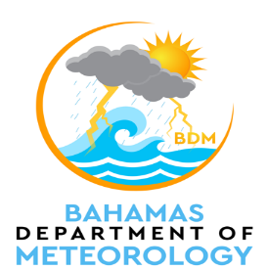
The Bahamas Department of Meteorology
INTRODUCTION:
The Bahamas Department of Meteorology, the Meteorological Provider of The Bahamas since 1957, is committed to the provision of meteorological forecasts, observations, and warnings:
1. WMO Global Gap Analysis (June 2023)
Table 1. WMO Global GBON Gap Analysis June 2023
GBON horizontal resolution requirements | GBON target | Reporting | Gap improve | Gap new | Gap total
Surface stations Horizontal resolution: 200km | 3 | 0 | 3 | 0 | 3
Upper-air stations Horizontal resolution: 500km | 1 | 0 | 1 | 0 | 1

Slide 13
The Bahamas Department of Meteorology
Table 2. Assessment of existing GBON stations per operational status and network ownership
GBON Requirements | Existing observation stations (# of stations)
 | NMHS network |  | Third-party network
 | Reporting | Improve | Reporting | Improve
Surface stations Horizontal resolution: 200km Variables: SLP, T, H, W, P, SD | 2 | 1 | 0 | 0
Upper-air stations Horizontal resolution: 500km Vertical resolution: 100m, up to 30 hPa Variables: T, H, W | 0 | 0 | 0 | 1
Status of The Bahamas Meeting GBON Requirements
The SOFF Initiative approved funding to install a surface station in Crooked Island. This station was one of the stations that The BDM had in its store. The level of funding includes:
- Shipping costs
- Civil Works
The proposal to fund a hydrogen generator to commence upper air ascents was denied.

Slide 14
The Bahamas Department of
Meteorology
A Recent Achievement of The BDM:
The BDM has successfully implemented a Quality Management System (QMS) according to the ISO 9001:2015 standard.
This standard is reflected in all meteorological products and services (aviation, public, and marine).
On the 8th – 9th of April 2025, the meteorological products and services were audited by external auditors from DNV Business Assurance, USA Incorporated.
The BDM obtained certification on the 18th of April.
Call for Support:
A Hydrogen Generator
Several Sea Level Monitoring Equipment
Smart Met App

Slide 15
Closing the Basic Weather and Climate Data Gaps in the Caribbean: SOFF regional implementation and creating synergies Belize
5 - 7 May 2025

Slide 16
NATIONAL METEOROLOGICAL SERVICE OF BELIZE Brief Overview of the NMSB and the Current GBON Status
The National Meteorological Service of Belize (NMSB) was established in 1972 (not legally). Since then, it has grown and now comprises three technical sections (Weather Analysis and Forecasting; Climate Services and Electronics & Information Technology) with a complement of 32 staff members (24 technical and 8 administrative).
Gap analysis for Belize indicates that for a country of Belize’s size a total of two surface stations and one upper air station are required to be GBON compliant. It was noted that there is a gap in the marine space, but this was not addressed under proposed SOFF investments.
Currently the NMSB maintains one surface station (transmits only SM and SI) and one upper air that exchange data internationally. Upper air station is reliant on NWS/NOAA for equipment.
Therefore, one additional station will be enhanced in the south of the country through SOFF to transmit data internationally. Also, the proposal submitted by Belize and approved by SOFF Secretariat includes additional support for the current surface station as well as capacity development and institutional strengthening to sustain GBON standard.
Belize is currently starting the SOFF Implementation Phase after a delay due to procedural issues that has been sorted out between the WMO/UNDP and the Implementing Entity (IDB)

Slide 17
NATIONAL METEOROLOGICAL SERVICE OF BELIZE Challenges and Opportunities
Delay since SOFF Investment Phase Funding approval to implementation due to procedural issues at the IE level
NMSB has changed three Ministries since funding approval which creates some challenges in bringing new Ministries onboard/updated
Human and Material resource gaps to maintain GBON stations which will be addressed by SOFF investment
Good working relationship and collaboration with Peer Advisor (UK Met Office) and Implementing Entity (IDB).
NMSB has been at the forefront of WIS2.0 implementation and development of SURFACE CDMS and so good working relationship with WMO and Regional partners has been developed

Slide 18
NATIONAL METEOROLOGICAL SERVICE OF BELIZE National & Regional Projects aligned with SOFF Investment
Energy Resilience for Climate Adaptation Project; Resilient Rural Belize Project and the Climate and Sustainable Agricultural Projects have all been externally funded projects that had components aimed at building the weather observation network in Belize resulting in a total coverage of over 70 weather stations country-wide.
Belize is working with CMO and other regional Met Services to implement WIS2.0 as well as the regional roll-out of the locally developed SURFACE CDMS. Both systems are vital component in the transmission of data globally.
The Caribbean Action for Resilience Enhancement (CARE) project funded by the EU through the Caribbean Development Bank (CDB) will also serve to build capacity to ensures sustainability.

Slide 19
Thank you for your attention!!!
Questions or Comments??

Slide 20
Closing the Basic Weather and Climate Data Gaps in the Caribbean: SOFF regional implementation and creating synergies Barbados Update
5 - 7 May 2025

Slide 21
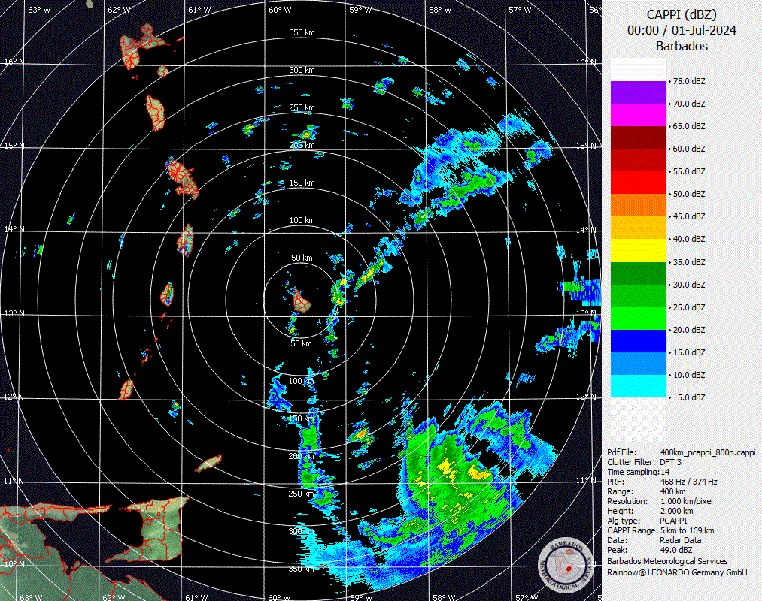
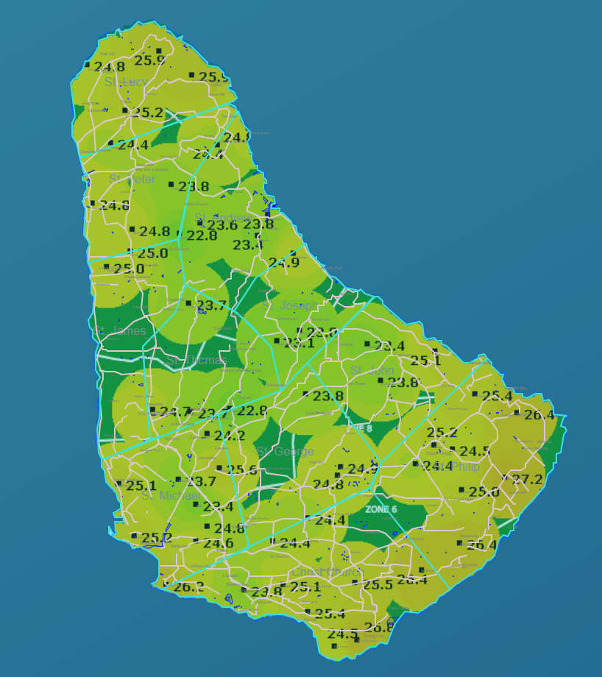
Barbados Meteorological Services Observing Capacity
The BMS has 1 surface station and 1 upper-air station as part of the GBON network
Additionally observing capacity
90 3DPAWS
Dual polar radar
7 Water level sensors
4 Unmanned sea surface drones
2 Spotter Buoys currently deployed (as part of a 30 buoy project)

Slide 22
Barbados GBON Status
The BMS is currently 75% GBON compliant
Surface station is reporting every hour
Upper air station is currently only reporting once daily since January due to faulty equipment and the reliance on international resources for upper air station equipment
The BMS is hopeful that SOFF could help with building capacity related to upper station equipment to reduce the country’s dependency on international resources

Slide 23
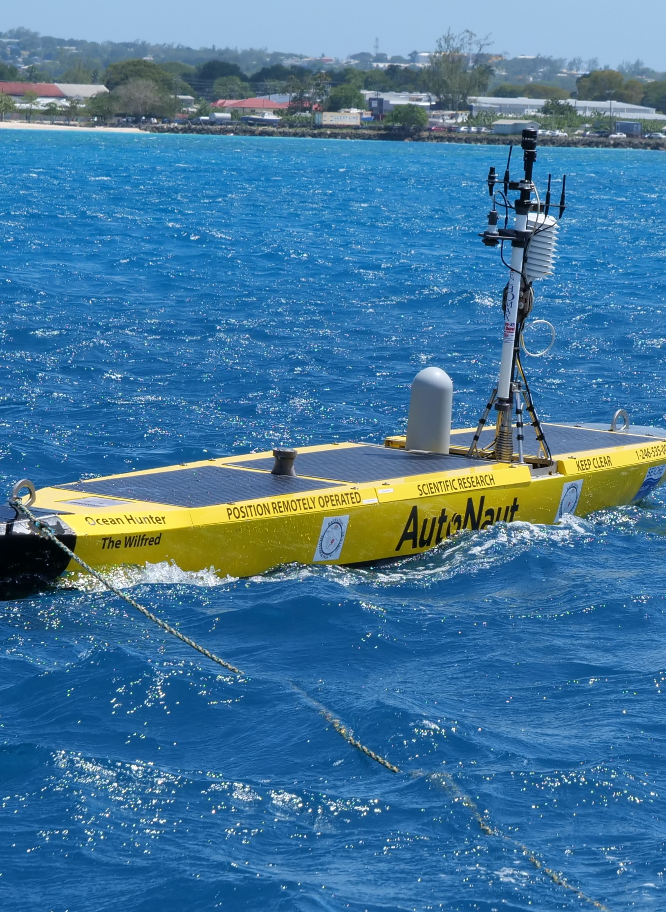
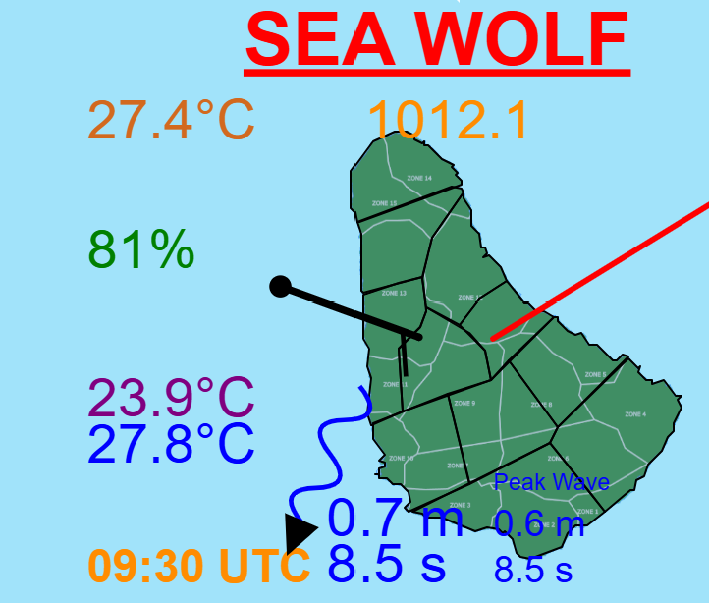
Projects that Align with SOFF Investments
One of the main goals of the BMS is the improvement of our observing capacity not only on the land but also in the marine space
Marine Observations
Spotter Buoys
Unmanned Sea Surface Drones
Arieal Drones

Slide 24
Questions?
5 - 7 May 2025

Slide 25
Closing the Basic Weather and Climate Data Gaps in the Caribbean: SOFF regional implementation and creating synergies Update from Cuba
5 - 7 May 2025
Orlando Osa Peralo
Jefe del Centro de Instrumentos y Métodos de Observación
Instituto de Meteorología de Cuba

Slide 26
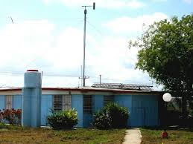
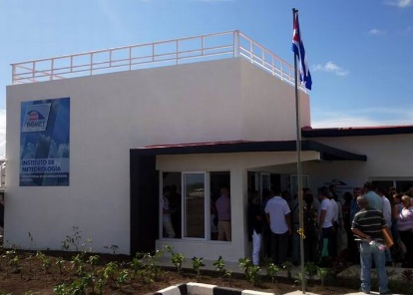
Situación actual en Cuba: Estaciones meteorológicas
Red de Estaciones Meteorológicas
325
328
Total de Estaciones Meteorológicas: 68
EMA en funcionamiento : 20
318
376
374
340
373
323
327
330
329
312
316
320
375
326
338
315
317
322
332
339
314
331
336
348
335
344
343
313
333
349
347
309
342
346
310
321
341
337
345
352
350
353
355
354
358
357
370
378
365
351
362
372
361
371
377
334
369
359
363
364
368
356
360
319

Slide 27
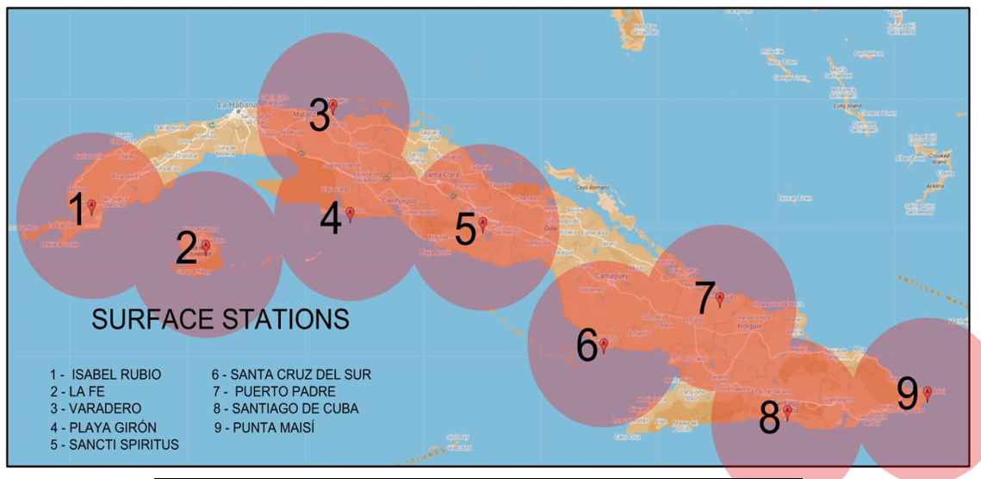
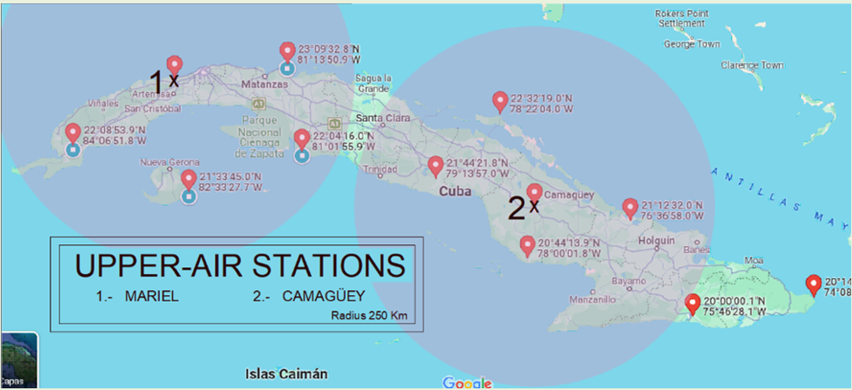
Meta Nacional hacia el cumplimiento de GBON
Objetivo:
Cumplir con el estándar de densidad de red GBON.
Garantizar el intercambio internacional de datos con:
Observaciones horarias (superficie).
2 sondeos diarios (altitud).
Acciones Clave:
✔ Seleccionar 9 estaciones terrestres de superficie.
✔ Establecer 2 nuevas estaciones de altitud (radiosondas).
Evaluación Técnica de Estaciones GBON
Acciones Requeridas para Cumplimiento:
Mejora parcial (5 estaciones), actualmente cumplen con GBON, pero requieren actualización de equipamiento.
Mejora completa (3 estaciones), no cumplen actualmente; necesitan modernización integral.
Nueva instalación (1 estación), Creación desde cero para alcanzar cobertura óptima
Nueva instalación(2 estaciones de aire superior), Creación desde cero para alcanzar cobertura óptima
.
Objetivo: Garantizar el cumplimiento total con los estándares GBON.

Slide 28
Closing the Basic Weather and Climate Data Gaps in the Caribbean: SOFF regional implementation and creating synergies Dominica
5 - 7 May 2025

Slide 29
Dominica Meteorological Service
Currently there are three offices, the Douglas-Charles airport, the Canefield Airport and the new office at Jimmit which serves as the head office. Data is only transmitted from the two airports only during operational hours.
We are not GBON compliant at present one reason is that do not operate for the full 24 hours additionally our stations do not have the capability of transmitting independently. There have been improvements we have increased the number of SYNOP messages being sent out.

Slide 30
SOFF Implementation update & lessons learned
No implementation presently. Still at the discussion phase. Stations need to be upgraded.
Country/regional programmes and projects that align with SOFF Investments
The DMS has been working with the CMO and the Belize Met Service to develop a new database platform that will have the capacity to covert the SYNOP message directly to BUFR format. This program will be able to incorporate the WIS2InABox as well. Its currently in the testing phase.

Slide 31
Closing the Basic Weather and Climate Data Gaps in the Caribbean: SOFF regional implementation and creating synergies Dominican Republic
5 - 7 May 2025

Slide 32
Dominican Institute of Meteorology INDOMET
Dominican meteorology began in 1954 with the training of the first observers and meteorologists by the WMO. The National Meteorological Service was established in 1955. The National Meteorological Office was created by presidential decree in 1984. In 2024, following the enactment of Law 19-24, we became the Dominican Institute of Meteorology. This program offers the following benefits:
Greater technical and administrative autonomy.
Better access to national and international funding.
Technical and scientific strengthening.
Greater prestige and institutional influence.
Greater response capacity to extreme events.
Promotes research.

Slide 33
Instituto Dominicano de Meteorologia INDOMET
La meteorología dominicana, inició en el año 1954 con la formación de los primeros observadores y meteorólogos por parte de la OMM. Estableciendo en el año 1955 el Servicio Meteorológico Nacional, para el año 1984 mediante un decreto presidencial se crea la Oficina Nacional de Meteorología y en el año 2024 tras la promulgación de la ley 19-24 pasamos hacer el Instituto Dominicano de Meteorología. Obteniendo los siguientes beneficios:
Mayor autonomía técnica y administrativa.
Mejor acceso a financiamiento nacional e internacional.
Fortalecimiento técnico y científico.
Mayor prestigio y peso institucional.
Mayor capacidad de respuesta ante fenómenos extremos.
Promueve la Investigación.

Slide 34
We currently do not have GBON. We are in the process of updating four Automatic Meteorological Stations, which will be incorporated into GBON to ensure compliance with data quality and time transmissions.
The SOFF implementation document is ready and awaiting approval. It is located at the WMO SOFF Mechanism Office, following the diagnosis and preparation of the AEMET and the National Contribution Plan, supported by the World Food Program.
The project "Generation and Management of Hydrometeorological Data and Climate Change Scenarios in the Dominican Republic" will be carried out through a loan from the IDB. In addition, the project will strengthen Early Warning Systems, with the implementation of rainfall thresholds and the monitoring of meteorological droughts with their thresholds, through CREWS.

Slide 35
En la actualidad no contamos con GBON, estamos en la socialización para la actualización de cuatro Estaciones Meteorológicas Automáticas las cuales se estarán incorporando al GBON para garantizar el cumplimiento de calidad del dato y transmisiones horaria.
El documento para la implementación SOFF está listo, esperando la aprobación, se encuentra en la Oficina de Mecanismo SOFF de la OMM, luego del diagnóstico y preparación de AEMET y el Plan Nacional de Contribución, apoyado por el Programa Mundial de Alimentos.
El Proyecto “Generación y gestión de datos hidrometeorológicos y escenarios de cambio climático República Dominicana”. El cual se realizará mediante un préstamo al BID. Además, del Fortalecimiento a los Sistemas de Alerta Temprana, con la realización de los umbrales pluviométricos y el monitoreo de la sequía meteorológica con sus umbrales. Mediante CREWS.

Slide 36
Closing the Basic Weather and Climate Data Gaps in the Caribbean: SOFF regional implementation and creating synergies Grenada update.
5 - 7 May 2025

Slide 37
Grenada Meteorological Service
GMS was established in 1984 and is managed by the Grenada Airports Authority
19 members of staff.
GMS has a fully functional Entry, Mid and Senior level personnel.
We are a full forecast center,
Not a member of WMO, as a result, Trinidad and Tobago Met. Services has the responsibility in the event of Tropical Cyclone activities. (Cabinet submission has been made for WMO membership).

Slide 38
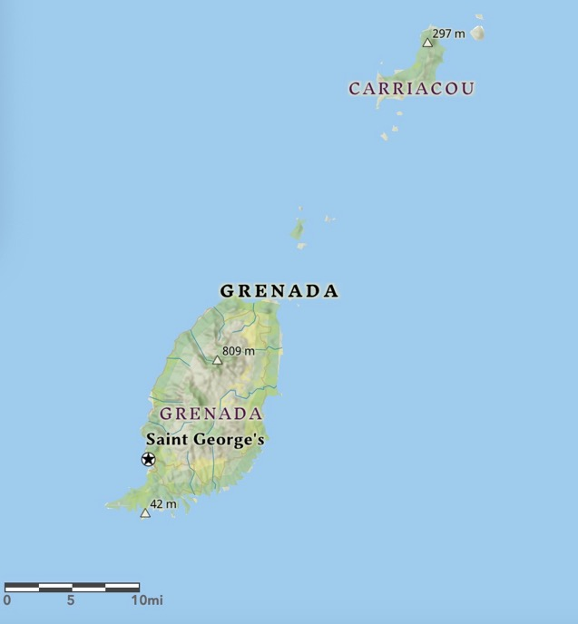
Grenada
Grenada
Population: 112,000
Size: 133 sq. miles
Location: 12.1N 61.7W
Islands: Grenada (largest), Carriacou and Petite Martinique
Location relative to North & South America
PETITE MARTINIQUE
Figure 1
Figure 2

Slide 39
Status of country in meeting GBON requirements.
GBON network is functional. Operated under WIS 2.0
Currently has 3 stations function under the project ( Point Saline, Carriacou & Marli)
SOFF Implementation update & lessons learned.
Dr. Fernando Belda-Esplugues, very active in ensuring documentation be completed. As a result, GBON National Gap Analysis draft has been completed and submitted. Two (2) additional stations, were identified as necessary to be added to the network.
WFP has been engaged as the IE but inconclusive.
No other projects aligned with SOFF program.

Slide 40
Closing the Basic Weather and Climate Data Gaps in the Caribbean: SOFF regional implementation and creating synergies Country updates - GUYANA
5 - 7 May 2025

Slide 41
Hydrometeorological Service
The Hydrometeorological Service was established in 1965 and has several responsibilities which include the development of systems to deliver weather, climate and water services in support of policy development; sustainable development; warnings and operational needs in aviation, marine, agriculture, defence, disaster risk reduction, EIAs, waste management, mining, tourism, construction, public recreation, etc.
Status of Guyana in meeting GBON requirements
SOFF Implementation update:
Country Hydromet Diagnostics (CHD) completed in March, 2024
GBON National Gap Analysis completed in March, 2024
GBON National Contribution Plan completed in February, 2025
The above actions allowed Guyana to identify gaps and determine possible solutions; identify the number, type and locations for GBON stations for both a low- and high-resolution station network. Ultimately, Guyana will be moving towards a high-resolution solution.

Slide 42
Hydrometeorological Service
Status of Guyana in meeting GBON requirements
SOFF Implementation Lessons Learned:
Existing Gaps in Guyana’s observational network to satisfy GBON requirements
Human and Technical Capacity required for the installation and maintenance of an upper-air station
Opportunities for Collaboration at regional and subregional levels for GBON compliance

Slide 43
Hydrometeorological Service
Country/regional programmes and projects that align with SOFF Investments
Government of Guyana makes regular budgetary allocations for the expansion and maintenance of the current automated network:
Automatic Weather Stations
Micro-automatic Weather Stations for interior locations (aviation)
Meteorological Buoys (Exclusive Economic Zone)
Regional Projects through the CIMH/CMO-HQU continue to support the expansion of the observational network
The CIMH provides training for technicians for maintenance and installation of stations
The CIMH is developing capacity for instrument calibration
EW4ALL

Slide 44
Closing the Basic Weather and Climate Data Gaps in the Caribbean:SOFF regional implementation and creating synergies HAITI
5 - 7 May 2025

Slide 45
UNITE HYDROMETEOROLOGIE (UHM)
L’UHM, la fusion en 2015 de deux entités de l’État. Le Centre national de météorologie (CNM) et le Service national des ressources en eau (SNRE). L’unité est en charge de prévisions atmosphériques et aéronautiques. Elle intervient également dans la gestion des eaux de surface et souterraines.
Réseaux d’observation de l’UHM et capacités actuelles;
Pas d’experts en instrumentation et maintenance
Difficultés d’implémentation du projet

Slide 46
Aucune des satations de l’UHM ne sont pas enregistrées comme station GBON, et leurs données ne sont pas partagées sur le GTS/WIS 2.0.
Pas de station en altitude actuellement en Haïti
Le projet CREWS (Renforcement des capacités);
Participation et apport d’Haiti dans les discussions du SOFF
Phase préliminaire (Pas de leçon tirée pour le moment)

Slide 47
Closing the Basic Weather and Climate Data Gaps in the Caribbean: SOFF regional implementation and creating synergies Jamaica Country update
5 - 7 May 2025

Slide 48
Introduction

Slide 49
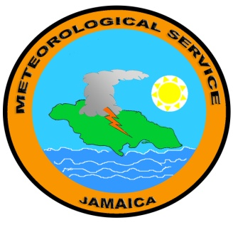
METEOROLOGICAL SERVICE
JAMAICA
BRANCH OF THE MINISTRY OF ECONOMIC GROWTH AND JOB CREATION
MEMBER
WORLD METEOROLOGICAL ORGANIZATION
SPECIALIZED AGENCY - UNITED NATIONS

Slide 50
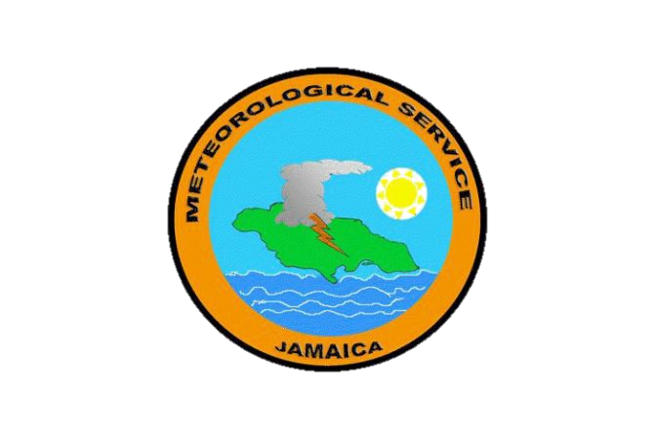
PRINCIPAL DIRECTOR
WEATHER
SERVICES
National Met Centre
Synoptic Sub-Station
Upper-Air Station
Radar Station
Instruments Section
SUPPORT SERVICES
Accounting Services
Clerical Services
Secretarial Services
Ancillary Services
CLIMATE
SERVICES
Data Acquisition Section
Data Processing Section
Applied Meteorology Section

Slide 51
GBON requirement
MSJ is currently working with assistance from the Caribbean Meteorological Organization (CMO) to solve the reporting issue, to meet the hourly target, and is planning a way to migrate to WIS2.0 compatible operations
MSJ operates one upper-air sounding station at the international airport in Kingston that is delivering soundings reliably twice a day thus being fully compliant with the GBON upper-air regulations. The station is supplied with equipment from National Weather Services as it is part of the Cooperative Hurricane Upper-Air Stations network.
Jamaica, with an area of almost 11,000 square kilometres and stretching about 235 kilometres from east to west.
Large surface weather station network, which includes two surface weather stations registered to the GBON WDQMS database. The stations are at the international airports in Montego Bay and Kingston with less than 150km space between them, thus fulfilling the GBON horizontal resolution regulation.
Both synoptic stations are reporting every 3 hours to the WDQMS database instead of the hourly resolution demanded for GBON. Even though the observation reports are sent every hour

Slide 52
SOFF Implementation (Readiness Phase)
Gap Analysis Completed :
Lack of temporal resolution of the shared synoptic sfc obs data.
Real-time data collection, automatic data quality control, and data management systems need to be strengthened.
Sustainable network maintenance can be strengthened w/ capacity building focusing on calibration and maintenance of the network

Slide 53
Lessons learnt
Main take away….. not in the SOFF Implementation process…..but a specific element…………Calibration
Periodic calibration, Calibration tool, Calibration center,/laboratories, access to standards, calibrated check-instruments,, traceability assurance systems, field verification, cost incurred in the calibration process,
Not always high on the priority list….. But equally important
Accurate observations, verified, and easily accessible needed to close gap
With an increase in the number of AWS….. Requires an increase in the Budget Allocation for Calibration

Slide 54
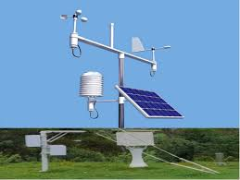
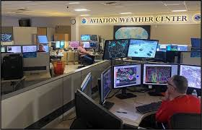
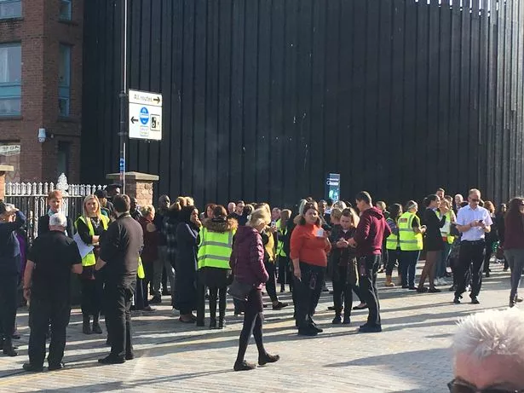
Next steps!
Completion of SOFF Project :
Await approval (SOFF + WMO Tech advisory team) re documents produced in readiness phase.
(IDB + MSJ + PA) to produce investment phase funding request
Create Real time display platform for the different types of AWS :
Partnership with UWI, Synoptic and Telecoms provider (CIMH request)
Fully GBON compliant
Meet with CMO, Belize Met service, to resolve issue (WIS2.0 )
Additional investments in Calibration efforts
Budget for / seek funding for calibration

Slide 55
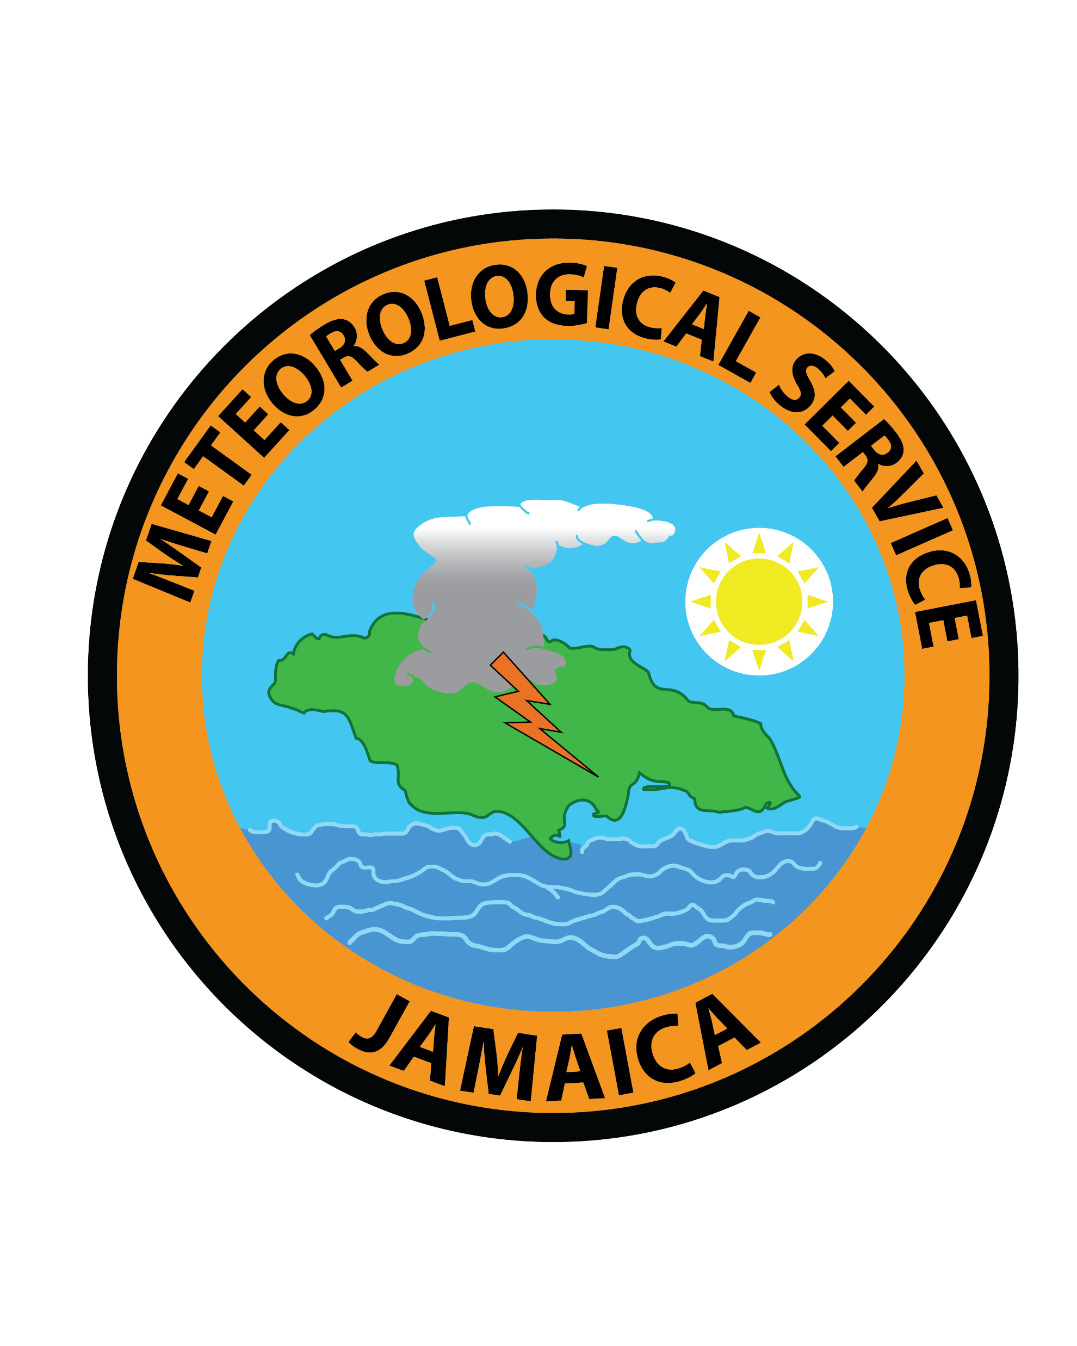
Thank You
Thanks to SOFF, Peer Advisor, WMO, CREWS, IDB, CMO, CIMH, regional NMHS, for the collaborative support in closing the observational data gaps in Jamaica, the Region, and the World

Slide 56
THE END

Slide 57
Closing the Basic Weather and Climate Data Gaps in the Caribbean:SOFF regional implementation and creating synergies St. Kitts & Nevis
5 - 7 May 2025

Slide 58
St. Kitts Meteorological Services
As an Aeronautical Met Office SKMS currently transmit 16 observations via WIS2.0 during operation hours and intend to maintain this density of GBON station for the near future.
The SOFF initiative operates through three (3) phases, namely:
The Readiness Phase
The Investment Phase
The Compliance Phase

Slide 59
Challenges encountered and lessons learned
Opportunities or support needed
Operating two (2) Met Offices in one country but managed daily by separate Airport authorities.
Having limited staff to support the documentation process so far.
No dedicated train staff within the dept. to maintain AWS; however, access to 1 within Airport operations.
Close proximity to 2 forecasting office may negate the need for upper-air station
Upgrading AWS at RLBIA to transmit 24-hours to satisfy GBON.
Train staff to maintain AWS
Capacity building for staff in data management and quality control.
Spares for prompt maintenance of station and to facilitate calibration of sensors.
Identifying a calibration center to calibrate AWS sensors

Slide 60
Country/regional programmes and projects that align with SOFF Investments
Uncertain at this moment

Slide 61
Closing the Basic Weather and Climate Data Gaps in the Caribbean:SOFF regional implementation and creating synergies Country updates: SAINT LUCIA
5 - 7 May 2025

Slide 62
SAINT LUCIA
The NMS is small with 2 offices.
1 main station located in the south of the island at the main airport
1 meteorologist +7 forecasters + 7 observers + 1 apprentice = 16 Met. Officers
1 small satellite station in the north of the island at the smaller airport
5 observers + 1 apprentice = 6 Met. Officers
Total staff – 22 , plus 1 Director
X-Band Radar (1) – not in operation, discussion are ongoing for full maintenance check
Overall Network Functionality Summary
HydroLynx Network (17 Stations, incl. 2 Repeaters)
5 Sutron AWS Stations
Tide gauges at 4 sites

Slide 63
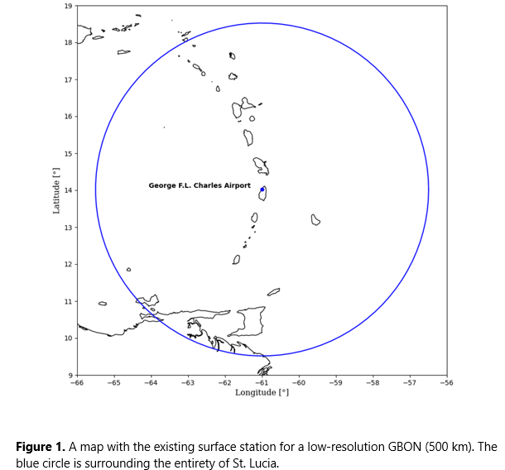
Status of country in meeting GBON requirements
SOFF Implementation update
SOFF has conducted an assessment and have noted there is still much needed to be done to meet GBON requirements
The island is going through the readiness phase
Peer advisor country - Austria,
Implementation entity – World Food Program (WFP)
Lessons learnt:
Staff constraints due current governmental procedures and framework presents
an ongoing challenge to maintaining an optimal staffed and efficient service.
Equipment necessary for operations are rapidly becoming outdated
Country/regional programmes and projects that align with SOFF Investments
None at present

Slide 64
Closing the Basic Weather and Climate Data Gaps in the Caribbean:SOFF regional implementation and creating synergies Suriname
5 - 7 May 2025

Slide 65
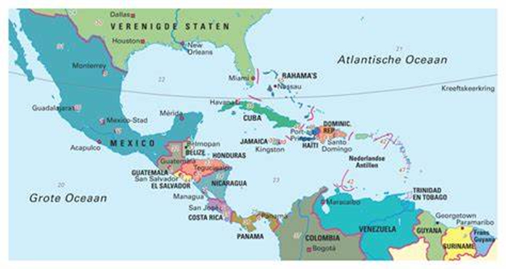
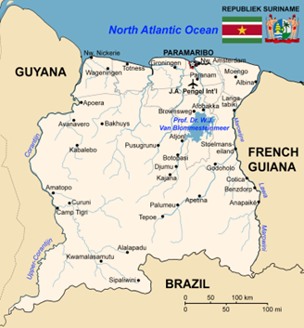
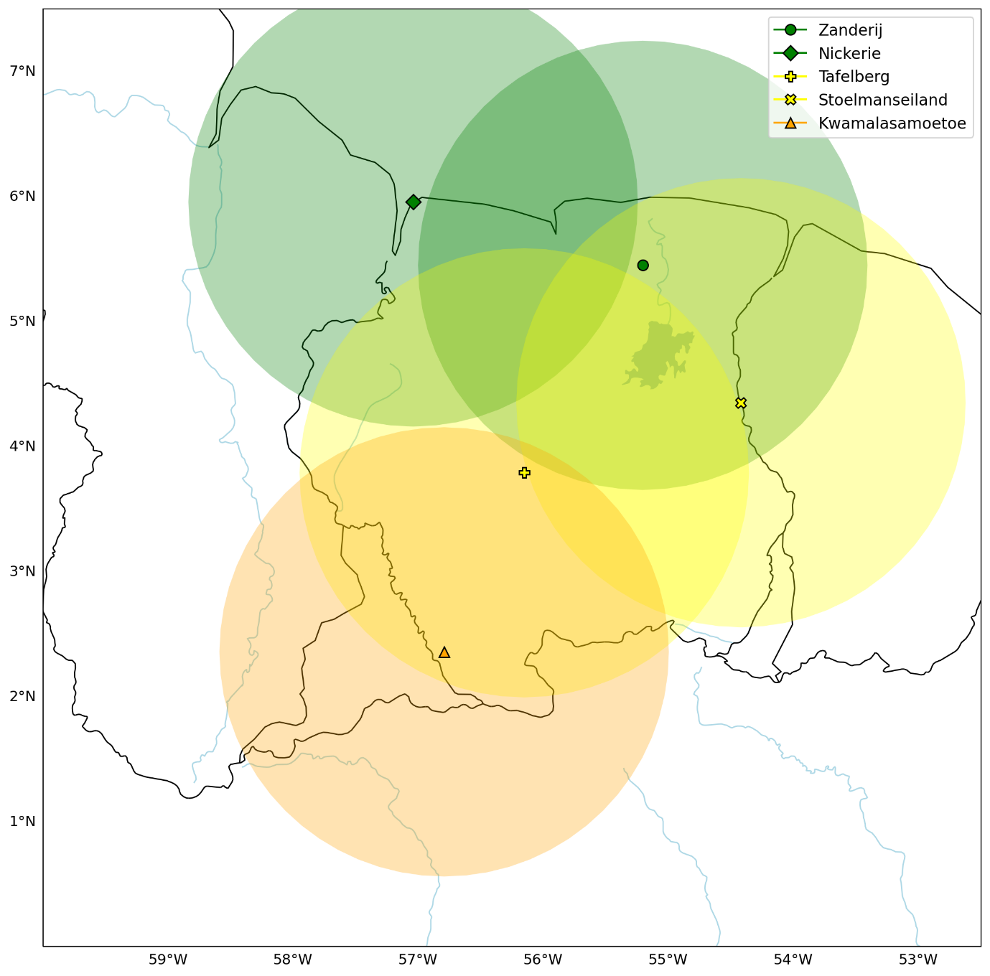
Suriname: Climate Risk & Early Warning Systems Updates
SOFF Regional Implementation and Synergies
Organization: Meteorological Department Suriname (MDS)
Dew Bhaggoe (Deputy Director and PR WMO in Suriname)
Truusje Warsodikromo (Advisor)
Date: 5-7 May 2025

Slide 66
Meteorological Department Suriname (MDS)
Brief introduction of the NMHS
- Meteorological Department of Suriname (MDS) under Ministry of Public Works
- Responsible for weather observation, forecasting, and climate services
- Strategic focus: Capacity building and institutional reform (last 4 years)
Status of country in meeting GBON requirements:
- Maintains a functioning meteorological and hydrological observation network.
- Not yet met the full Global Basic Observing Network (GBON) requirements.
- Significant gaps persist in data frequency, quality, and calibration, as well as in international data exchange,
particularly in relation to the implementation of key systems such as WIGOS, WIS, GTS, and OSCAR.
SOFF Implementation update:
- Peer Advisor: KNMI | Implementing Entity: UNDP
- NGA, CHD, and NCP signed by KNMI and Suriname
- Funding request submitted in April 2024
Lessons:
- Data Exchange & Integration: Data currently shared with the Brazilian ICAO databank.
- Limiting global data exchange.
- Gaps highlight the need for stronger partnerships, targeted training, calibration and improved coordination.
Future Outlook:
- Integration of national investments with SOFF infrastructure
- Focus on sustainability, international systems, and regional collaboration

Slide 67
Country/regional programmes and projects that align with SOFF Investments
1. India–UNDP Fund : Early Warning for All/Floods
- AWS, AWLS, ICT equipment (PCs, laptops, servers)ArcGIS licenses and training
- SOFF Link: Strengthens observation network & digital readiness for GBON compliance
2. Makandra Programme : Early Warning for all and data Infrastructure
Training: CLIMSOFT, R-Instat, Training Personnel: Synoptic & Climatological Forecasting (KNMI)
- SOFF Link: Builds national capacity for data management and forecasting
3. GCCA+ Phases 1 & 2: EU & UNDP
- Climate resilience, early warning systems, water management
- Support for data integration, vulnerability assessments
- SOFF Link: Enhances adaptation, risk data platforms, and multi-hazard response

Slide 68
Closing the Basic Weather and Climate Data Gaps in the Caribbean:SOFF regional implementation and creating synergies St Vincent & Grenadines
5 - 7 May 2025

Slide 69
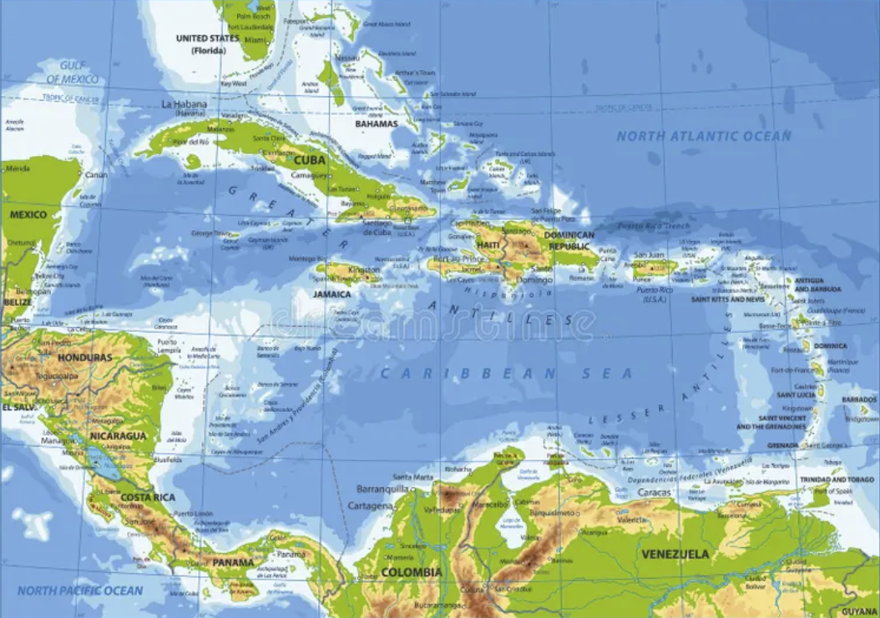
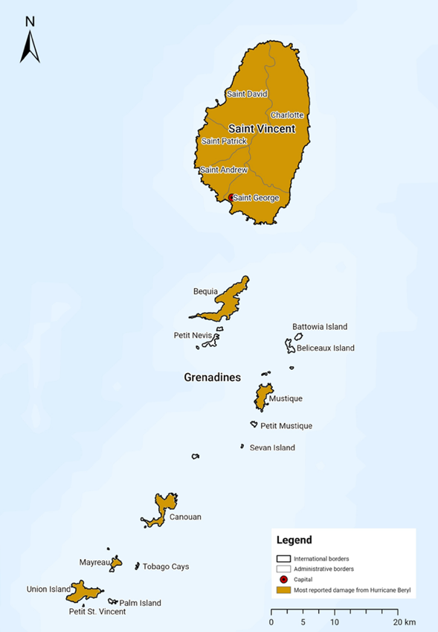
SVG METEOROLOGICAL SERVICES
ETJ - CLIMO Station - 1979 to present
AIA - AERONAUTICAL 2017 to present
Upgrades to Monitoring Network (PPCR)
3 stations AIA* BQA CAI*
Staff of 12
1 Manager, 2 Forecasters, 1 Instrument Head, 8 Meteorological Assistants
2023 Needs Gap analysis conducted. Recent Plan Drafted
SVG Not 24 hour operational. (16 hours ) 6am – 10 pm daily
WIS2 Compliant - Hourly SYNOP information transmitted
WIGOS Station Identifier Plan not completed (Ongoing plan to adopt GND scheme)
Human resource Gap major factor in SVG. AWS may be a solution to supplement missing data gaps.
Department Structure is not aligned with Regional Standards

Slide 70
Country/regional programmes and projects that align with SOFF Investments –
- N/A
WIGOS STATION IDENTIFIER?
AWS DEPLOYMENT FOR MONITORING –MINISTRY OF AGRICULTURE?

Slide 71
Closing the Basic Weather and Climate Data Gaps in the Caribbean: SOFF regional implementation and creating synergies Country updates
5 – 7 May 2025
TRINIDAD AND TOBAGO

Slide 72
Trinidad and Tobago Meteorological Service (TTMS) SOFF Implementation
Brief introduction of the TTMS
🔹 Two Divisions: → Piarco, Trinidad → Crown Point, Tobago.
🔹 Piarco (Trinidad) office, primary office: Forecast products, early warnings, observation station.
🔹 Crown Point (Tobago) office: Observation station; supports some forecasting operations.
Status in meeting GBON Requirements
🔹 Peer advisors: Finnish Meteorological Institute (FMI).
🔹Current Status: 2 surface stations and 1 upper-air station .
🔹 Not fully GBON compliant: Significant gaps identified (stations require upgrading; lacking key components).
SOFF Implementation Update
🔹 Completed: National Gap Analysis and Country Hydromet Diagnostic report.
🔹 Final Stages: National Contribution Plan
🔹 Readiness activities enabled TTMS to:
→ Clearly define infrastructure and capacity gaps
→ Draft lifecycle maintenance and calibration plans
→ Strengthen inter-agency collaboration

Slide 73
Trinidad and Tobago Meteorological Service (TTMS) SOFF Implementation
Lessons Learned: → Peer collaboration (FMI, CMO, CIMH) is essential. → Regional calibration facilities need strengthening. → Staffing and succession planning are crucial for sustainability.
National and Regional Programmes/Projects
🔹 CHUAS (in partnership with US NWS): Continued support for upper-air observations.
🔹 Membership in CIMH and CMO enables participation in regional modeling, training, and calibration efforts.
🔹 Collaboration with the national Water Resources Agency: Sharing of hydrology data supports EW4All goals.
Upcoming programmes/projects:
🔹 Partnership with CCRIF and Ministry of Finance: Acquisition of additional AWS.
🔹 Partnership with South Oropouche River Basin (SORB) Project: Acquisition of additional AWS.
🔹 Future expansion plans include new surface observation network stations at
Central and Southwestern Trinidad, aimed at strengthening national coverage
and achieving a higher GBON station density over time.

