Slide 1
Global Basic Observation Network (GBON)
Nir Stav, WMO Director of Infrastructure
SOFF regional workshop, 5-7 May 2025, Kingston, Jamaica

Slide 2
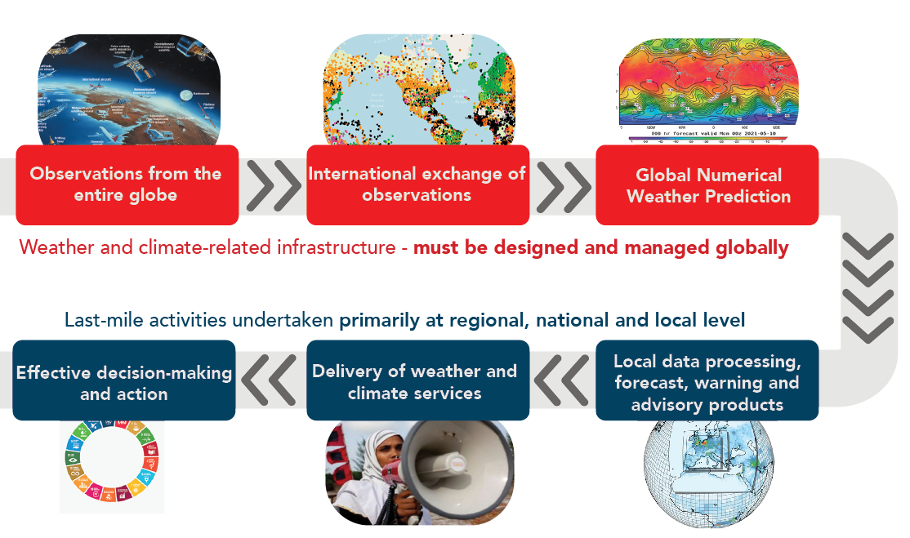
Successful application of weather and climate services depend on a functioning meteorological value chain
Global meteorological infrastructure

Slide 3
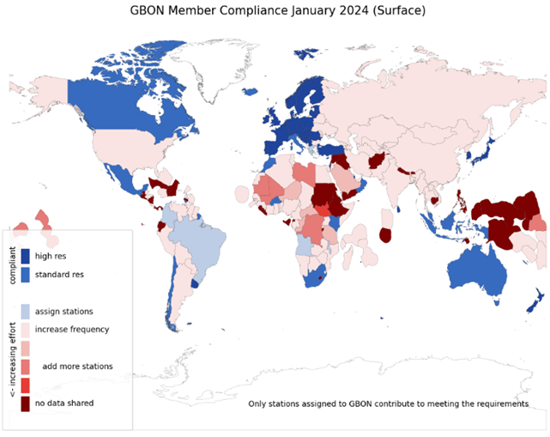
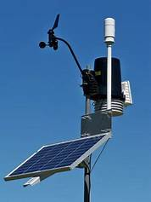

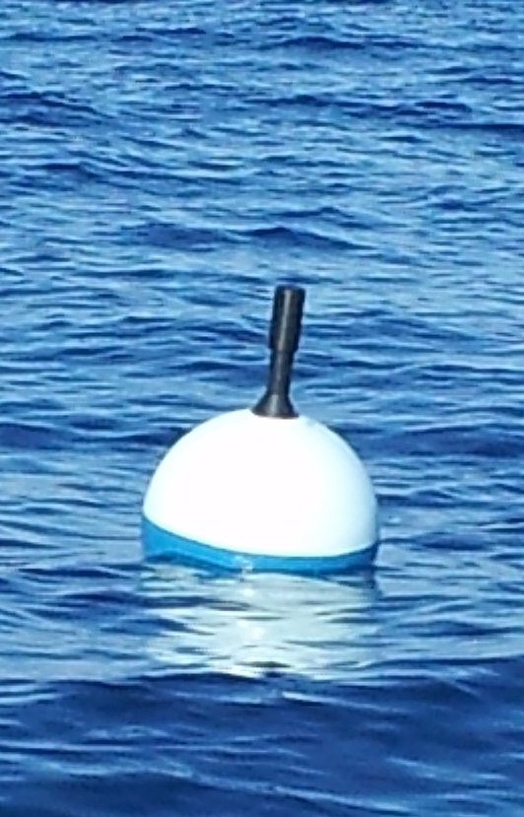
Global Basic Observing Network (GBON)
A global public good for improved weather prediction and climate reanalysis
Worsening gaps in the basic surface-based observations that keep weather predictions on track
Members in 2021 accepted obligation to take and share GBON observations at minimum horizontal and time resolution
  Surface land at 200 km, hourly
  Upper air over land at 500 km, 2x daily
  Surface marine in EEZ at 500 km, hourly
WMO co-created the Systematic Observations Financing Facility (SOFF) to help Members meet that GBON obligation, with priority on support to LDCs and SIDS
The designations employed and the presentation of material on this map do not imply the expression of any opinion whatsoever on the part of the Secretariat of the World Meteorological Organization concerning the legal status of any country, territory, city or area or of its authorities, or concerning the delimitation of its frontiers or boundaries.

Slide 4
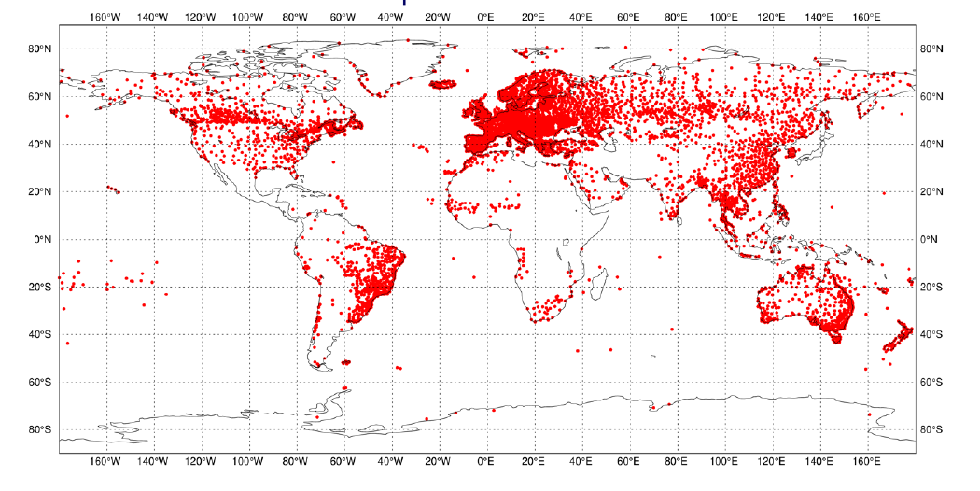
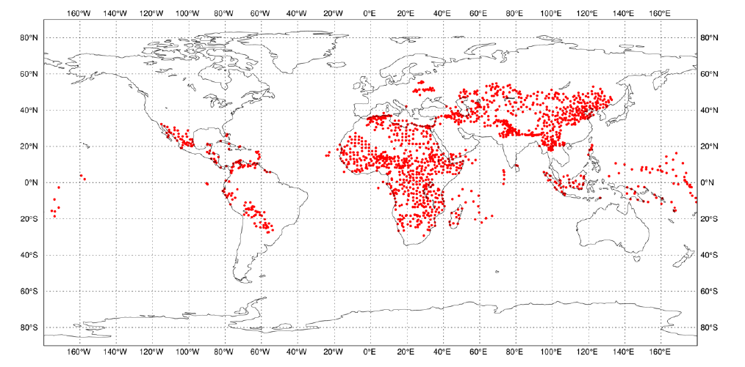
reference: ECMWF SOFF Impact Experiments
Existing
surface pressure (as of June 2023)
GAP to be closed
surface pressure needs, official development assistance (ODA) countries

Slide 5
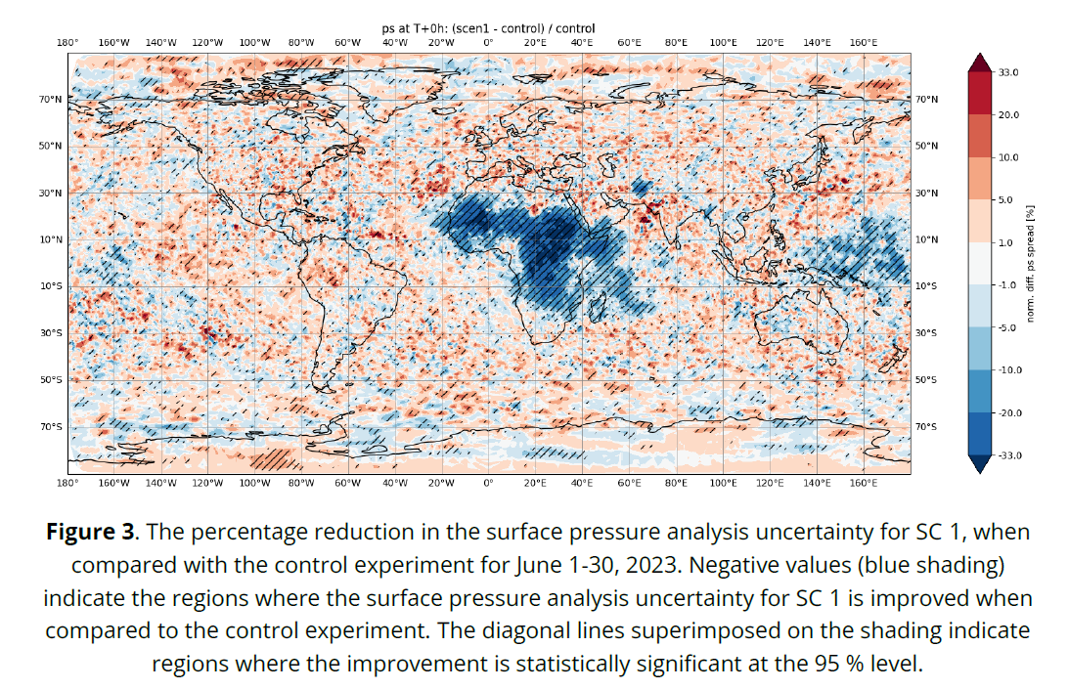
ECMWF SOFF Impact Experiments – surface pressure
additional surface observations increase significantly the quality of the analysis and short term prediction in their region.
This improvement is afterwards propagated further and further away, as the weather patterns progress

Slide 6
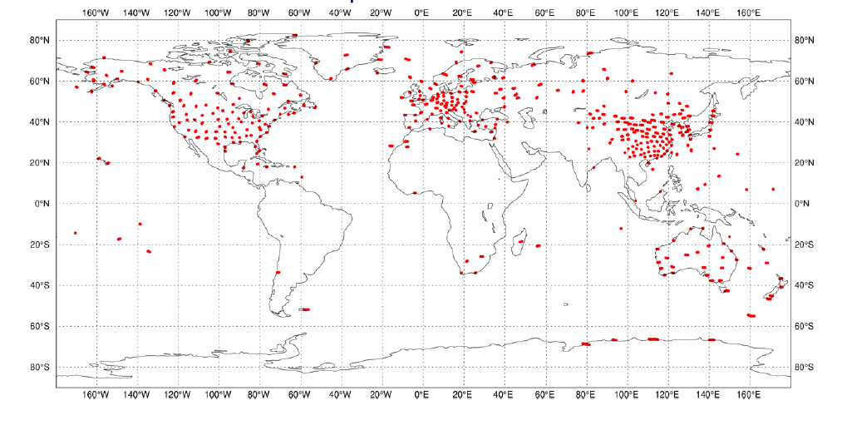
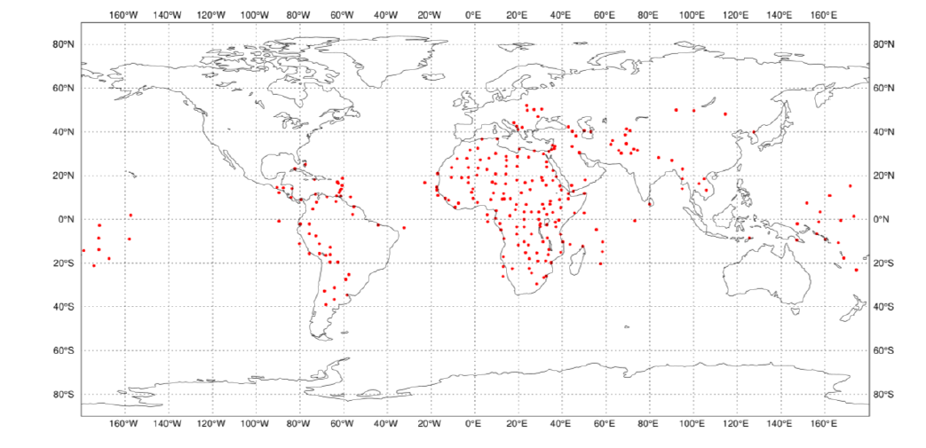
reference: ECMWF SOFF Impact Experiments
Existing
Upper Air Soundings (as of June 2023)
GAP to be closed
Upper Air Soundings needs, official development assistance (ODA) countries

Slide 7
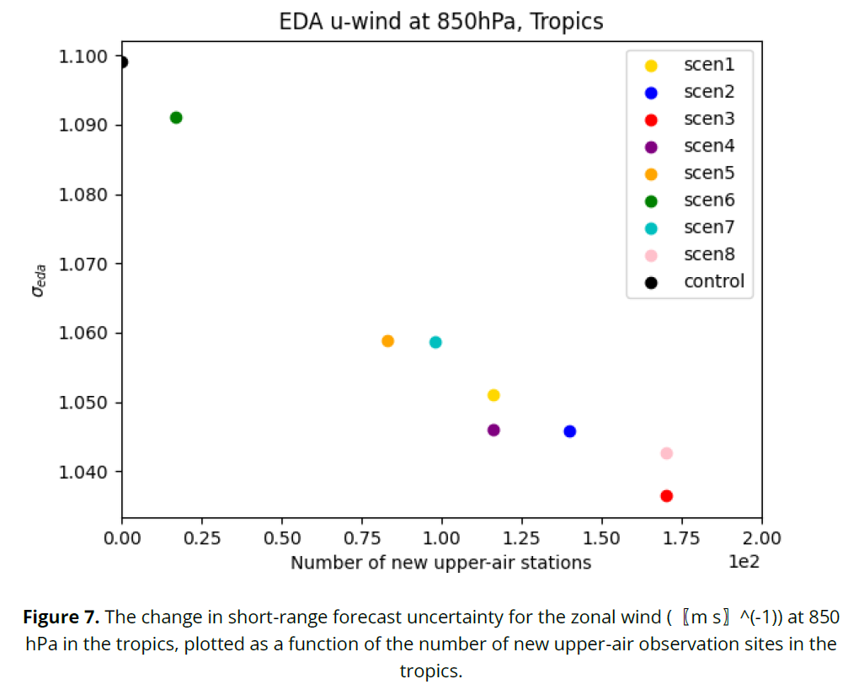
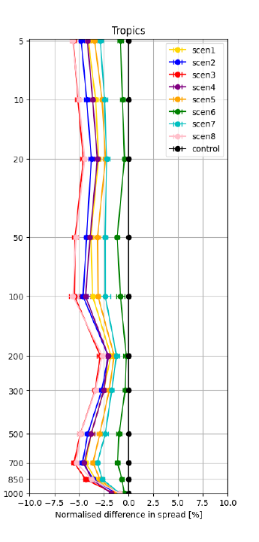

ECMWF SOFF Impact Experiments – upper air
As more and more upper air observations are added, the analysis and the prediction get better
This improvement is afterwards propagated further and further away, as the weather patterns progress
Reduction in zonal wind error
Reduction in temperature error

Slide 8
GBON requirements and SOFF scope
Securing an adequate supply of observational data to the global NWP centres that serve all countries with forecast and analysis products
GBON requirements - per station type | GBON Variables
 | Pressure | Temp | Hum | Wind | Precip | Snow Depth
Surface land stations Horizontal resolution: 200 km (500 km for small island states) Observing cycle: 1h Real-time data exchange to WMO Information System (WIS) | X | X | X | X | X | X
Upper-air stations operated from land Horizontal resolution: 500 km (1000 km for small island states) Vertical resolution: 100m, up to 30 hPa Observing cycle: twice a day Real-time data exchange to WMO Information System (WIS) |  | X | X | X
 | X | X
Open to SOFF investment today
Marine surface stations in EEZs
Horizontal resolution: 500 km
Observing cycle: 1h
Coastal stations not included, all contributions in EEZ, including foreign, count to country compliance
Gap analysis to be performed
Station compliance
Based on requirements above
Country compliance
Station compliance at required horizontal resolution
(number of stations required for surface area of country)
INFCOM-3 approved WIGOS Guide
GBON Technical Regulations: WIGOS Manual (WMO-No. 1160) – Cg-Ext(2021)

Slide 9
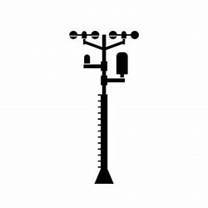





GBON Guide: EC-77 (Feb. 2023)
GBON compliance: tools and criteria
GBON station compliance
Availability ≥80%
Timeliness <5%
Quality <5%
Security
Power
Comms
Comms
WIS2 node
Station
Data
processing
centre
WMO
Information
System
Global NWP
centre
Consumables
Trained operators
Regular maintenance and calibration
WIGOS
Data Quality
Monitoring
System
WDQMS
WMO Secretariat and
WIGOS Regional Centres
Tailored SOFF reporting
Notes:
For upper air, additionally we are looking at required resolution
WDQMS is operated in cooperation with DWD (Germany), ECMWF, JMA (Japan), and NOAA/NCEP (USA)

Slide 10
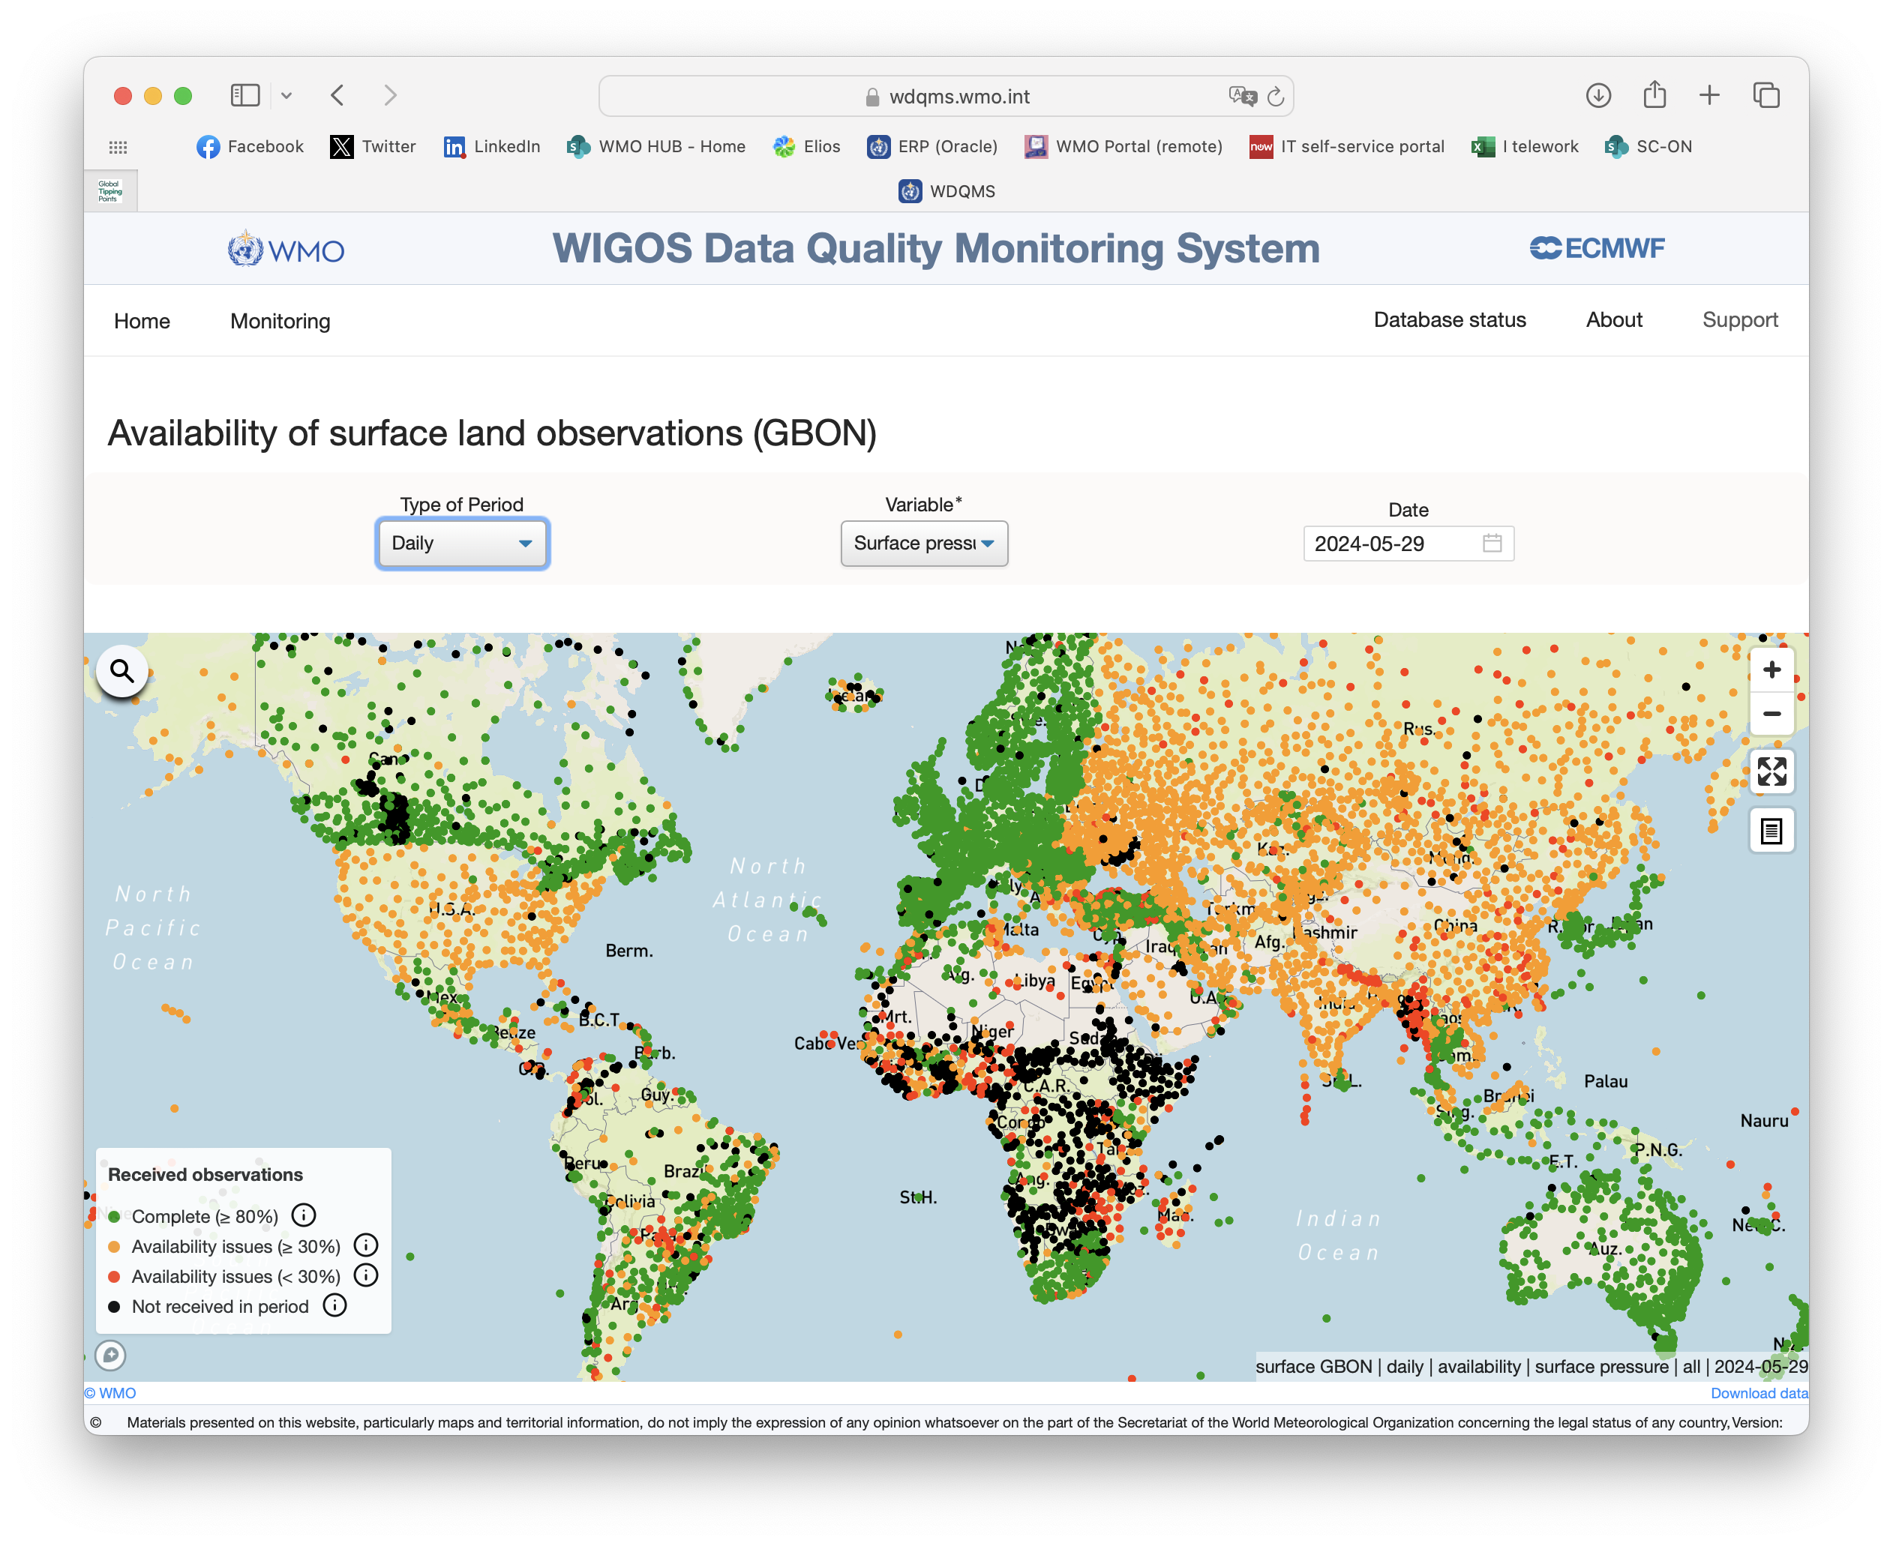
GBON station level compliance: WMO tools supporting SOFF
Notes:
Albert (backup: Champika)

Slide 11
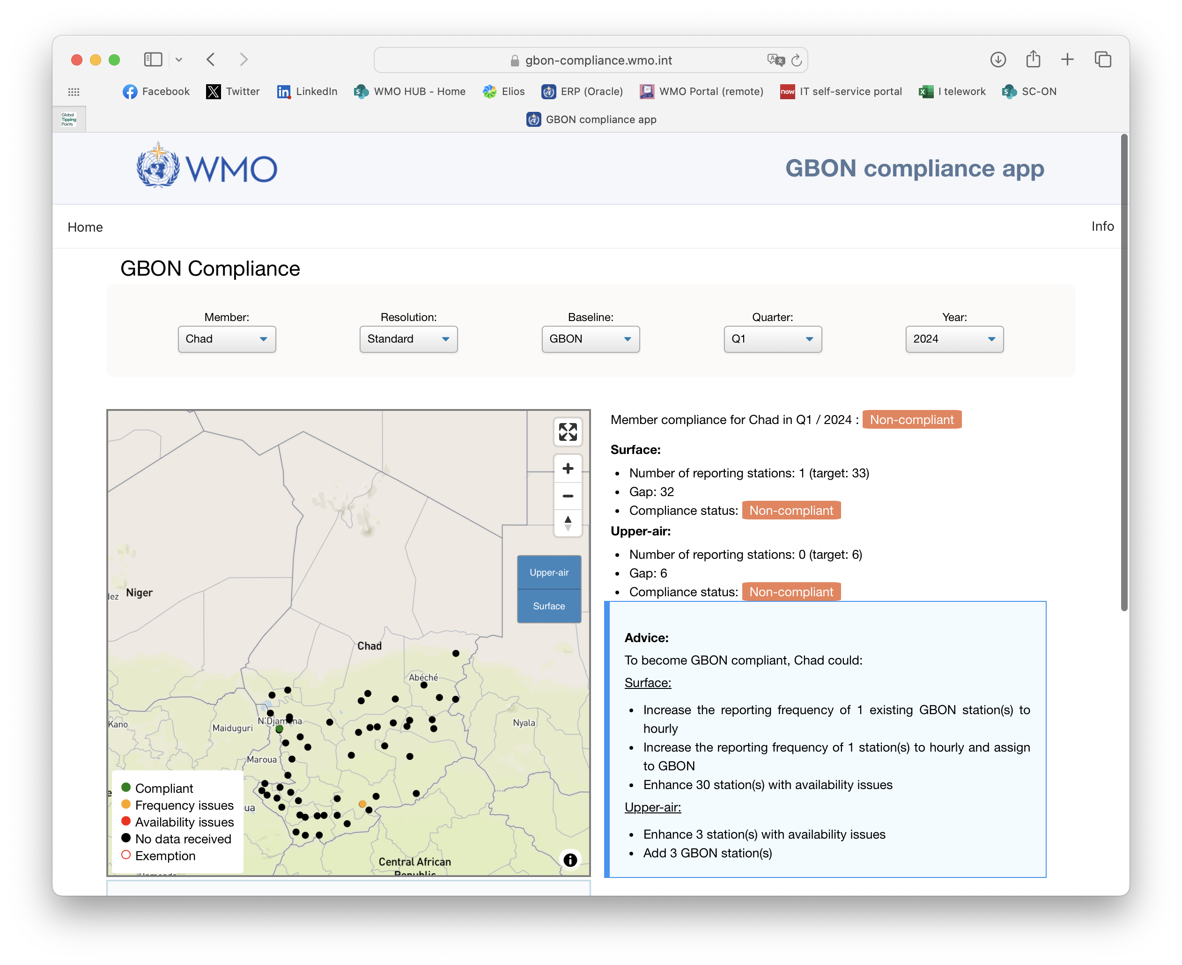
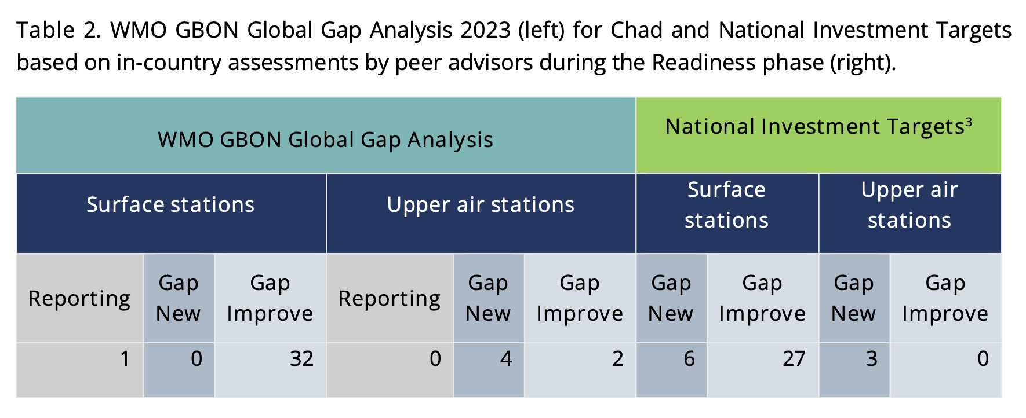
GBON gap analysis: WMO tools supporting SOFF
Notes:
Albert (backup: Champika)

Slide 12
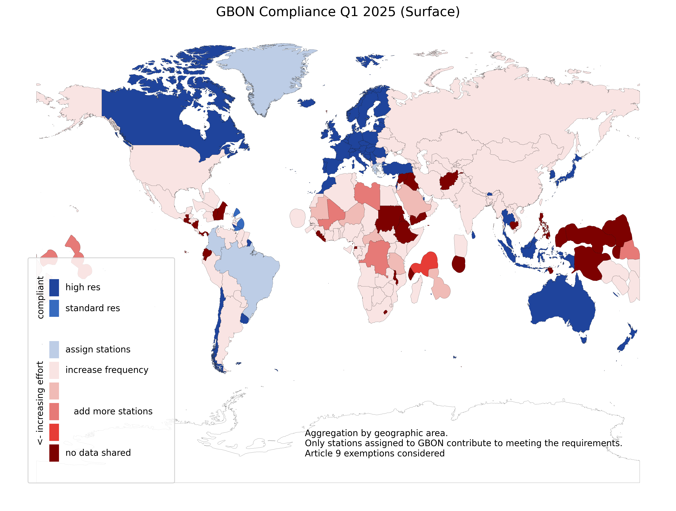
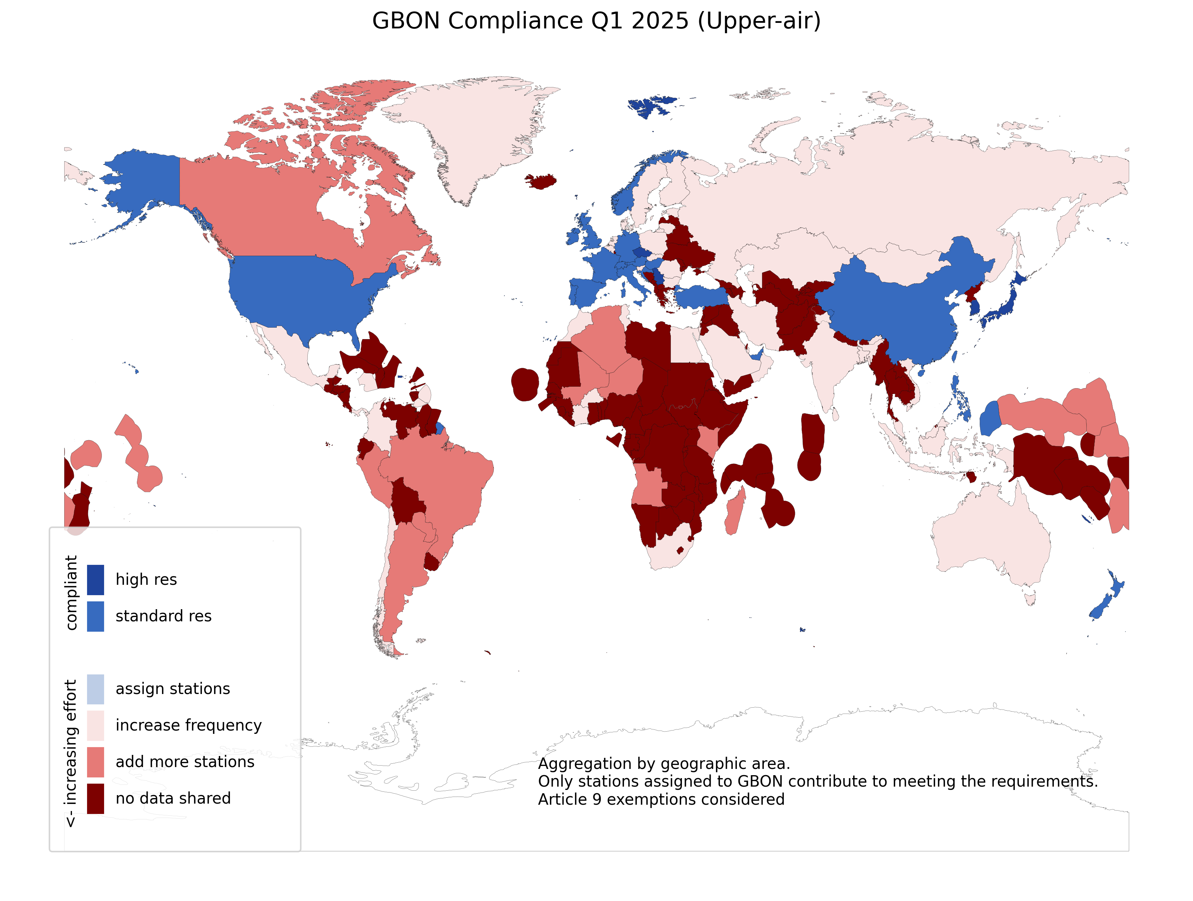
GBON COMPLIANCE FOR Q1 2025

Slide 13
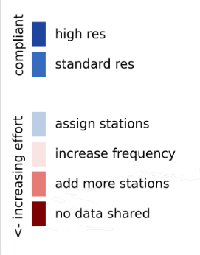
GBON Compliance of the Caribbean subregion in Q1 2025
Surface
Upper-air

Slide 14
Questions ?
SOFF regional workshop, 5-7 May 2025, Kingston, Jamaica

