Slide 1


Regional Context in the Caribbean -
Hydromet Updates
Closing the Basic Weather and Climate Data Gaps in the Caribbean: SOFF regional implementation and creating synergies, 5- 7 May 2025
Arlene Laing, PhD
Caribbean Meteorological Organization
Headquarters Unit
Trinidad & Tobago

Slide 2








Caribbean Meteorological Organization (CMO)
Origin – UK Air Ministry, 1941, British Caribbean Meteorological Service, established 1951
Caribbean Met. Council (1962), Caribbean Met. Service (1963) established Caribbean Met. Institute (1967)
Caribbean Community (CARICOM) established – Aug 1973
CMO established as umbrella of Ministerial Council, Caribbean Met Service & Institute – Oct 1973
Organs of CMO
Caribbean Meteorological Council (CMC) – Ministerial-level, Governing body
Caribbean Institute for Meteorology & Hydrology (CIMH)
CMO Headquarters Unit (CMO-HQ)
Caribbean Meteorological Foundation (CMF)*
  *non-functioning
Organs
CMC
Governing Body
CIMH
CMF*
HQ
Secretariat

Slide 3
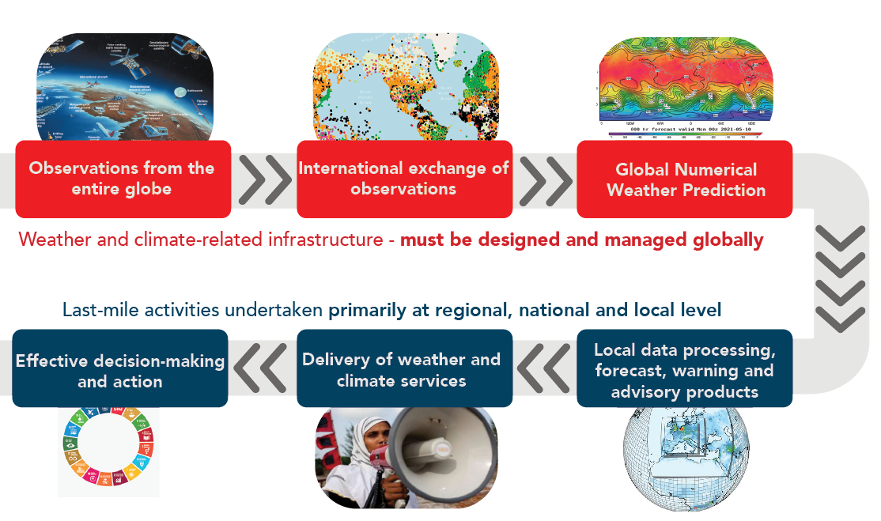
Weather & Climate Value Cycle
SOFF Support
  WMO Unified Data Policy – free sharing of core and recommended data (mainly in real-time)
& regionally
Protects lives
Safeguards property
Supports economic development
WMO, 2021

Slide 4
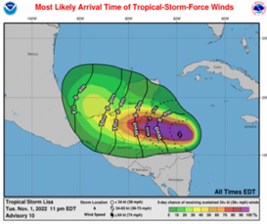
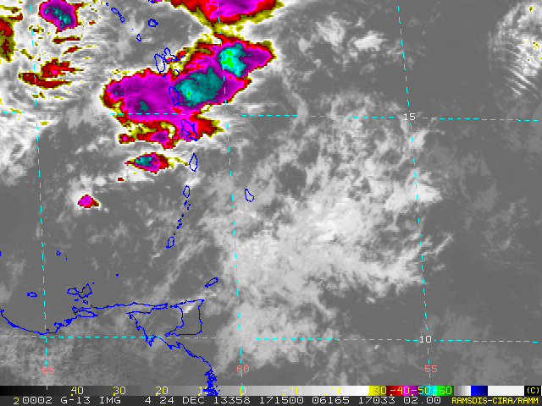
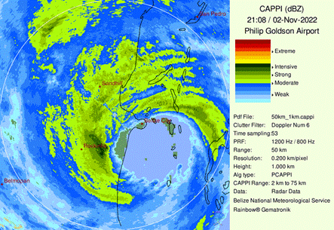
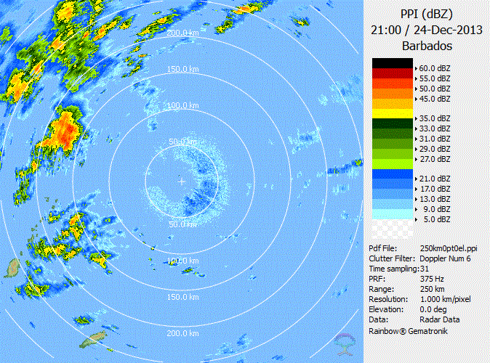
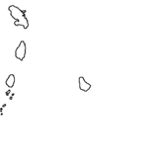

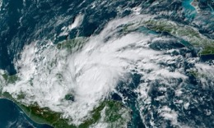
Early Warnings for Tropical Cyclones & Other Severe Weather
WMO Hurricane Committee, since 1977
CMO National Met Services collaborate closely on early-warning system for tropical cyclones with other NMSs.
Coordinated by WMO and led by US National Hurricane Center. Back-up arrangement between regional National Met Services.
  WMO Severe Weather Forecasting Programme Caribbean. Began in 2016
  Any Time of Year: Heavy Rain, Strong Winds, Rough Seas (+ excessive heat, since 2024)
  Improve collaboration among Met. Services for non-tropical cyclone severe weather
Co-chaired by CMO HQ and Météo-France Martinique, supported by CIMH (training lead)
Hurricane Lisa, 2022
24 - 25 Dec 2013
2100 UTC 24 Dec – 0100 UTC 25 Dec 2013
Seed funding from Canada through CREWS

Slide 5
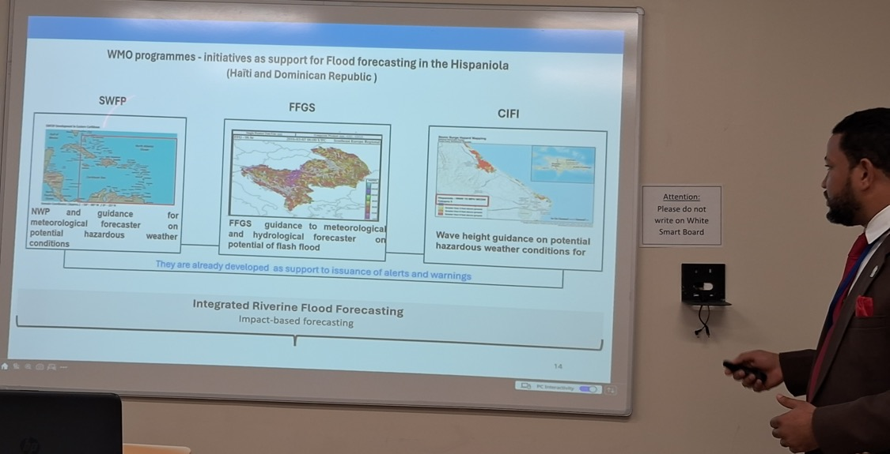
WMO Programmes: Forecasting High Impact Events
Wagner Rivera, Dominican Republic

Slide 6
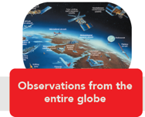
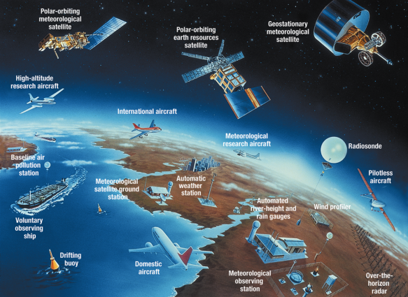
1. Enhancing Resilience of Observations
Standardization of network - ease of calibration and maintenance (e.g., via WMO Regional Instrument Centre at CIMH)
Backup data in geographically dispersed locations (CIMH climate data also on servers at CMO HQ and CCCCC)
Severe weather case database, hosted at CIMH, mirrored at CMO HQ

Slide 7
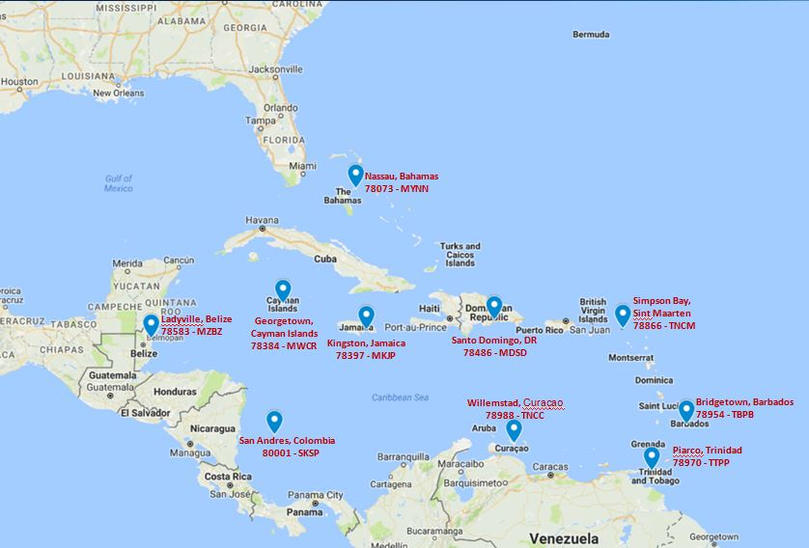

1. Cooperative Hurricane Upper Air Stations (CHUAS)
Among most valuable observations for forecasting
NOAA/NWS supported: Equipment, spare parts and consumables, assistance with major maintenance and training. Supported for this year.
Host countries provide meteorological technicians, support staff, buildings and utilities for twice daily rawinsonde launches
5 CMO Stations - joint facility of CMO, Members contribute to CMO Rawinsonde Network Fund
Special Soundings in support of Storm Forecasts
  Hurricane Beryl: 45 special soundings were performed at CHUAS Stations
Courtesy, Dr Tatiana Gonzales, NOAA Upper Air Program

Slide 8
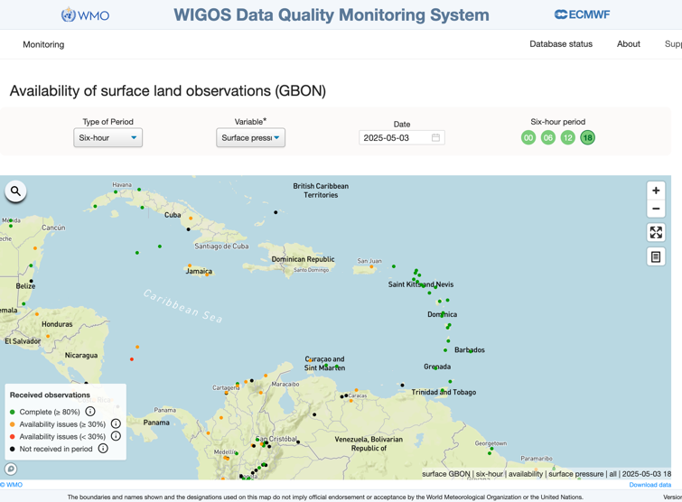
1. Quality of Observations
WMO Integrated Global Observation System (WIGOS)
Global Basic Observation Network (GBON)
  Basic observation network for global numerical weather prediction - for public good of all nations
  National Meteorological Services – National entities for data integration
  Data Quality Management – RA IV Distributed Regional WIGOS Centre
        US/NOAA, Canada/ECCC (Leading nodes)
        CMO HQ & Trinidad & Tobago Met Service (English-speaking States)
        Costa Rica/IMN (Spanish-speaking States)

Slide 9
1. Regional WIGOS Centre: Pilot Phase Dec 2023
USA - NOAA: Leading Node for Quality Monitoring
Canada - ECCC: Leading Node for Metadata Management & Issues Related to Haiti (French speaking)
Trinidad & Tobago Met Service: Contributing Node for English-speaking Caribbean for metadata management
British Caribbean Territories / CMO HQ: Contributing Node for English-speaking countries for quality monitoring & incident management
Costa Rica (IMN): Contributing Node for Spanish-speaking countries for both metadata & quality monitoring
Courtesy, K Kerr

Slide 10
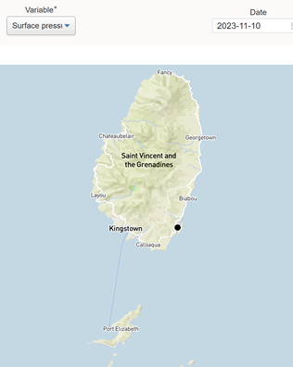
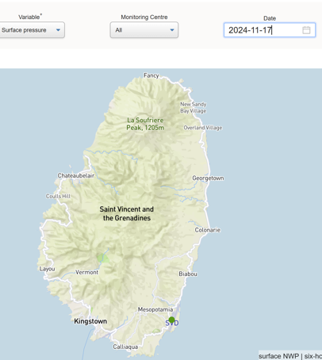
1. Regional WIGOS Center: Monitoring and Activities
Contributing nodes: CMO HQ & TTMS for English-speaking States
Performing mandatory functions & more
Assisting CMO members with data availability and quality issues
Improved data availability and quality across the region
Black: more than 2 years outstanding
Solved: green since May 2024
Courtesy, K Kerr

Slide 11

1. Enhancing Resilience of Observations:
CMO Operational Radar Group (CORG)
Built trust & cooperation among CMO radar operators & invited neighbouring operators
CORG FEEDBACK LOOP
Cultivate Strong Relationships
Seek Feedback
Listen and Learn
Take Action
Share Back
Created centralized online repository to access shared information to aid capacity building & similar future projects
Focused dialogue on common problems to generate feedback
Documented best practices, lessons learned, and solutions
e.g., data archiving, retrieval, dissemination
Encouraged sharing of innovative solutions, know-how, best practices adopted
Courtesy, K Kerr

Slide 12
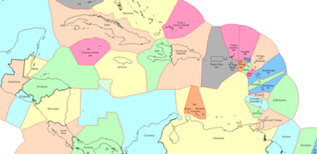
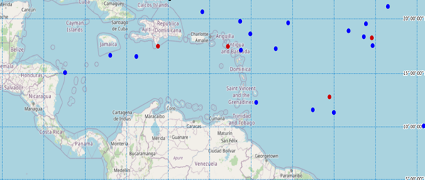
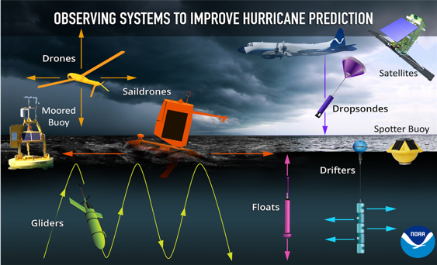
1. Ocean observations vital to the Caribbean
Air–sea interface processes key to intensification of tropical cyclones & severe local storms Accurate estimates and forecasts of physical processes rely on observations
Caribbean EEZ
Need more marine observations
  Barbados Met Service: Operational Autonauts
  Rutgers University/NOAA led sub-surface transects – 2024 – used for Beryl forecasts
      2025 Planned Caribbean Profile Observations Ocean Gliders + Argo + Fishing Vessel Observation Network (FVON) - real-time profile data for assimilation by hurricane forecast models
  CIMH expanding near-shore marine observations, funds from Caribbean Development Bank

Slide 13

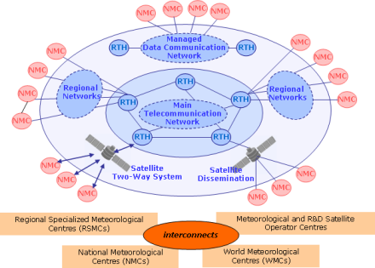
2. WMO International Data Exchange
WMO Global Telecommunication System
Real-time (24/7) international data exchange to safeguard lives and property and support economic development.
WMO Unified Data Policy (free exchange of core and recommended data)
NOAA is Regional Telecommunications Hub (RTH-Washington)
Special component carries meteorological data for aviation
Supports multi-hazard, multipurpose early warning systems, e.g., tsunamis
Notes:
Such an occurrence is not an abstract thought, one of the Caribbean’s radar systems was hacked last year, resulting in the system being out of operations for some months.

Slide 14
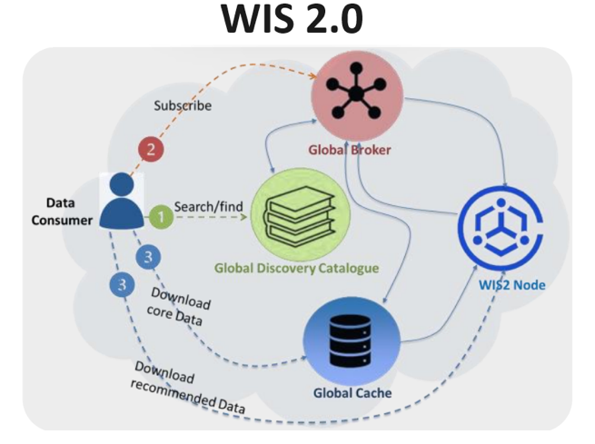
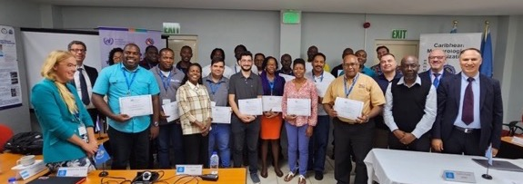
2. Transition to WMO Information System (WIS 2.0)
WMO WIS 2.0 Training Workshop hosted by CMO HQ, 19 persons trained, June 2023
Belize, T&T, Cayman Is. – led piloting of WIS2.0
CMO WIS2.0 Node established Oct 2023, with cloud services from WMO, 16 Members
https://wiscaribbeancmo.org
- SOFF funding contingent on international data exchange
https://community.wmo.int/en/news/wis-news-2023-06-the-2nd-wis2-training-workshop-trinidad-and-tobago

Slide 15
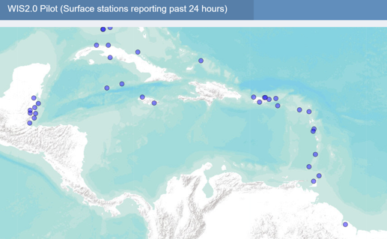
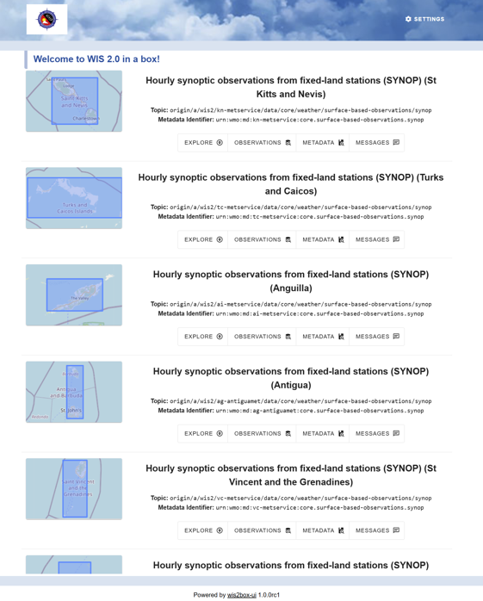
2. Transition to WMO Information System (WIS 2.0)
CMO Members & Neighbouring States among global leaders using WIS2 to share data
16 of 16 Members currently sharing BUFR data on WIS2.0 in real time every hour
Barbados, Belize, Trinidad & Tobago - national WIS2 nodes
System for Unified Real-time monitoring and Forecasting of Atmospheric and Climatic Events (SURFACE) – Belize initiative
https://wiscaribbeancmo.org/

Slide 16
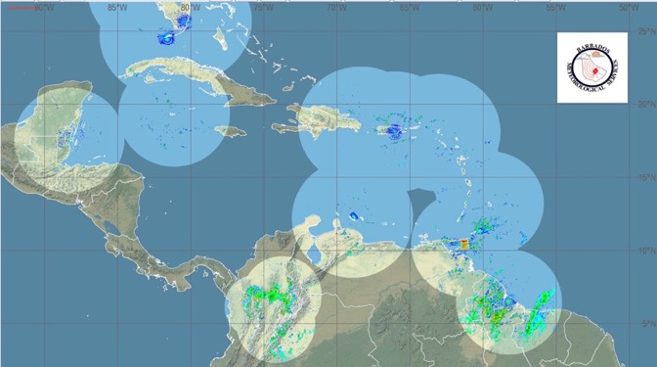
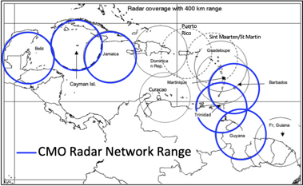
2. Weather Radar: Data Shared for Early Warnings
In 2009, network of 4 Doppler weather radars implemented by CMO HQ, funded by the EU, for 13-million Euro. In 2013, CMO HQ implemented dual-polarized Doppler radar in Grand Cayman
Météo-France developed first Caribbean radar base reflectivity mosaic. Barbados Met Service expanded mosaic.
Radar data for mosaic shared via NOAA/NWS RA IV GIFS Server, every 15-minutes
NOAA/NWS transitioning to WMO Information Systems (WIS2.0)
Will WIS 2.0 be good fit for exchange of radar data?

Slide 17
1. Meteorological Services to Aviation
Infrastructure and Information Systems
  ICAO Meteorological Information Exchange Model (IWXXM) - CMO HQ provided software to Members for conversion
  Will WIS 2.0 be good fit for exchange of data for aviation?

Slide 18

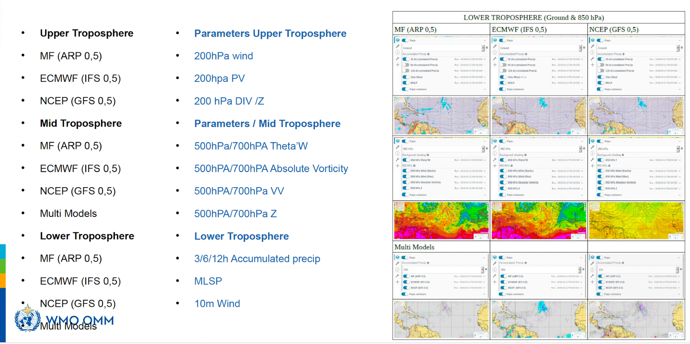
3. WIPPS Global Centres & SWFP Caribbean
SWFP Caribbean: Deterministic Global NWP
Courtesy, Emmanuel Cloppet, Meteo-France-Martinique

Slide 19
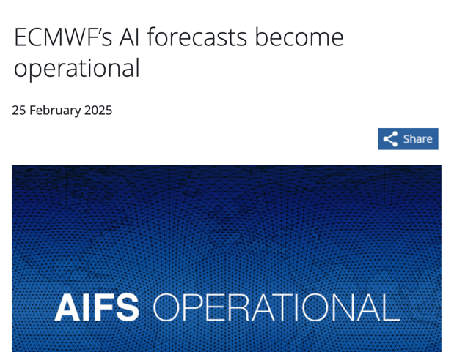


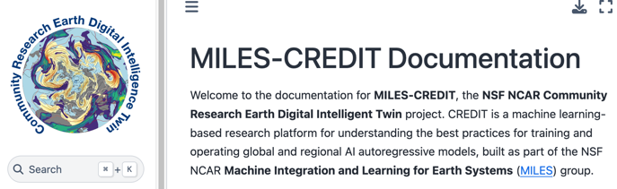
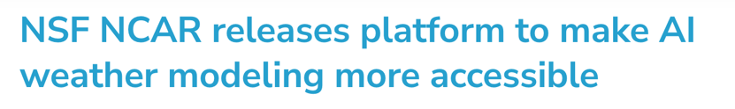
3. Machine Learning and AI in Weather Prediction
July 2024
April 2025
https://www.youtube.com/watch?v=4QRLcoJM05M

Slide 20
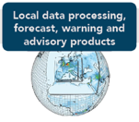
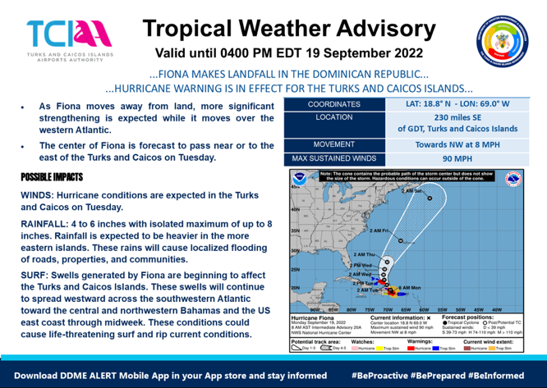
4. Local Data Processing, forecast, warning, & advisory products
National Framework for Weather, Water, and Climate & Ocean Services
National Institutionalized mechanism to coordinate elements pertaining to entire value chain for the production, delivery and application of weather, water, and climate services (e.g., National Climate Outlook Forum, Hurricane Alerts, Drought Bulletins, etc.…)
Engage all national stakeholders – in co-production, tailoring, communication and utilization of weather, water, and climate services in a national dialogue
Met Service & Disaster Office
co-production, co-design, co-delivery

Slide 21








Thank you!
CMO Headquarters Unit, www.cmo.org.tt

