Slide 1
World Meteorological Organization (WMO)
WMO Regional Association IV (RA IV)
Relevant Outcomes of the
Nineteenth Session of Regional Association IV (RA IV-19)
Rodney Martinez
WMO Representative
North America, Central America, and the Caribbean

Slide 2
General Summary of the session (1)
The session adopted 4 resolutions, 11 decisions, and
1 recommendation, which were recorded in a session's preliminary report, and will later be compiled into the final report
Out of a total of 60 registered participants with credentials who attended in person or online, from 19 RA IV Member States or Territories, the ratio of female to male participants was 1 : 1.73
In addition, the session had 16 additional participants who did not present valid credentials
Notes:
This ratio of female to male means that there were an average of 1.73 male participants for every woman who participated in the meeting

Slide 3
General Summary of the session (2)
Participating WMO Members that are Members of RA IV
Participating WMO Members that are not Members of RA IV
Spain
International organizations and other bodies
FIAPP
ITU
Meteopress
WHO
Presidents of constituent bodies and Chairs of other bodies
President of SERCOM
19. Trinidad & Tobago
1. Antigua and Barbuda | 10. France
2. Bahamas | 11. Guatemala
3. British Caribbean Territories | 12. Honduras
4. Canada | 13. Jamaica
5. Colombia | 14. Mexico
6. Costa Rica | 15. Panama
7. Curaçao and Sint Maarten | 16. Saint Lucia
8. Dominican Republic | 17. United Kingdom of Great Britain and Northern Ireland
9. El Salvador | 18. United States of America

Slide 4
General Summary of the session (3)
The Association elected Ms Evan Thompson (Jamaica) as president and Ms Luz Graciela Morales De Calzadilla (Panama) as vice-president of RA IV
The Association decided to postpone the decision on whether or not to hold Phase II of RA IV-19, and to hold its twentieth session in late 2027 or early 2028, in order to align the RA IV strategic, governance and financial cycles with WMO cycles
The nineteenth session of Regional Association IV closed at 11:00 CST on Saturday, 29 March 2025

Slide 5
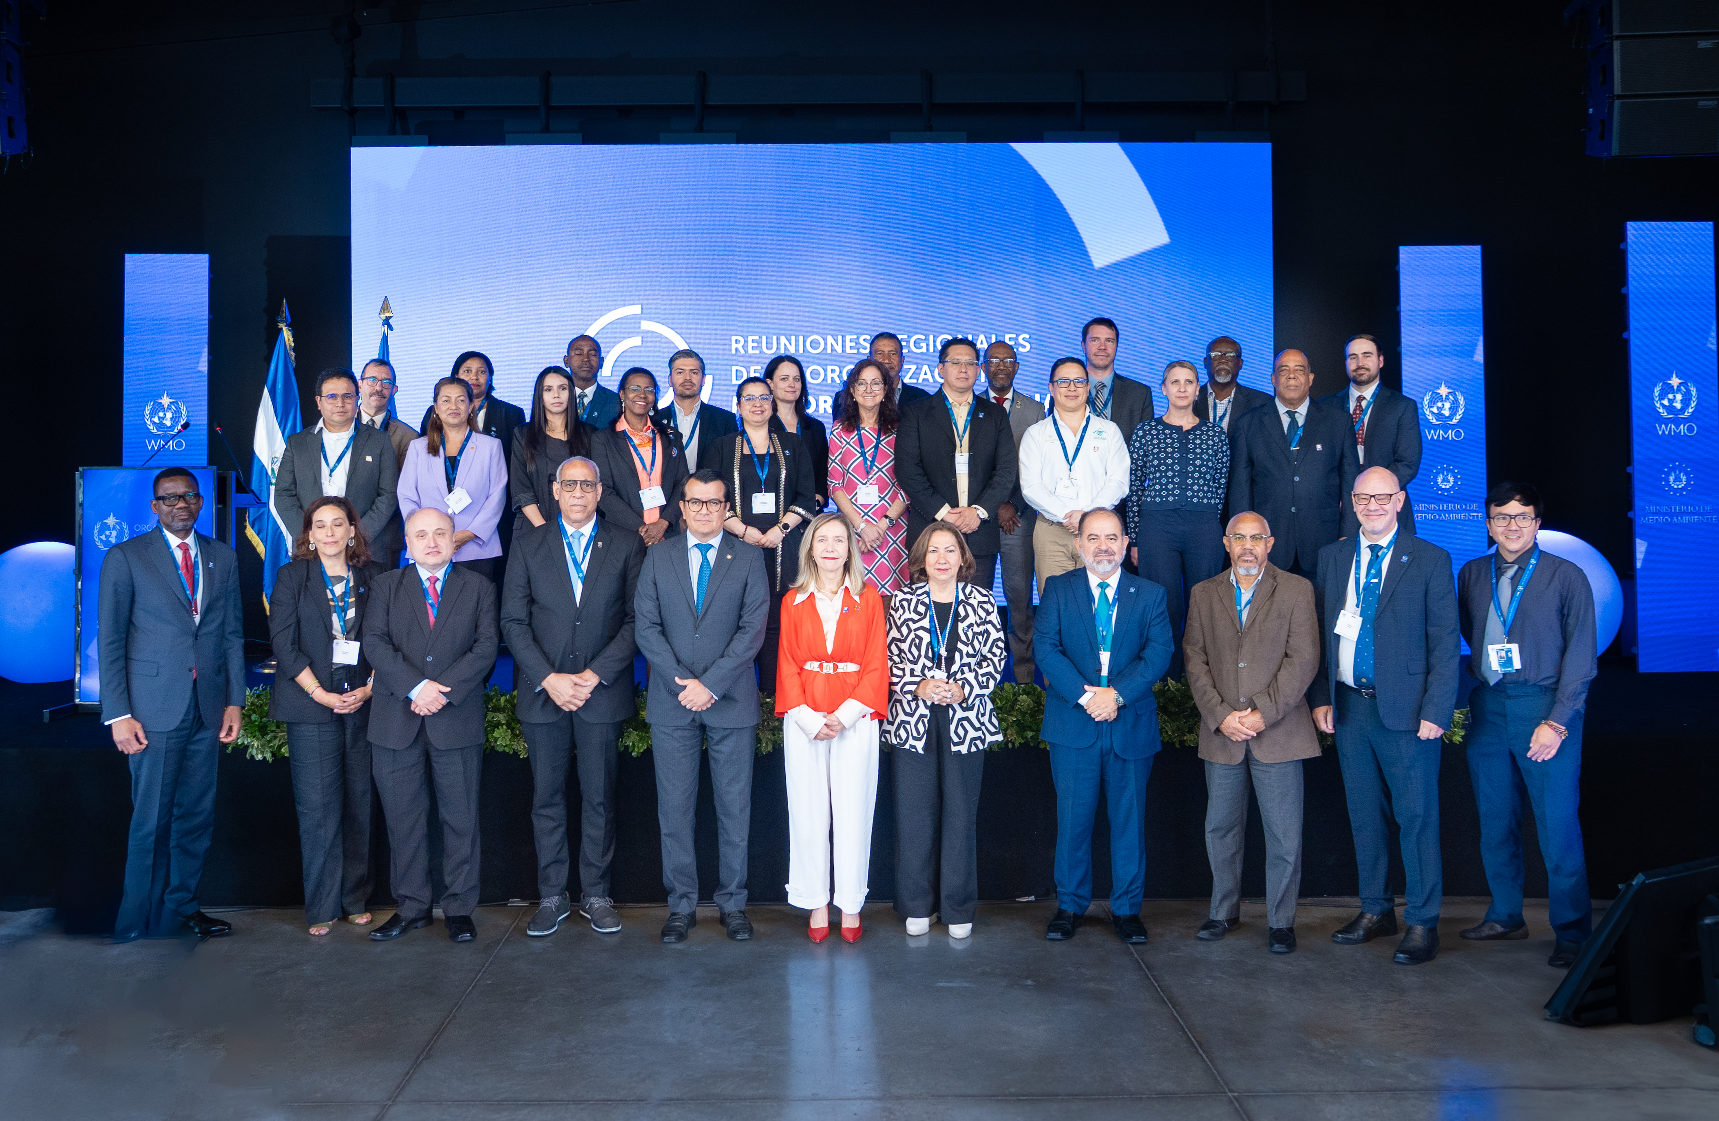

Slide 6
Resolutions, decisions and recommendations adopted by RA IV
Resolution | Decision | Recomm | Title
 | 2/1 |  | Report by the Acting President of the Association, working groups, Hydrological Adviser and Regional Office for the Americas
 | 3.1/1 |  | Regional design of the upper-air component of the Global Basic Observing Network (GBON)
 | 3.1/2 |  | General regional infrastructure requirements for 2024–2027
3.2/1 |  |  | Early Warnings for All (EW4All) Action Plan for Regional Association IV
 | 3.3/1 |  | General regional research requirements for 2025–2027
 | 3.4/1 |  | Capacity development, education and training
 | 4.1/1 |  | Regional priorities
4.2/1 |  |  | Working structure of Regional Association IV
 | 4.2/1 |  | Chairs and vice-chairs of subsidiary bodies under the working structure of Regional Association IV in the next intersessional period
4.3/1 |  |  | Regional Work Programme for 2024-2027
 | 4.4/1 |  | Alignment and planning of regional activities between RA IV, the Technical Commissions and the Research Board
 | 5.1/1 |  | Resource mobilization and horizontal cooperation aimed at supporting the activities established in the RA IV Regional Work Programme 2024–2027
 | 5.2/1 |  | Systematic Observations Financing Facility (SOFF) Expansion to Middle-income States and Territories in RA IV
 |  | 5.3/1 | WMO engagement with the regional United Nations System and regional intergovernmental agencies, development partners and bodies
 | 5.4/1 |  | Establishment of a Regional Open Consultative Platform for Regional Association IV (R-OCP-RA IV)
6/1 |  |  | Review of previous resolutions and recommendations of the Association

Slide 7
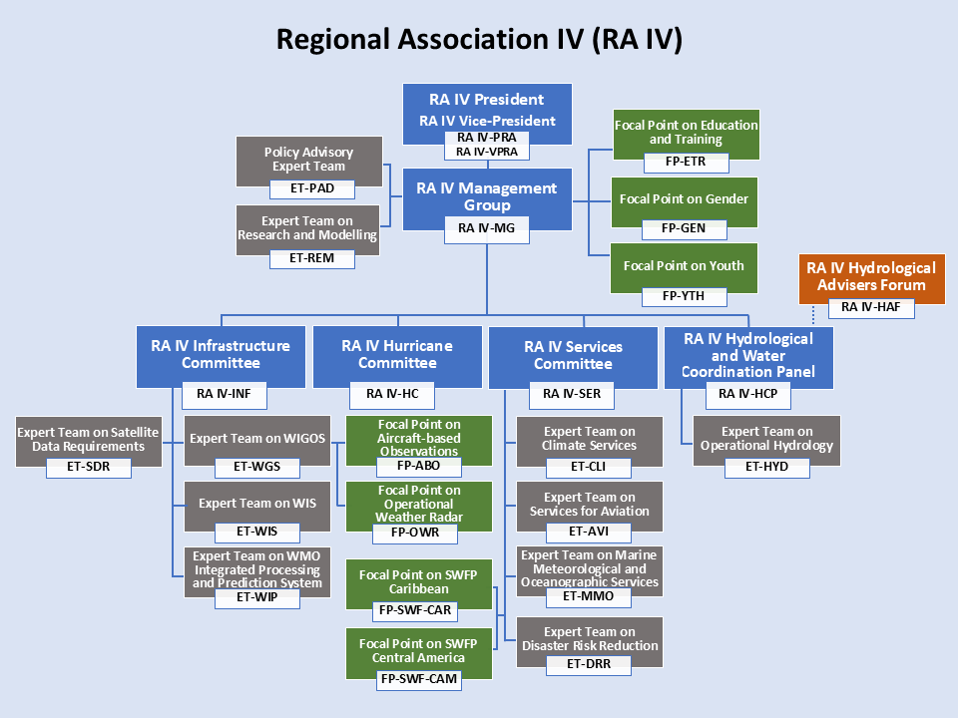
Working structure adopted by RA IV

Slide 8
Decision 5.2/1 (RA IV-19(I))
Systematic Observations Financing Facility (SOFF) Expansion to Middle-income States and Territories in RA IV
Regional Association IV (North America, Central America and the Caribbean)
Noting with appreciation:
(1) That the Systematic Observations Financing Facility (SOFF) is already providing SOFF Readiness phase support to 12 of its members,
(2) That SOFF Investment phase support has been approved for Belize, and that the Cuba Investment Phase funding request is under Steering Committee consideration,
Decides:
(1) To recommend to the Executive Council (EC) to request the Secretary-General, that also serves as the SOFF Steering Committee co-chair, to communicate to the Steering Committee the importance and urgency of considering:
(a) The expansion of SOFF Investment and Compliance phase support to Middle-income Members that currently are not eligible for this support, including those in RA IV; in order to enable these Members to close the Global Basic Observing Network (GBON) data gaps while ensuring subregional efficiency gains;
(b) The expansion of the present scope of SOFF, as resources permit, to cover surface marine GBON stations/platforms in Exclusive Economic Zones (EEZs);
(2) To invite RA IV Members to join the Secretary-General in advocating and mobilizing resources for the SOFF United Nations Multi-Partner Trust Fund (UNMPTF), including by securing highest level political support;
(3) To recommend to the EC to urge all partners who have the capacity, including RA IV Members, multilateral development and climate funds, as well as philanthropies, to contribute to the SOFF UNMPTF, including through innovative mechanisms.

Slide 9
Chairs and Vice Chairs appointed to
RA IV Subsidiary Bodies
RA IV Subsidiary Body | Chair | Vice-chair
Hydrological and Water Coordination Panel | Peter Clarke (Jamaica) | Berny Fallas (Costa Rica)
Infrastructure Committee | Kerry Powery Linwood (BCT) | Martha Pereira (Costa Rica)
Services Committee | Alcely Lau Melo (Panamá) | Kenneth Kerr (BCT)

Slide 10
Thank you!

