Slide 1


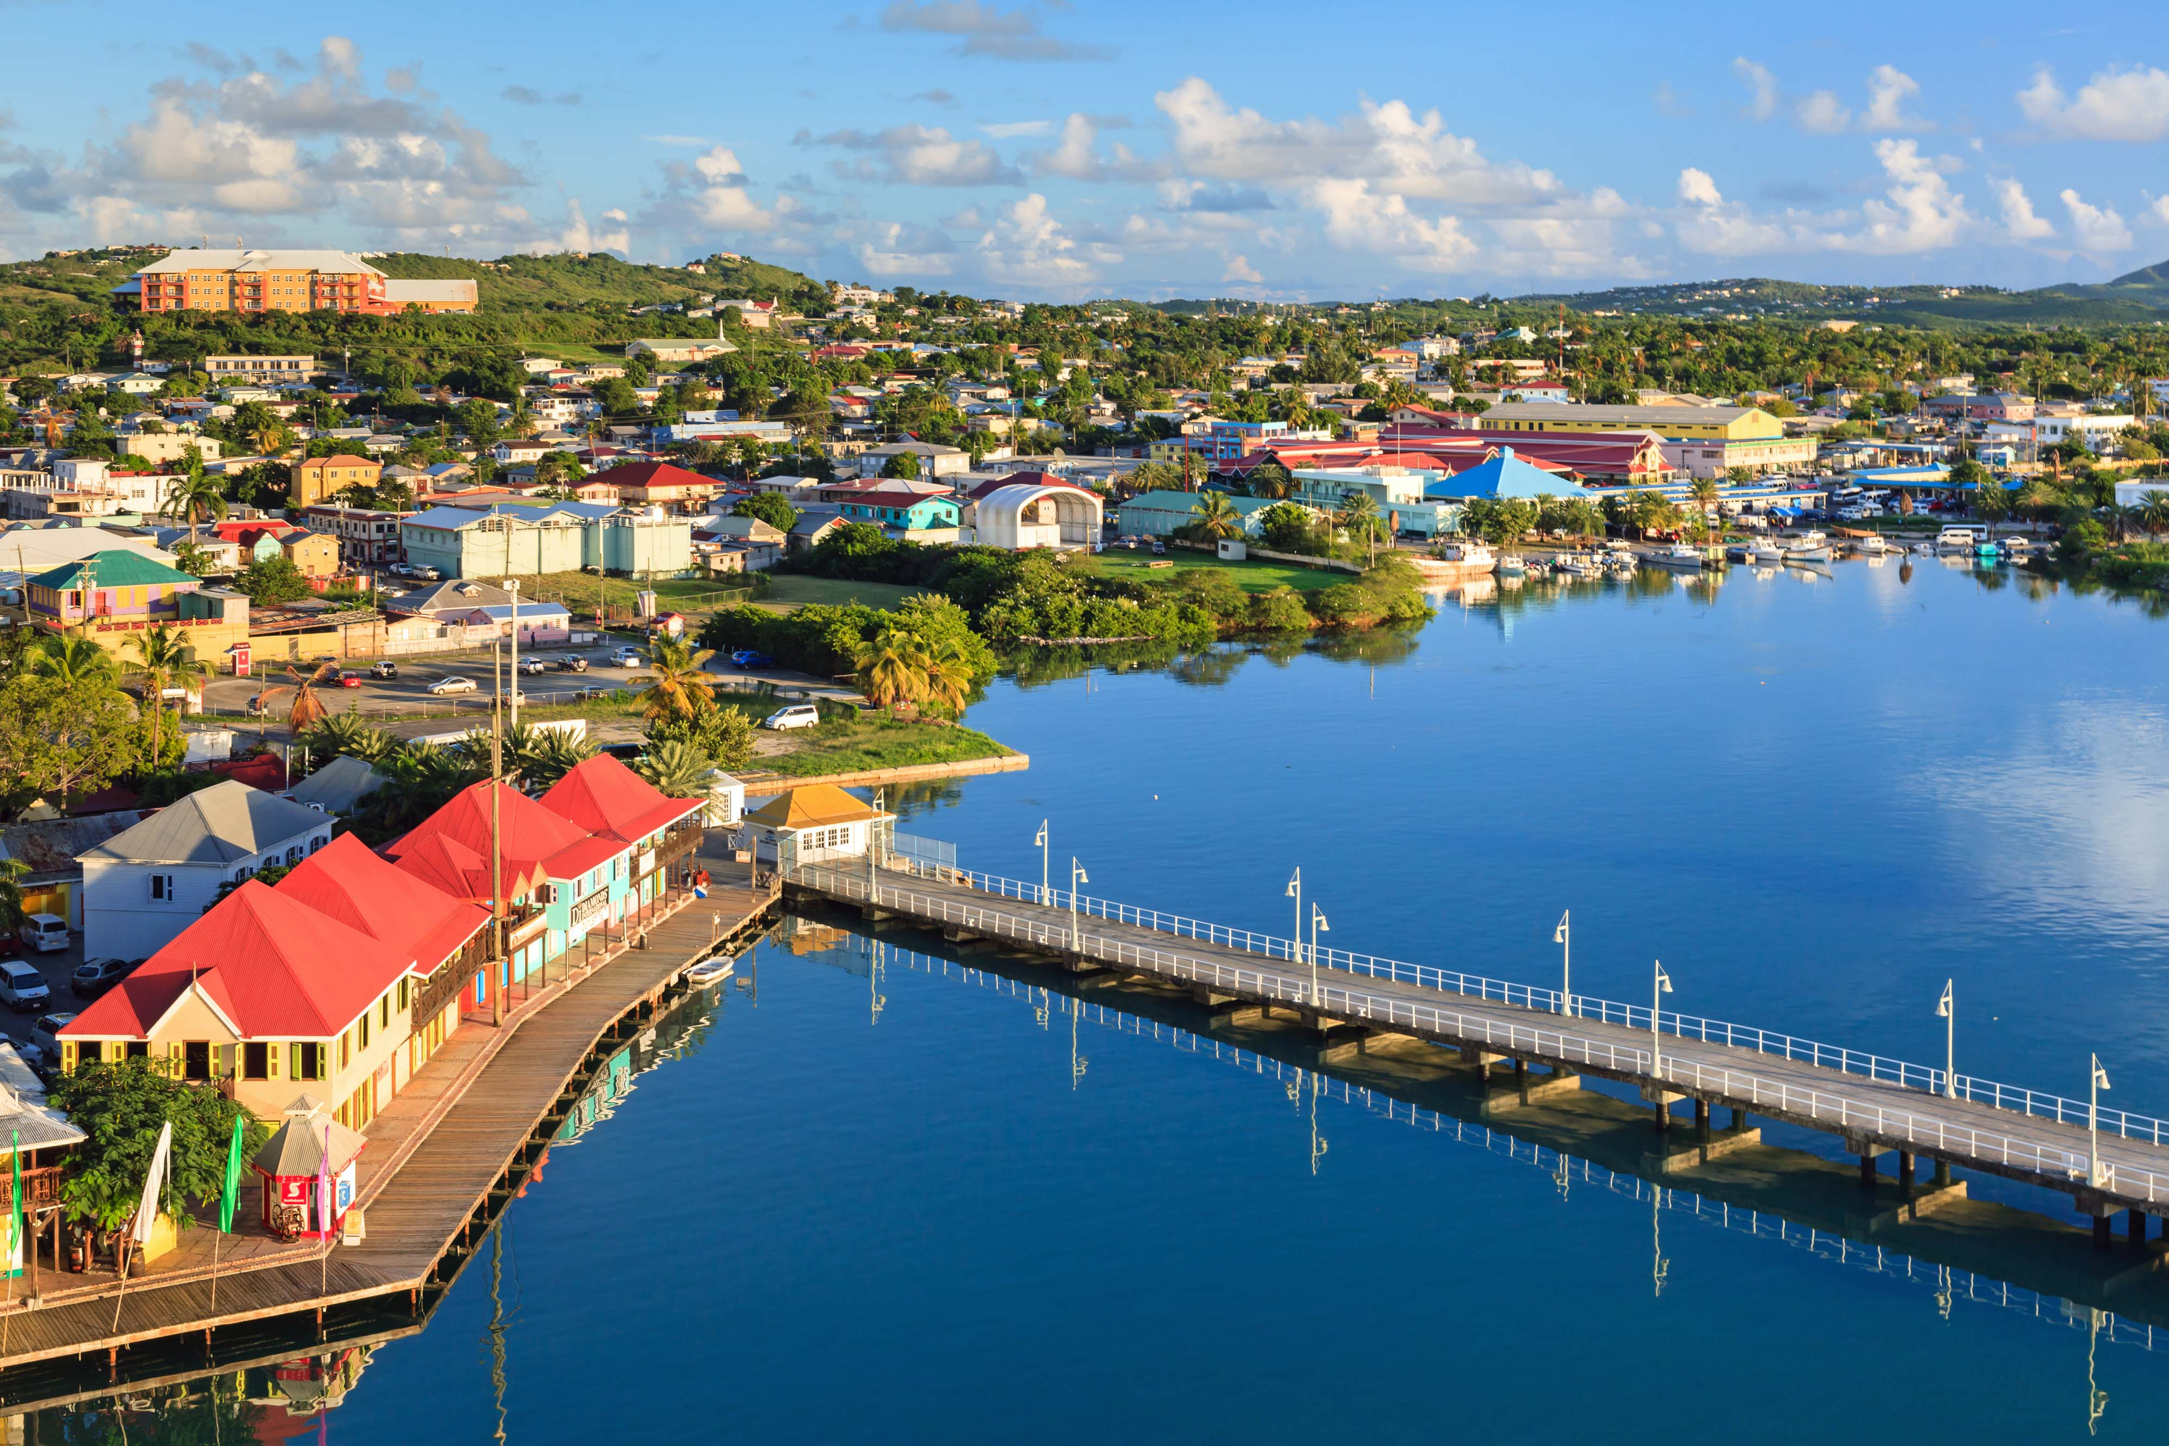

CDB’s Contribution in closing weather and climate data gaps in the caribbean
Yves Robert Personna, PhD
Senior Programme Manager, CARE Programme yves.personna@caribank.org; 246 826 3454
Environmental Sustainability Unit

Slide 2
CDB PORTFOLIO RELEVANT TO SOFF INVESTMENTS IN THE CARIBBEAN
Strategic Alignment with SOFF
  CDB supports all four EWS pillars—risk knowledge, hazard monitoring, communication, and response—in Caribbean SIDS.
Enhancing Risk Knowledge
  Partnered with UWI’s Climate Studies Group Mona on the State of the Caribbean Climate Report (2020).
  Informs NDCs, adaptation strategies, and climate investment; update currently underway.
Monitoring & Forecasting
  Strengthened hydromet networks in 5 countries via CIMH.
  Trained ~300 professionals in forecasting and climate services (2018–2022).
  Approved $1.5M grant to build marine and air quality monitoring capacity.
National-Level Hydromet Support
  Jamaica, Saint Lucia & Trinidad and Tobago: Upgrading hydromet networks and integrating climate risk in water management.
  GCF project in development with CMO, Belize, and Trinidad and Tobago to strengthen national and regional EWS.
Partnership With Other Regional Development Banks (CAF & CABEI in Climate Information and EWS for GCF Financing
Path Forward
  Opportunities to deepen collaboration, fill data gaps, and scale regional impact through coordinated action.

Slide 3
Future Opportunities
In a resource constrained environment - How could SOFF enhance its leverage of other hydromet investments in the region?
Timely opportunity to close EWS gaps in Caribbean SIDS
Focus on two transformative drivers:
  • Programmatic approach – scale, efficiency, harmonization
  • Strategic partnerships – expertise, co-financing, sustainability
Supports access to major climate finance (e.g., GCF, Adaptation Fund)
CDB's strong track record in regional climate resilience
Ready to collaborate with SOFF for greater impact and synergy

Slide 4
Future Opportunities
Where could more be done in terms of joint scoping of investments, developing larger programmes of work to implement EW4All, coordination mechanisms in-country, etc.?
Persistent gaps and fragmented EWS efforts across the region
Need for action at both regional and national levels
Regional Priorities:
  Joint scoping of investments
  Larger, coordinated regional programmes
  Economies of scale and streamlined climate finance access
  Alignment across countries and institutions
National Priorities:
  Stronger coordination mechanisms
  Break silos between key agencies (e.g., Met services, disaster agencies)
  Clarified roles and improved collaboration
  Timely, accurate warnings to those most at risk

Slide 5
Conclusion/Takeaways
🛑 | Persistent EWS Gaps
💰 | High Resource Needs
🤝 | Coordinated Action – Align efforts across agencies and partners
🎯 | Strategic Approach – Focus on efficiency and impact
🌍 | Scalable Solutions – Regional, transformative investments
🚀 | CDB Ready to Collaborate – With SOFF and other partners

