Slide 1



Closing the Basic Weather and Climate Data Gaps in the Caribbean: SOFF Regional implementation and creating synergies
Session 2: SOFF Status – opportunities and challenges
5 – 7 May 2025

Slide 2
What is SOFF?

Slide 3



The Systematic Observations Financing Facility – SOFF
A specialized United Nations climate fund co-created by the World Meteorological Organization, United Nations Environment Programme, and United Nations Development Programme
Established to fill in major gaps in basic weather and climate data in the countries with the biggest capacity constraints – Least Developed Countries and Small Island Developing States
Mandated to support the implementation of the Global Basic Observing Network – GBON

Slide 4
GBON – An International agreement on the mandatory basic weather and climate observations
193 countries and territories of the World Meteorological Congress established in 2021 for the first time the minimum set of observations that all countries must generate and internationally exchange - Global Basic Observing Network (GBON)
While GBON compliance is mandatory, major data and capacity gaps exist in most developing countries, hampering effective climate action across the globe.
Least Developed Countries (LDCs) and Small Island Developing States (SIDS) generate and exchange less than 10 % of the GBON data.

Slide 5
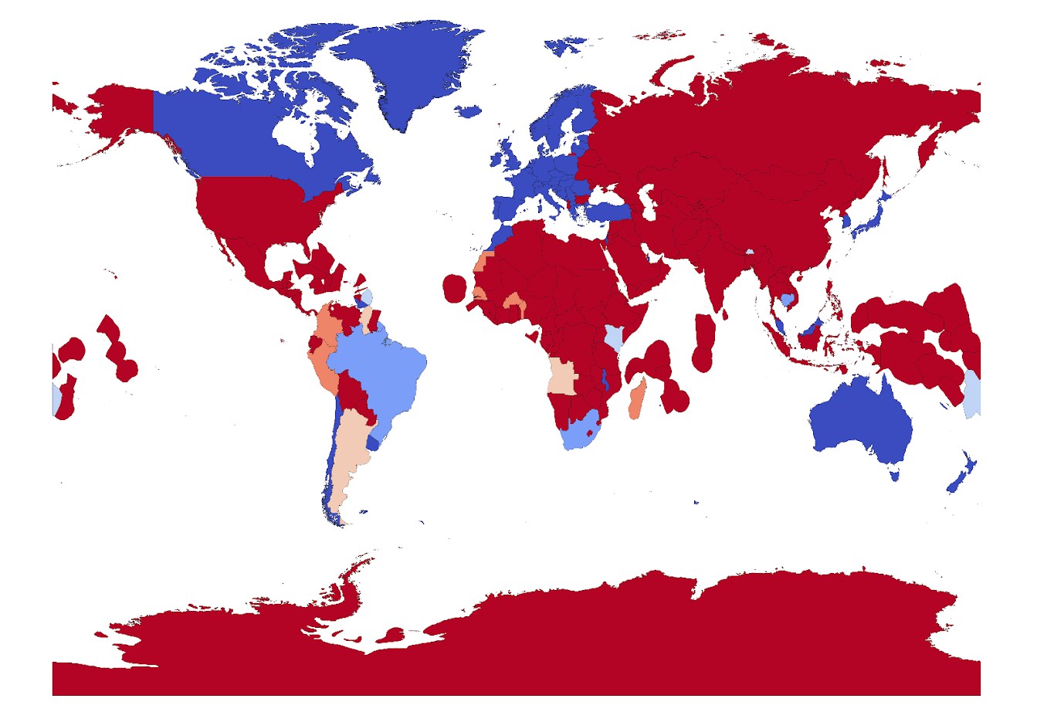
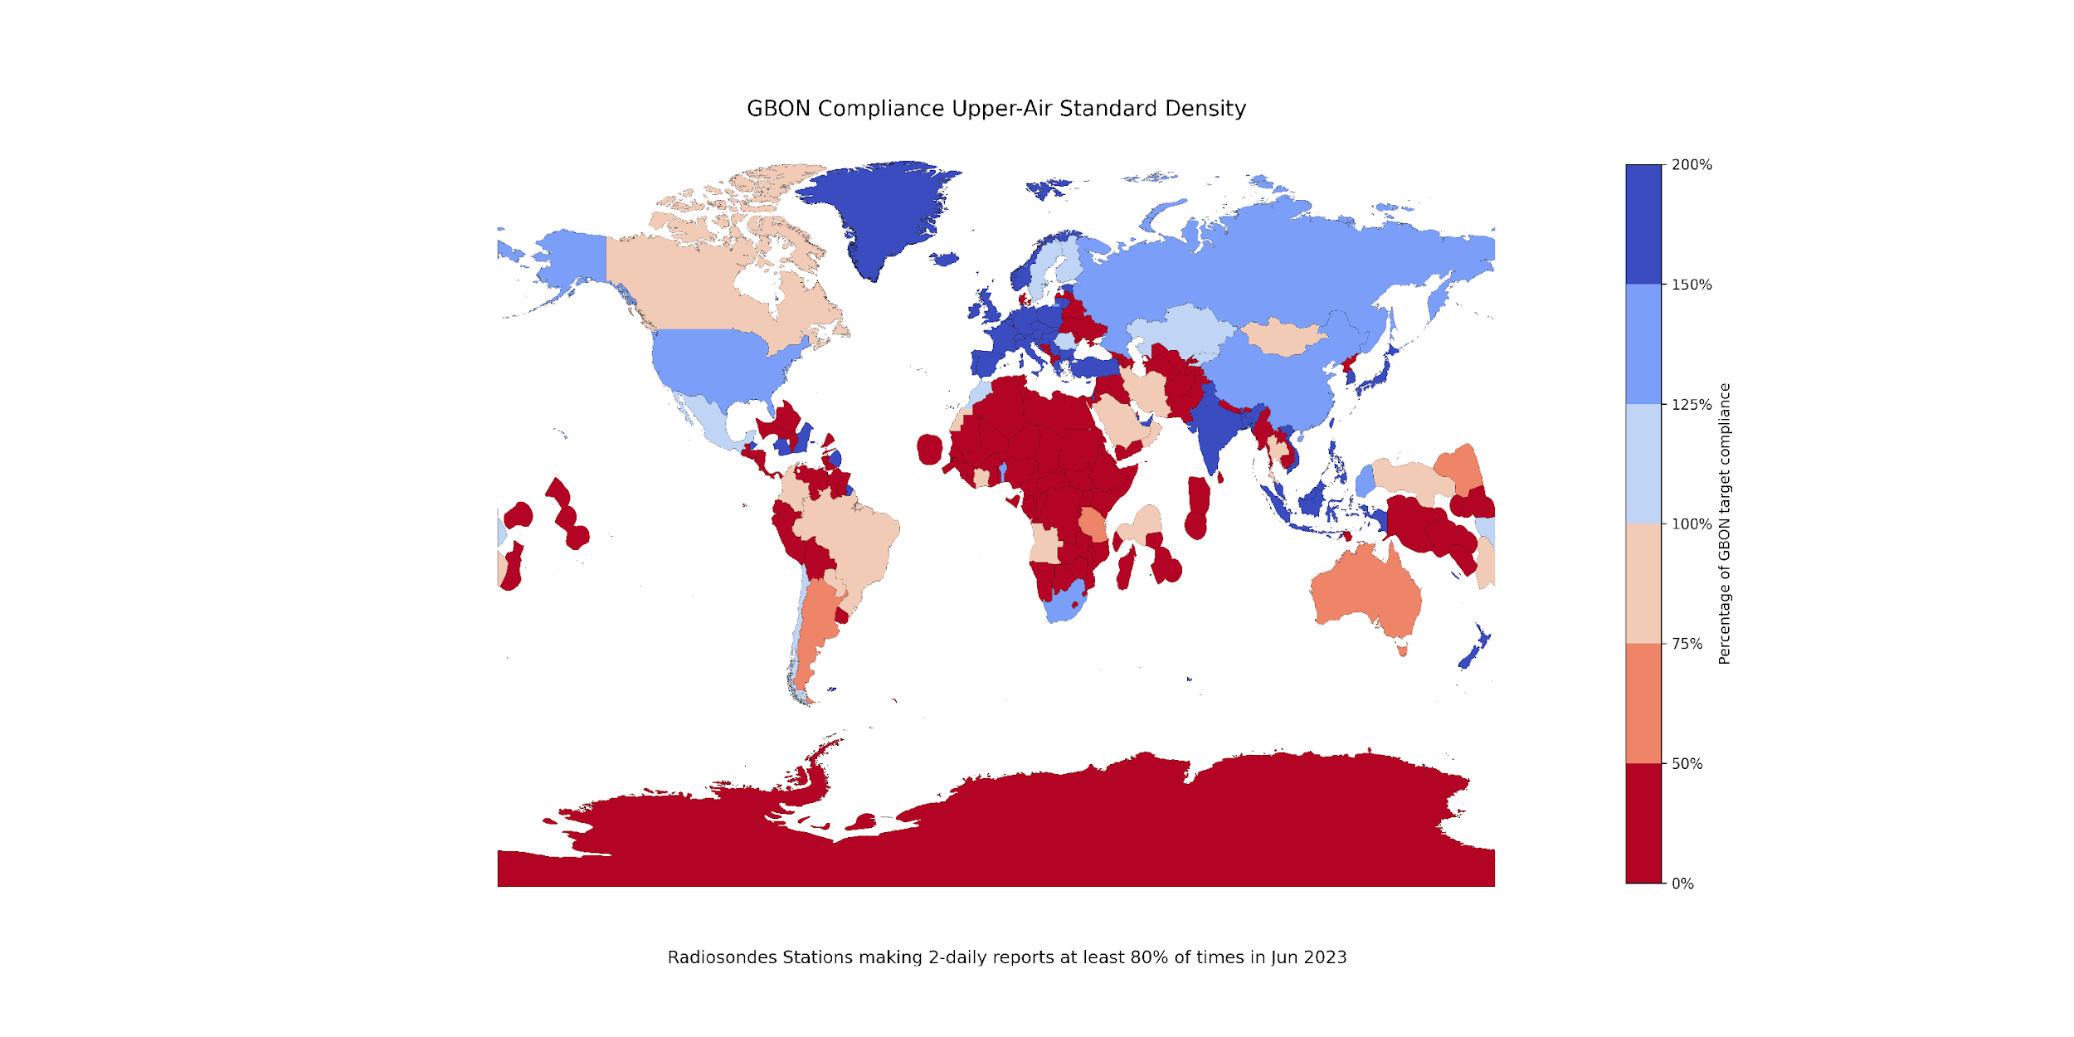
Major observation gaps in developing countries
Surface stations
Upper air stations
Areas in dark red are far from meeting the Global Basic Observing Network (GBON) requirements.
Source: SOFF Secretariat and WMO Global GBON Gap Analysis, June 2023
Notes:
Least Developed Countries (LDCs) and Small Island Developing States (SIDS) generate and exchange less than 10 percent of the internationally agreed and since January 2023 mandatory Global Basic Observing Network (GBON) data.

Slide 6

The importance of observations

Slide 7

Closing the basic weather and climate data gap is foundational to the climate services value chain
International exchange of observations
Observations from the entire globe
Global Numerical Weather Prediction
Weather and climate-related infrastructure – must be designed and coordinated globally
Activities undertaken primarily at regional, national and local level
Local data processing, forecast, warning and advisory products
Effective decision-making and action
Delivery of weather and climate services
The Meteorological Value Chain: All links in the chain must operate effectively to yield success.
Adapted source: WMO Secretariat, 2021.

Slide 8
Closing the basic weather and climate data gaps is essential – economic importance
USD 5 billion
USD 162 billion
Benefits directly enabled by GBON implementation in countries with the largest data gaps are estimated to exceed USD 5 billion per year.
Weather and climate observations are essential to fully realize the USD 162 billion of estimated minimum annual socio-economic benefits of weather and climate prediction.

Slide 9
Why are there major weather and climate data gaps despite substantial investments?
The substantial investments in observing systems have not translated into increased observational data sharing.
Lack of a global approach to address the global nature of the problem
Lack of an appropriate measure of success
Lack of a long-term and systematic approach to strengthen capacity
Lack of a coordinated and integrated implementation approach
Lack of a realistic financing and effective technical assistance model

Slide 10
SOFF – A new approach to close weather and climate data gap
SOFF is built on a unique funding and operational model for effective and sustainable support to developing countries to comply with the mandatory data sharing requirements of GBON
Peer-to-peer technical assistance provided by met offices from 28 countries – long term twinning arrangements
Single focus on data generation and exchange and crowding-in additional financing for investments in latter part of value chain.
SOFF is delivering at speed and scale. As of May 2025, 66 countries programmed, 61 receiving support, USD 105 million approved plus USD 16 million conditionally approved.
High country demand: 35 additional countries have requested SOFF support

Slide 11
SOFF – bringing together multiple partners under one roof
28
9
18
17
Steering Committee members
Implementing Entities
Advisory Board members
Peer Advisors
WMO
meteorological offices from advanced countries to provide technical assistance
Multilateral Development Banks and UN agencies
donors, co-founders and other stakeholders,
incl. LDC Group, AOSIS, CREWS
“enablers”
incl. REAP, IFRC, UNDRR, climate funds, private sector,
civil society
Technical Authority and SOFF Secretariat host
Notes:
as a UN fund, SOFF effectively brings together:
27 met offices from advanced countries to provide technical assistance
9 Implementing Entities
MDBs, UNDP, UNEP, WFP, IFAD
11 donors and several additional stakeholders in SOFF Steering Committee
incl. LDC Group, AOSIS, CREWS
“enablers” in SOFF Advisory Board
incl. UNDRR, climate funds, private sector, civil society

Slide 12
SOFF Phases of support

Slide 13
SOFF phases of support
GBON gap analysed and screened (NGA)
GBON national contribution developed and screened (NCP)
Country Hydromet Diagnostics undertaken (CHD)
SOFF funding for peer advisory services to support the country in developing these products
Readiness
SOFF provides a grant for the implementation of the GBON National Contribution Plan, i.e., GBON stations and capacity building
GBON infrastructure in place
GBON human and institutional capacity developed
Investment
  GBON data internationally shared and results-based finance provided
SOFF provides annual results-based payments for GBON-verified data sharing.
Compliance

Slide 14
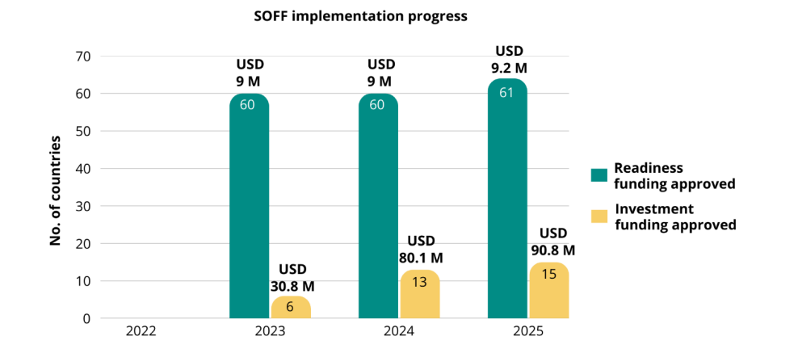
SOFF implementation progress

Slide 15
SOFF Regional Implementation

Slide 16
SOFF regional approaches
SOFF promotes regional approaches to ensure optimal design of the observing network and to promote coordinated implementation, pursuing efficiency gain and economies of scale.
Regional Approaches
Atlantic | Workshop in Cabo Verde co-hosted by SOFF and KNMI, November 2023 3 Atlantic SIDS and partners
Pacific | Workshop in Fiji co-hosted by SOFF and Fiji Met, April 2024 13 Pacific islands countries and partners
Africa | Workshop in Cote d’Ivoire co-hosted by SOFF and AfDB, September 2024 23 African countries and partners
South Asia | Workshop in Bhutan co-hosted by SOFF and NCHM, September 2024 4 South Asian countries and partners
Caribbean | Virtual engagement started in July with 16 countries Workshop in person foreseen for January/February 2025

Slide 17
SOFF support in the Caribbean
Country | Peer Advisor | Implementing Entity | Readiness Budget (USD) | Implementation Progress
Antigua and Barbuda | United Kingdom | UNDP | 182,970 | Readiness phase completed
Bahamas | Finland | IDB | 131,653 | Readiness phase completed
Barbados | Finland | IDB | 129,943 | Undergoing Readiness phase
Belize | United Kingdom | IDB | 199,757 | Investment Funding Request approved in Nov 2023 for USD 864, 543
Cuba | Spain | UNDP | 160,000 | Readiness phase completed
Dominica | Austria | WFP | 135,650 | Undergoing Readiness phase
Dominican Republic | Spain | WFP | 160,000 | Readiness phase completed
Grenada | Spain | N/A | 120,000 | Undergoing Readiness phase
Guyana | Austria | IDB | 170,748 | Readiness phase completed
Haiti | Switzerland | IDB | 145,000 | Undergoing Readiness phase
Jamaica | Finland | IDB | 125,799 | Undergoing Readiness phase
Saint Kitts and Nevis | Finland | IDB | 128,463 | Undergoing Readiness phase
Saint Lucia | Austria | WFP | 135,650 | Undergoing Readiness phase
Saint Vincent and the Grenadines | Austria | WFP | 135,650 | Undergoing Readiness phase
Suriname | Netherlands | UNDP | 150,000 | Readiness phase completed
Trinidad and Tobago | Finland | IDB | 129,745 | Undergoing Readiness phase

Slide 18
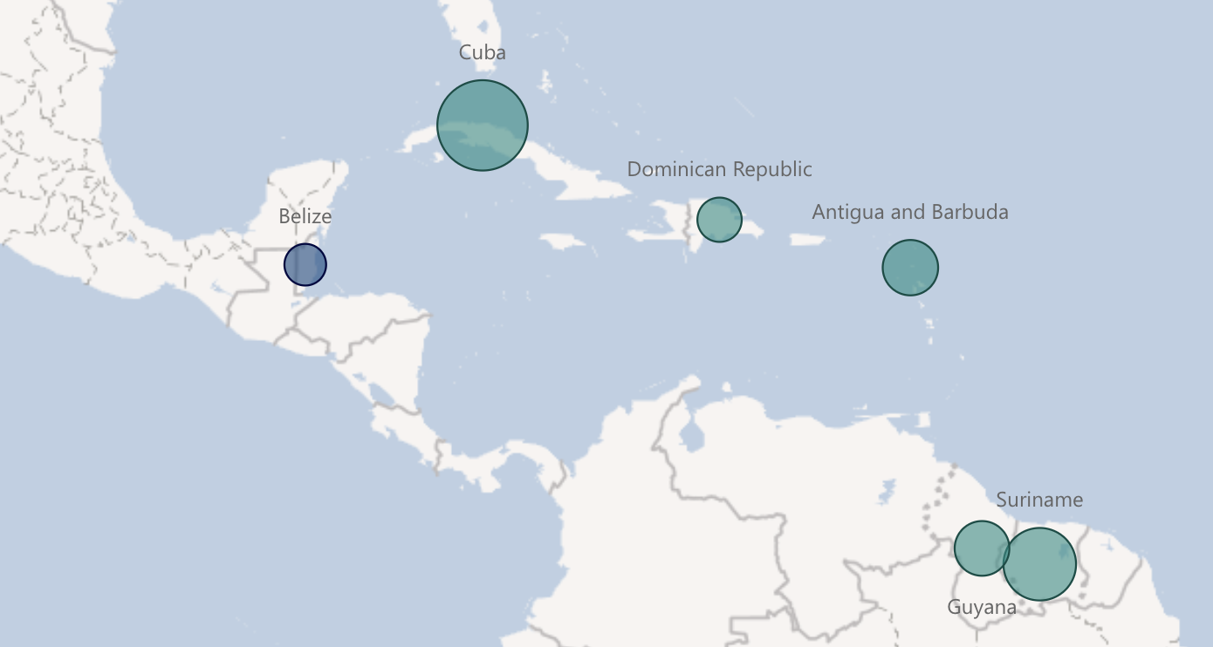
SOFF investments in the Caribbean & other climate funds
Dominican Republic
AF | CIF | CREWS | GCF | GEF
Antigua and Barbuda
AF | CIF | CREWS | GCF | GEF
Cuba
AF | CIF | CREWS | GCF | GEF
Belize
AF | CIF | CREWS | GCF | GEF
Suriname
AF | CIF | CREWS | GCF | GEF
 | SOFF Investment Phase ongoing
 | SOFF Investment funding request submitted
Guyana
AF | CIF | CREWS | GCF | GEF

Slide 19
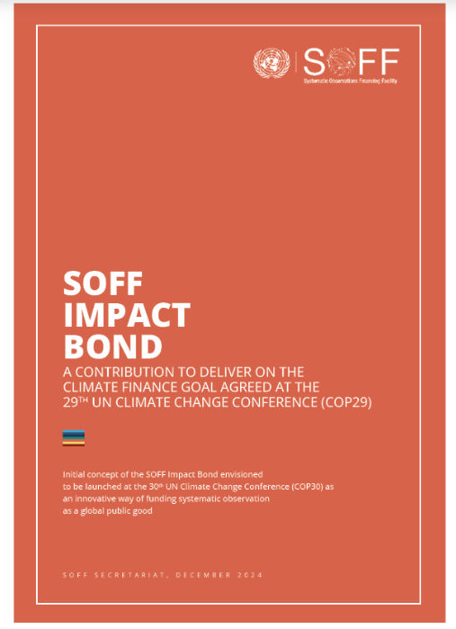
SOFF First Implementation Period 2022 - 2025
SOFF take-off was possible thanks to the commitment and leadership of twelve initial funders that have contributed with USD 107M to date, and has responded to high country demand.
Building a closely knit “SOFF operations community of practice” has been a notable initial success, valued by countries and operational partners.
The external environment for international resource mobilization has dramatically worsened for all development and climate actors, significantly impacting SOFF limiting its ability to raise the funding needed to respond to the demand for country support.
Mobilizing the required resources will need substantial and innovative efforts, and for that reason the upcoming Steering Committee meeting will adopt the SOFF Resource Mobilization requirements and actions until 2027, which includes the development of a SOFF Impact Bond aimed to be announced at COP30

