Slide 1



Closing the Basic Weather and Climate Data Gaps in the Caribbean: SOFF Regional implementation and creating synergies
Objectives and agenda
5-7 May 2025

Slide 2
Objectives
Identify common challenges on observational infrastructure and fulfilment of the GBON compliance. Neighbouring countries often share similar challenges, especially when it relates to technical infrastructure, but also with the actual use of observational data.
Share best practices. Each country possesses unique strengths and solutions in various fields that may lead to a fruitful exchange for improving capacity also at the policy level.
Identify synergies across countries that could benefit the weather services operations and facilitate the achievement of the SOFF targets and projects implemented in the region through various partners.
Foster a cooperative umbrella with regional actors like CMO for SOFF activities in the countries that could boost activities at the policy and strategic level, specifically for the upcoming Investment Phase of SOFF.
Discuss joint training programmes to work towards the enhancement of human capacity and the generation of a pool of resources and know-how transfer.
Discussion on additional international support, leveraging actions that could be performed.
Discussion on potential additional future collaboration between all the actors, especially under the much wider umbrella of the EW4All initiative.

Slide 3
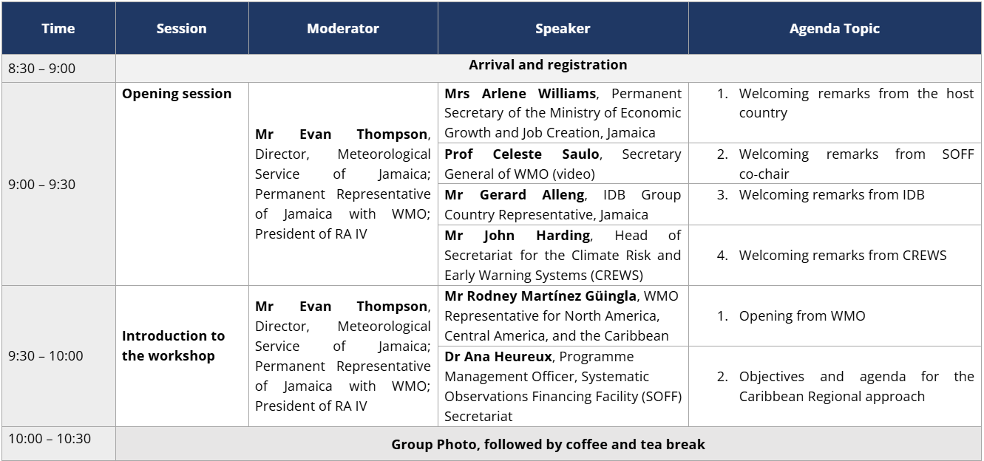
Agenda – Day 1

Slide 4
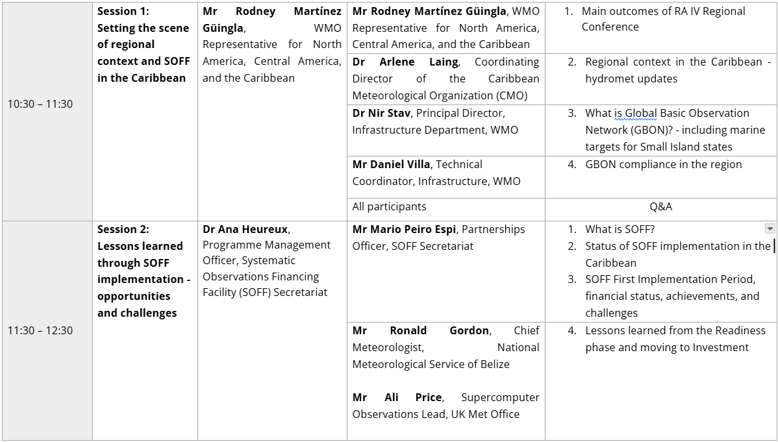
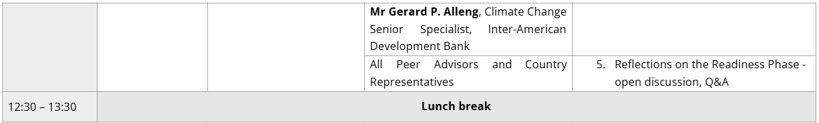
Agenda – Day 1

Slide 5
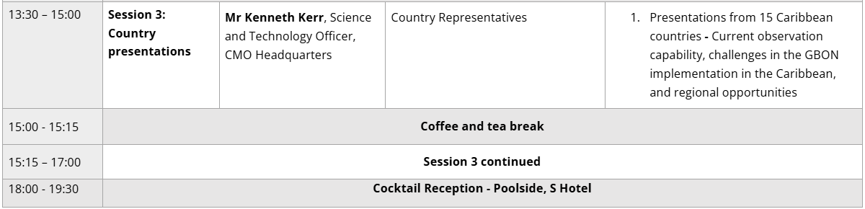
Agenda – Day 1

Slide 6
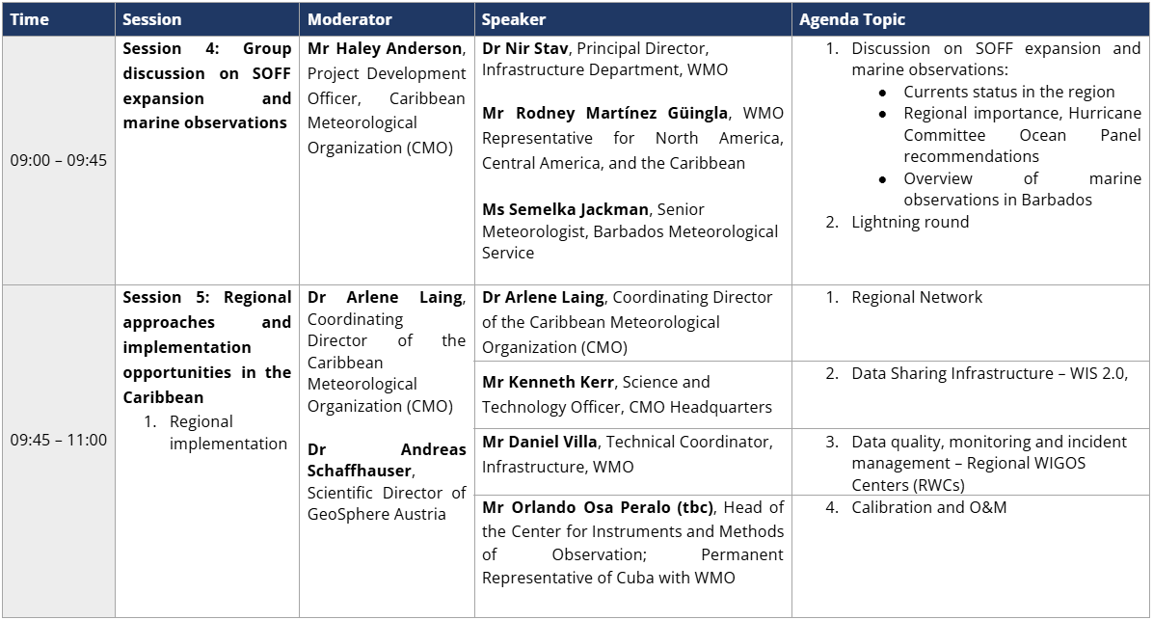
Agenda – Day 2

Slide 7
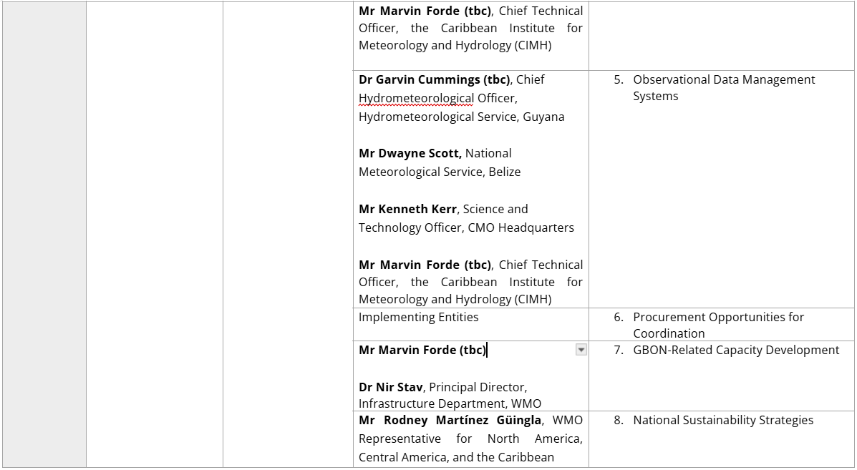
Agenda – Day 2

Slide 8
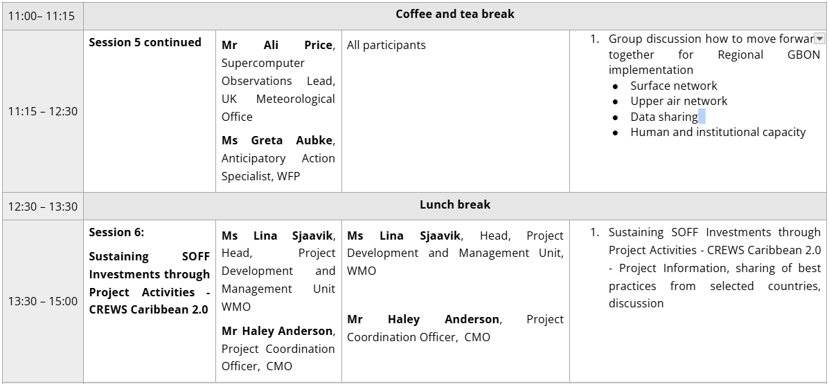
Agenda – Day 2

Slide 9
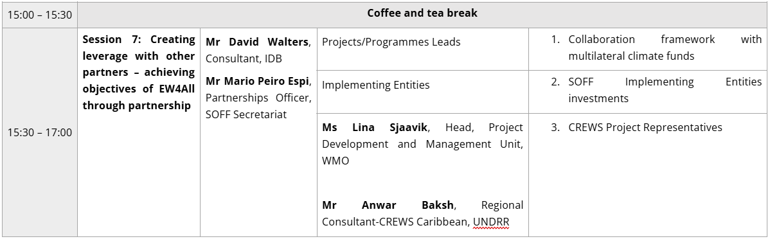
Agenda – Day 2

Slide 10
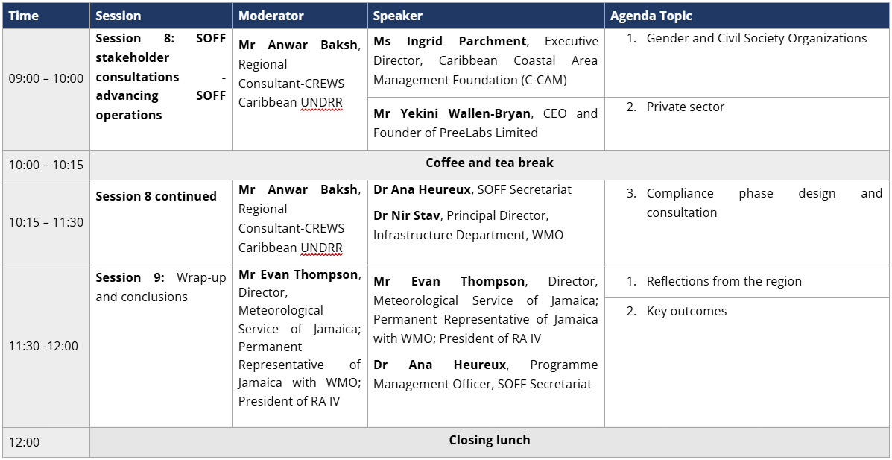
Agenda – Day 3

