Slide 1

SOFF Compliance Phase
Consultation
SOFF Peer Advisors and Implementing Entities Workshop
9-10 October 2024

Slide 2
SOFF phases of support
Readiness
GBON gap analysed and screened (NGA)
GBON national contribution developed and screened (NCP)
Country Hydromet Diagnostics undertaken (CHD)
SOFF funding for peer advisory services to support the country in developing these products
Investment
SOFF provides a grant for the implementation of the GBON National Contribution Plan, i.e., GBON stations and capacity building
GBON infrastructure in place
GBON human and institutional capacity developed
Compliance
  GBON data internationally shared and results-based finance provided
SOFF provides annual results-based payments for GBON-verified data sharing.

Slide 3
SOFF compliance phase:
The unique element ensuring long-term sustainability of SOFF investments
Decision 5.7 on SOFF & GBON compliance
“The Compliance phase provides results-based finance and peer advisors’ technical assistance to beneficiary countries to operate and maintain the surface-based observation network and the international sharing of data based on the principle of additionality.”
Results-based funding provided annually on an open-ended basis
NMHS responsible for implementation (operations, maintenance and GBON compliance); alert SOFF Secretariat on potential issues
Peer advisors provide on-demand advisory support; inform WMO Technical Authority of issues and progress

Slide 4
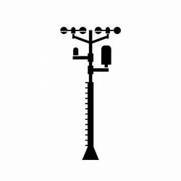





GBON Guide: EC-77 (Feb. 2023)
GBON compliance: what does it take?
GBON station compliance
Availability ≥80%
Timeliness <5%
Quality <5%
Security
Power
Comms
Comms
WIS2 node
Station
Data
processing
centre
WMO
Information
System
Global NWP
centre
Consumables
Trained operators
Regular maintenance and calibration
Assign as GBON in OSCAR Surface
WIGOS
Data Quality
Monitoring
System
WDQMS
WMO and
WIGOS Regional Centres
Tailored SOFF reporting
Notes:
For upper air, additionally we are looking at required resolution
WDQMS is operated in cooperation with DWD (Germany), ECMWF, JMA (Japan), and NOAA/NCEP (USA)

Slide 5
Guiding question 1
What are the total costs of compliance and what level of contribution should national meteorological services make?

Slide 6
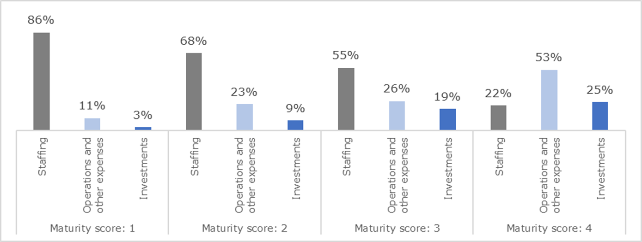
Countries' ability to contribute to the Compliance phase: results from first 20 CHDs

Slide 7
Feedback from consultations so far
Estimated compliance phase costs
  “Whatever it takes” approach, i.e. total costs approach
  Total costs to be country tailored, to be developed during investment phase
  A standard methodology should be developed on what to include in “whatever it takes” to ensure consistent approach across countries
  How much does it cost - based on the approved investment phase proposals so far, total costs of compliance phase is estimated to be USD 40 million per year for all 77 SIDS/LDCs.
  Need to ensure that this amount can be mobilized annually
Country contribution level
  Countries emphasized the necessity of being realistic about their contributions, strongly advocating for in kind contributions e.g. staff time and office space.
  Level of contribution should be country tailored and -financing to be linked to NMHS capacity as assessed by Country Hydromet Diagnostics (CHD) with proposal to undertake another CHD in the last year of the SOFF Investment phase
Administrative complexities
  NMHSs emphasized need to ensure that they get the annual payments and that they are not kept by central government
Challenges to results-based finance model
  The risks of unanticipated costs need to be factored in (currency, inflation, etc).​
  How to deal with challenges such as vandalism - community ownership of the stations can help mitigate risks
  Additional financing might be needed in case of force major or vandalism
Continued peer advisor support incl. training
  Continued training and institutional strengthening during the compliance phase needs to be provided by peer advisors to mitigate anticipated frequent staffing changes.​
Phased approach
  The investment phase can be executed through a phased approach, which implies that a country would be in both phases, investment and compliance

Slide 8
Guiding question 2
While the SOFF Compliance phase will provide support to individual SOFF beneficiary countries, how could additional (sub) regional Compliance phase support be designed?

Slide 9
Feedback from consultations so far
Investment phase to be approached from Compliance phase perspective
  Investment decisions (e.g. location of stations, number of stations beyond GBON, calibration) and (sub) regional support to be factored in Investment phase funding request
Role of Regional Centers
  GBON compliance is a national responsibility, but WMO regional centers (RWC, RIC) and advanced NMHSs from the region could provide complementary support
Countries to receive compliance payments
  While support from Regional Centers might be needed, countries request to receive the total compliance phase payments, to then decide if they want to request support from Regional Centers and potentially fund this support
Clear, concise, and self-explanatory guidance from WMO TA
  Countries request better guidance from WMO Technical Authority Secretariat on GBON compliance, covering WIS, data management, and calibration, including the roles of GISC, RIC, and RWC.
SOFF regional funding window
  SOFF to consider a funding window for (sub)regional support during Investment and Compliance phase

Slide 10
Guiding question 3
What capacity do countries have to access and make effective use of global forecast products? Should SOFF develop and implement a “two-way-street” train the trainers program?

Slide 11
Feedback from consultations so far
Importance of “two way street”
  Countries emphasized the importance of having access and in particular being equipped to use forecast products from global and regional centers
  Countries noted that available products are not easily usable and significant training is required.
  Countries appreciate ECMWF providing access to increased forecast products
Two way-street train the trainers program
  The envisioned train the trainers program for peer advisors to provide hands-on country tailored training on the use of global and regional forecast data and products is appreciated.
  This could be complemented by a regional training programs offered by regional institutions and mechanisms like the South Asia Hydromet Forum
Stocktake of available trainings
  The envisioned SOFF train the trainers program should build on and complement existing training offers from Global Producing Centers and other partners – need to map out available trainings and ensure complementarity

