Slide 1

WIS2 - Introduction
Rémy Giraud: SC-IMT Chair
Octobre 2024

Slide 2
WIS2 principles

Slide 3
WIS 2.0
“
  WIS 2.0 is a collaborative system of systems using Web-architecture and open standards to provide simple, timely and seamless sharing of trusted weather, water and climate data and information through services.”

Slide 4
Technological change
“
Technological advances and the increasing demand for more and more diverse services from increasingly sophisticated and capable users changes rapidly the service delivery and business models in many parts of the world.”
WMO Strategic Plan (2020-2023)
“
Most Members are ill-prepared for the explosion in data volumes and the growing diversity of new data sources.”
Cg-17
Cloud computing, Web services, data analytics, machine learning and other technologies present new operating concepts that will improve operational efficiency, information sharing and service delivery, and enable users to more effectively exploit data.”
“
CBS led review of emerging data issues

Slide 5





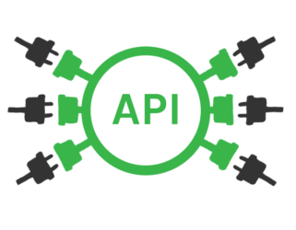

WMO Information System (WIS 2.0)
1963 World Weather Watch
1970s Global Telecommunication System
2007 WMO Information System (WIS)
2019 WMO Reform (Earth System Approach)
2021 WMO Unified Data Policy / GBON
WIS 2.0
  … system of systems using Web-architecture and open standards to provide simple, timely and seamless sharing of trusted data and information …
  Open Standards (OGC, W3C, IETF, …)
  Open Source (use off the shelf tools)
  Data sharing through Web and publication/subscription (pub/sub) protocols
  Cloud ready (turn-key solutions)
  Web APIs (Application Programming Interface)
Notes:
A little history to start …
The WMO Global Telecommunications System (GTS), established in the 1970s was designed to enable WMO Members to share data and products with each other in support of operational weather forecasting. Over the last 40 years or so, the GTS has successfully moved indispensable, time-critical data between NMHSs day-in, day-out.
But weather and climate data is important to everyone. So WMO Congress commissioned the WMO Information System (WIS) in 2007.
WIS builds on and incorporates the GTS, adding a data catalogue, data discovery portal and additional mechanisms for users to subscribe to and download data shared on the GTS. It is comprised of hundreds of data providing centres from across the globe (Data Collection and Production Centres, and National Centres), plus 15 Global Information System Centres (or GISCs) that are regional hubs for search, discovery, and access to data.
The original WIS is a child of its time – designed circa 2005. It’s based on service-oriented architecture principles, uses complex ISO 19115/19139-based XML for metadata, and is not well integrated into the Web. Since 2005, we’ve seen a move towards “webby” applications, with good practice characterised in the W3C Data on the Web and W3C Spatial Data on the Web Best Practices. In summary: Resource-oriented architecture, RESTful Web services, and JSON and HTML as core formats.
This is a journey that OGC has been on for some time now, and many of the OGC API standards appear ripe for inclusion in WIS2.
Our aim for WIS2 is to increase data provider participation by lowering the technical barriers to entry, and from the data consumer perspective, make weather and climate data Findable, Accessible, Interoperable, and Reusable (FAIR).

Slide 6
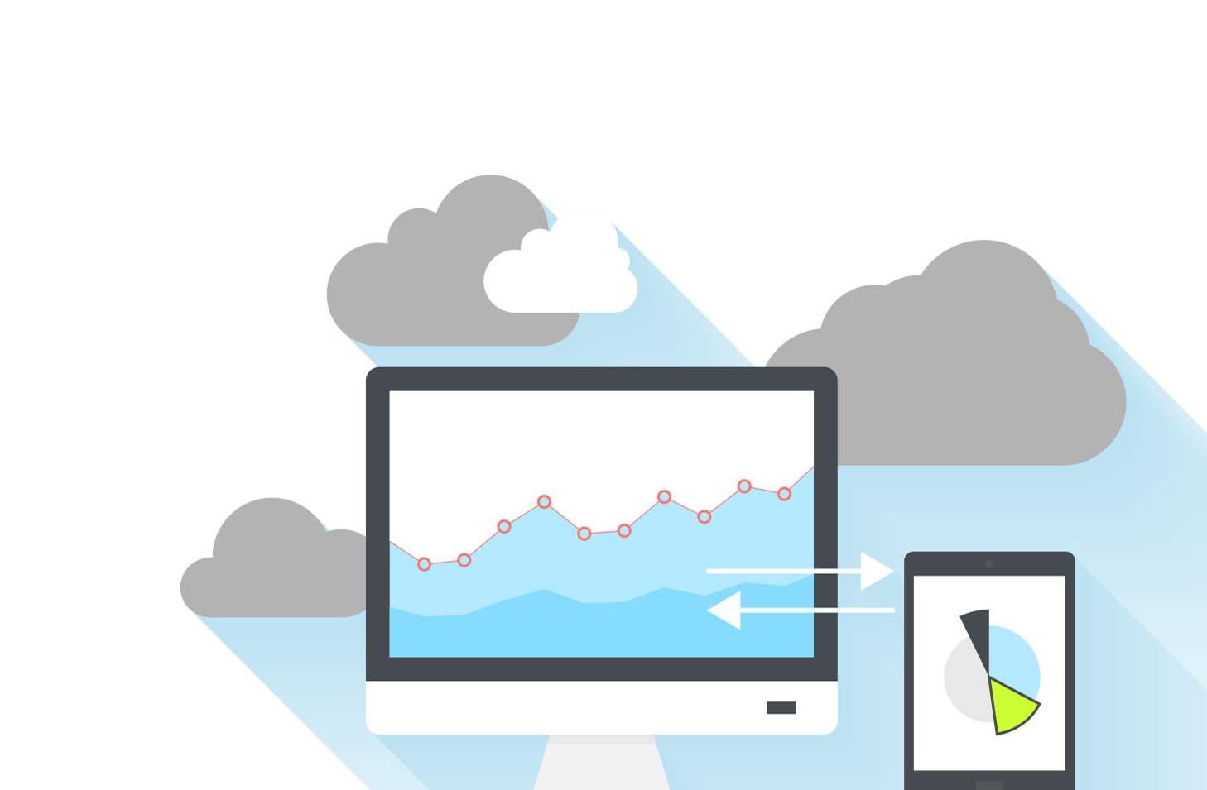


“
WIS 2.0: uses Web services for publishing data”
Data is published via Web services – Web applications that allow computer programmes to access or interact with that data …
Access control and security are built-in to Web technology
0101001010100101001010111110101001010001010100101001010100101000001010101010001010010010101001010
010010101011101010101010001010111010111110101001001010010100101000101010110100110101010000100100010
101011101001011101010100010100010100100100100100111111010010101010010100001010010101001000100010010
Notes:
WIS is no longer about pushing data around the network – it’s about exposing what you have using Web services
The WMO review of emerging data issues finds that Web services are one of the technologies that “present new operating concepts that will improve operational efficiency, information sharing and service delivery, and enable users to more effectively exploit data.” Is there a map of centres we can publish?
In WIS 2.0, participating centres will provide Web services that enable users to access and interact with data.
When designing their Web services, publishers should consider the capability of users to work with the data. Instead of expecting users to download entire datasets for local processing, WIS centres should provide Web services that allow users to download only the data or information they actually need; for example, extracting only the geographic subset of data of interest to the user.
Whereas the current WIS focused on operational data, the services which can be made available in WIS 2.0 also enable centres to share historical data and offer access to archives, where appropriate, to support the needs of all WMO programmes.
…
Providing data using the Web does not automatically mean that those resources are freely available to all without restrictions on use.
Access controls and security developed for on-line banking, eCommerce applications and many more
Web technologies allow for authentication and authorization where necessary: the provider retains control of who can access published resources and can require users to accept a license specifying the terms and conditions under which those resources can be used before allowing them access.

Slide 7



“
WIS 2.0: uses open standard message protocols to replace the GTS.”
1001010010010100101000101010
Real-time data sharing … Like ‘WhatsApp for weather’
10101101110100101001010
1001010010010101110101101110100101001010
Everyone who wants access can ask to subscribe
1001010010101101110100101001010
Publish your data via a Web service
10010100100101010101010011010101110100101001010
1001110
Data streamed in real-time as soon as available
1001010010010101110101101110100101001010
1001010010010101111101101001010
Notes:
WhatsApp: simple, secure, reliable messaging
“publish-subscribe” messaging protocols make it simpler to distribute to data in real-time to many consumers
Satellite-based data dissemination still needed where there is no Internet connectivity; e.g. GEONETCast

Slide 8
WIS2 Solution Design
WIS2.0 Technical Foundations
Message Queuing Protocols
Provide expandable services-architecture
OGC Metadata Standard
Unified monitoring approach
Functional Requirements
Using open standards
Using Web solutions
Cloud ready solutions
Support
Big Data
Business Requirements
Emerging
Data Issues
Support
GBON
Support Unified
Data Policy
Support All
WMO Programmes
Replace GTS

Slide 9
Wis2 Architecture FOR real-time data exchange

Slide 10
WIS 2.0: Pub/Sub solution
Using MQTT 3.1.1 or 5.0 protocols Data Producers will publish a short message describing the available data and the method (URL) to access it
Global Brokers are subscribing to these announcements and Global Cache download the data for further redistribution
This solution will:
  Gradually replace the GTS for weather data
  Provide a solution for all WMO programs

Slide 11
GTS vs. WIS 2.0
On the GTS and the WIS, available data is pushed by the producing centre as soon as it is available to a static list of recipients.
In turn, those push again that same data to subsequent users, etc.
Resulting in many hops (delays and availability risks) and many changes to adapt the manually maintained routing tables.
The WIS 2.0 solution by using of the shelf software aims at:
  Moving from a static push model to a dynamic pull model
  Improving the reliability of the distribution of real time data
  Reducing the number of hops between the producer and the user
  Allowing a dynamic selection for the user of the required data
  Allowing the producer to provide new data rapidly and easily
  Using the same solution for data from all WMO Programmes

Slide 12


WIS2 Architecture
Global
Services
WIS2 node

Slide 13
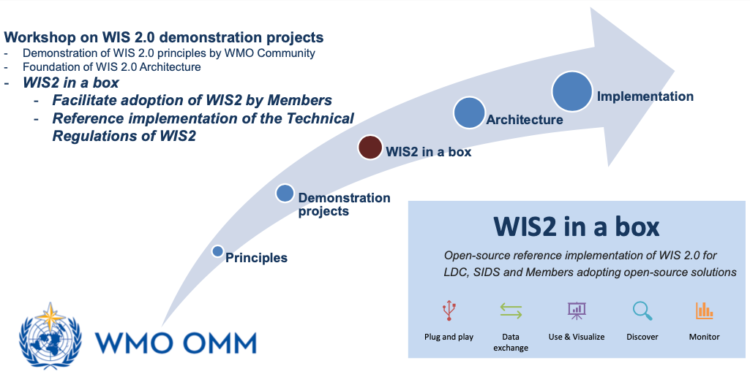
WIS 2 in a box:
Reference implementation of WIS2 Node

Slide 14

WIS2 node
NCs / DCPCs are going to implement a WIS2 Node to exchange data in WIS2
The WIS2 Node shares data from an HTTPS service and sends notifications to MQTT subscribers
No need to provide access to all the users in the world, only to some WIS2 Global Services
WIS2 node is the platform for data exchange instead of GTS
Global
Services
Downloads data
Receives notifications of new data
Subscribes to
No change on approved data format
No change in the current WIS roles
WIS2 node

Slide 15






Global Services
Downloads core data
Subscribes to topics
Discovers data/services
Downloads recommended data
Global Cache
Global Broker
Global Discovery Catalogue
Global Monitoring
WIS2 node
A storage providing a copy of the WMO Core data from the NCs/DCPCs to be accessed by the users.
  Data will be open to everyone.
  Some Global Caches are required globally for resilience.
Providing notifications of all the data available in the Global Caches or in originating centers.
  Users will subscribe to a Global Broker to get notifications of new data to be downloaded from Global Caches or WIS2 node
Monitoring of data exchanged in WIS2.
  Global Services provides metrics in real time
  Global Monitoring Center will collect statistics from Sensor Centers and provide web accessible maps and results.
It is a discovery catalogue of data and services.
  Provides an API to list the available data and services
  Harvests metadata from the WIS2 Nodes.

Slide 16
WIS2 implementation timeline
Pilot Phase
Pre-operational
Operational
2023
2024
2025
2022
2030
Pilot Global Brokers
Pre-oper Global Brokers
Global Brokers operation
Pilot Global Discovery Catalogue
Technical Regulations
Pilot Global Caches
Pre-oper Global Caches
Global Caches operation
Stop transition infrastructure
WIS 2.0
Guidelines
NCs
DCPCs
Pre-oper Global Discovery Catalogue
Global Discovery Catalogue operation
Q1
Q2
Q3
Q1
Q2
Q3
Q1
Q2
Q3
WIS2 box release 1.0
Transition Infrastructure
WIS2 Monitoring
NCs & DCPCs
NCs & DCPCs
Workshops and training
INFCOM-2
EC 75
Cg-19
EC 76
INFCOM-3
EC 77
NCs/DCPCs may stop WIS1 functions if migrated to WIS2
GISCs contributing to Global Services may stop WIS1
Beginning of the transition
WIS 2.0 Tech- Reg approved
Guidelines for WIS 2.0 implementation published
Technical guidance in the Guide to WIS
Report on WIS2 progress

Slide 17
Video – Congress 19 – May 2023
https://vimeo.com/761382308

Slide 18

Thank you
Merci

Slide 19
WMO Information System (2nd generation)
- an evolution of data exchange
Rémy Giraud, chair WMO SC-IMT
Jeremy Tandy, vice-chair WMO SC-IMT
Notes:
Standing Committee on Information Management and Technology (SC-IMT)
——
Title:
WMO Information System (2nd generation) - an evolution of data exchange
Overview:
This presentation will discuss data exchange within the WMO. Briefly touching on 150 years of history, the main focus will be the 2nd generation of the WMO Information System (WIS 2.0) which will become operational in January 2025 and will phase out the existing Global Telecommunications System (GTS) over the following 5-years. The presentation describes how WIS 2.0 addresses the combined challenges of big-data and open access through adoption of open, Web-based technology, cloud solutions and a collaboration with Amazon. But the story doesn’t end there…

Slide 20


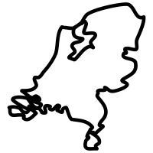




The journey from the producer…
I want to share data from my national network of land-based, fixed observing stations¹
¹ WMO data sharing covers 6 Earth system domains; observations, predictions, re-analyses, etc. – see the WMO Unified Data Policy (Resolution 1) for more information
Notes:
Let’s zoom in on a particular data provider: KNMI in Netherlands
[Flags from Vecteezy.com: https://www.vecteezy.com/vector-art/1936193-set-of-rounded-flags-of-the-world]

Slide 21

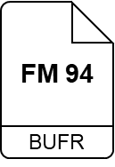

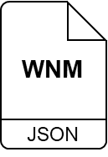
¹ Guide to WIS (WMO No. 1061), Vol II, §1.1.4 Why are datasets so important [draft]
² Guide to WIS (WMO No. 1061), Vol II, §1.3.1 How to get started [draft]
³ Guide to WIS (WMO No. 1061), Vol II, §1.3.2 How to provide discovery metadata to WIS2 [draft]
⁴ Manual on WIS (WMO No. 1060), Vol II, Appendix E: WIS2 Notification Message [draft]
⁵ Manual on WIS (WMO No. 1060), Vol II, Appendix D: WIS2 Topic Hierarchy [draft]
⁶ Manual on WIS (WMO No. 1060), Vol II, Appendix F: WMO Core Metadata Profile 2 [draft]
files in BUFR format
or other WMO approved data formats
HTTPS
00110001
00110000
» »
For WIS2 I see that my collection of real-time observation data is called a ‘Dataset’¹
WIS2 Notification Messages⁴
GeoJSON published on standardised topic hierarchy⁵
MQTTS
Following instructions in the WIS2 Guide², I establish a WIS2 Node to share my Dataset
nl-knmi-nmc
And provide ‘discovery metadata’ about my Dataset as specified in the WIS2 Guide³
WCMP2
WCMP2 Discovery Metadata⁶
extending OGC-API Records / GeoJSON
JSON
Notes:
WIS2 Technical Regulation approved at Cg-19 (2023) and EC-78 (2024) – final versions are pending official publication by WMO
[Flags from Vecteezy.com: https://www.vecteezy.com/vector-art/1936193-set-of-rounded-flags-of-the-world]

Slide 22


¹ Manual on WIS (WMO No. 1060), Vol II, Appendix F: WMO Core Metadata Profile 2 [draft]
In WIS2, discovery metadata has to conform to the WMO Core Metadata Profile v2¹. It’s like this:
Description of the Dataset
Identifier
Title
Description
Keywords
Geometry (extent)
Time (extent)
Tell me more about metadata!
HTTPS
Who to contact
Publisher contact
How to access
Using the description of your Dataset I can understand what it contains and how to access it.
Data access (files)
Data access (API)
Data access (notifications)
MQTTS
Conditions of use
Data policy
Rights
License
nl-knmi-nmc
How to attribute
WCMP2
WCMP2 Discovery Metadata
extending OGC-API Records / GeoJSON
Citation
JSON
Notes:
WIS2 Technical Regulation approved at Cg-19 (2023) and EC-78 (2024) – final versions are pending official publication by WMO
See also: Creative Commons’ Recommended Best Practices For Better Sharing Of Climate Data
https://creativecommons.org/2024/01/29/recommended-best-practices-for-better-sharing-of-climate-data/
[Flags from Vecteezy.com: https://www.vecteezy.com/vector-art/1936193-set-of-rounded-flags-of-the-world]

Slide 23
… to the consumer
What did you say about
Global Services?
HTTPS
MQTTS
nl-knmi-nmc
WCMP2
WCMP2 Discovery Metadata
extending OGC-API Records / GeoJSON
JSON

Slide 24





Global Broker: Provides highly available global distribution of notifications about new (meta)data available for downloaded from WIS2 Nodes or Global Caches
Global
Broker
HTTPS
Global Cache: Provides highly available HTTP(S) download of Core data cached from WIS2 Nodes
Global
Cache
MQTTS
Global Discovery Catalogue: Provides users an API to discover datasets and services
Global
Discovery
Catalogue
Global Monitor: Reports the health of WIS2 using metrics aggregated from all Global Services
Global
Monitor
Notes:
Global Cache: stores and provides a copy of real-time and near-real-time Core data from WIS2 nodes
Data consumers should access data via Global Cache
Raw data access server – deliberately simple, file-based data-server (HTTP/S)
Push notifications via Global Broker (MQTT/S)
Encodings: agnostic/programme specific to support target communities (e.g., GRIB2, BUFR4, WaterML2, CF/NetCDF, FM301/CfRadial2, GeoJSON)
——
Global Broker: provides notifications of all data available in WIS2
Subscribes to notifications from WIS2 nodes (and other Global Service instances) and republishes
Highly-available, high-performance; multiple instances to serve global community
Event driven discovery/access
Push notifications
Protocol: MQTT/S
Encoding: GeoJSON
Standard topic hierarchy
Data consumers subscribe to topics of interest at the Global Broker; server-side filtering via topic, client-side filtering via message content
——
Global Discovery Catalogue: provides a cataloguing and discovery capability of WMO dataset collections
Web-based API facilitating search/browse data published via WIS (OGC-API Records)
Harvests WIS2 discovery metadata from WIS2 Nodes (WCMP2 / OGC-API Records)
Yellow pages (discovery metadata) gateway into WIS data and services
Provides indexing capability to mass market search engines
Provides quality assessment services of discovery metadata in support of continuous improvement in alignment with WIS2 metadata KPIs
——
Global Monitor: captures information on data availability and whether that data can effectively be accessed by Data consumers
Also monitors performance of WIS2 components
Provides a ‘dashboard’ that will support tracking of compliance against data policy regulation and management of operational system
Based on OpenMetrics
---
[Flags from Vecteezy.com: https://www.vecteezy.com/vector-art/1936193-set-of-rounded-flags-of-the-world]

Slide 25

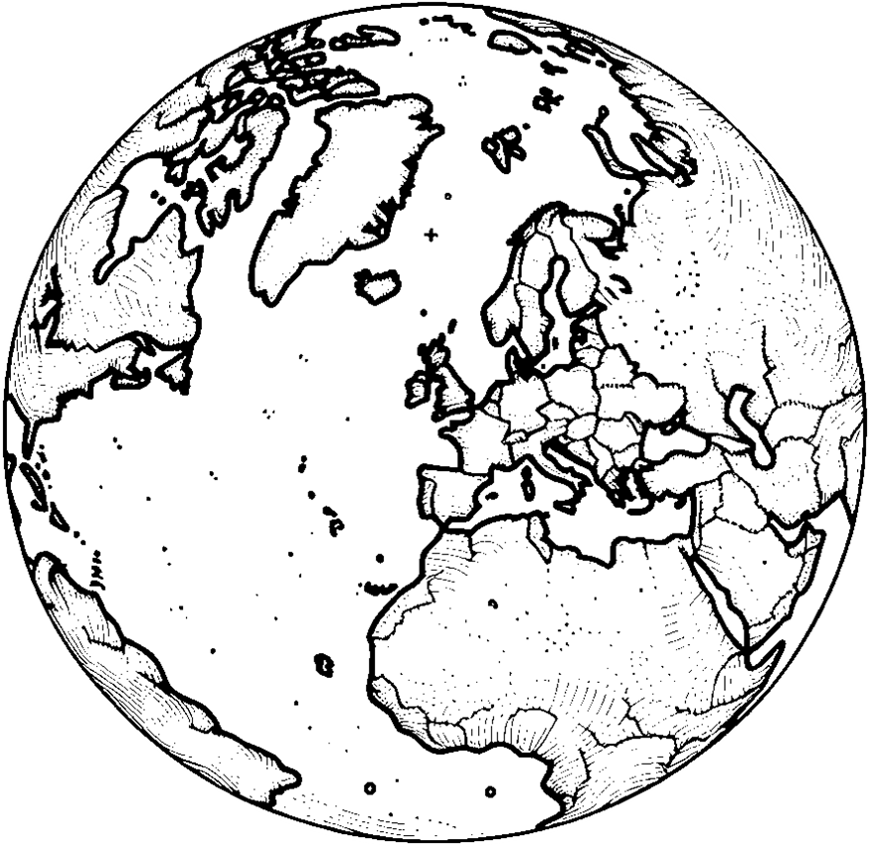
4x Global Brokers subscribe to Notification Messages from WIS2 Nodes and republish the messages for onward distribution
Global
Broker
HTTPS
MQTTS
nl-knmi-nmc
WCMP2
Global Brokers also subscribe to each other for resilience, discarding duplicate messages they have already received and republished – fully meshed network is not required
JSON
Notes:
4x Global Brokers subscribe to Notification Messages from WIS2 Nodes and republish the messages for onward distribution
Global Brokers also subscribe to each other for resilience, discarding duplicate messages they have already received and republished – fully meshed network is not required
[Image of Earth created with Microsoft Copilot / DALL-E 3: “a simple black and white line image of the Earth centred on the UK”]
[Flags from Vecteezy.com: https://www.vecteezy.com/vector-art/1936193-set-of-rounded-flags-of-the-world]

Slide 26
5x Global Caches each subscribe to Notification Messages from at least 2x Global Brokers, discarding duplicate messages
Global
Cache
HTTPS
MQTTS
nl-knmi-nmc
WCMP2
JSON
Notes:
5x Global Caches each subscribe to Notification Messages from at least 2x Global Brokers, discarding duplicate messages
UK/USA (Met Office, NOAA) jointly provide a service on AWS publishing data through ASDI
China operate both Global Broker and Global Cache
[Image of Earth created with Microsoft Copilot / DALL-E 3: “a simple black and white line image of the Earth centred on the UK”]
[Flags from Vecteezy.com: https://www.vecteezy.com/vector-art/1936193-set-of-rounded-flags-of-the-world]

Slide 27
On receipt of a Notification Message, a Global Cache downloads a copy of the data for public access and publishes a new Notification Message advertising that the data is available there. Global Brokers subscribe to those Notification Messages and republish them
HTTPS
Global
Cache
MQTTS
nl-knmi-nmc
WCMP2
JSON
Global Caches will receive Notification Messages advertising data from other Global Caches. If they have not already downloaded the data from the “origin” WIS2 Node, they download a copy from the peer Global Cache and publish a Notification Message that they have it too
Notes:
On receipt of a Notification Message, a Global Cache downloads a copy of the data for public access and publishes a new Notification Message advertising that the data is available there.
Global Brokers subscribe to those Notification Messages and republish them.
Global Caches will receive Notification Messages advertising data from other Global Caches. If they have not already downloaded the data from the “origin” WIS2 Node, they download a copy from the peer Global Cache and publish a Notification Message that they have it too.
[Image of Earth created with Microsoft Copilot / DALL-E 3: “a simple black and white line image of the Earth centred on the UK”]
[Flags from Vecteezy.com: https://www.vecteezy.com/vector-art/1936193-set-of-rounded-flags-of-the-world]

Slide 28


2x Global Discovery Catalogues curate discovery metadata published by WIS2 Nodes allowing users to find datasets that meet their needs and see how to access data / subscribe to notifications
search engines
HTTPS
Global
Discovery
Catalogue
MQTTS
nl-knmi-nmc
WCMP2
Global Discovery Catalogues are indexed by search engines allowing users to discover datasets using their preferred means
JSON
Notes:
2x Global Discovery Catalogues curate discovery metadata published by WIS2 Nodes allowing users to find datasets that meet their needs and see how to access data / subscribe to notifications
Metadata distribution uses the same mechanism as is used for data: Notification Messages to advertise availability and indicate where it can be downloaded from
Global Discovery Catalogues are indexed by search engines allowing users to discover datasets using their preferred means
China operate Global Broker, Global Cache and Global Discovery Catalogue
[Image of Earth created with Microsoft Copilot / DALL-E 3: “a simple black and white line image of the Earth centred on the UK”]
[Flags from Vecteezy.com: https://www.vecteezy.com/vector-art/1936193-set-of-rounded-flags-of-the-world]

Slide 29
2x Global Monitors collect metrics from all other Global Services and publish real-time dashboards to indicate the health of the WIS2 system. Alerts are triggered when intervention is required by a service operator
HTTPS
MQTTS
nl-knmi-nmc
WCMP2
Global
Monitor
JSON
Notes:
2x Global Monitors collect metrics from all other Global Services and publish real-time dashboards to indicate the health of the WIS2 system. Alerts are triggered when intervention is required by a service operator.
Metadata distribution uses the same mechanism as is used for data: Notification Messages to advertise availability and indicate where it can be downloaded from
China operate all 4 types of Global Service: Global Broker, Global Cache, Global Discovery Catalogue and Global Monitor
[Image of Earth created with Microsoft Copilot / DALL-E 3: “a simple black and white line image of the Earth centred on the UK”]
[Flags from Vecteezy.com: https://www.vecteezy.com/vector-art/1936193-set-of-rounded-flags-of-the-world]

Slide 30
So – I start by searching for the data that I need using my favourite search engine
Then subscribe to notifications from one of the Global Brokers listed in the metadata
search engines
And download from the Global Cache mentioned in the first Notification Message to arrive
Notes:
[Image of Earth created with Microsoft Copilot / DALL-E 3: “a simple black and white line image of the Earth centred on the UK”]
[Flags from Vecteezy.com: https://www.vecteezy.com/vector-art/1936193-set-of-rounded-flags-of-the-world]

Slide 31
Thank you
Merci

Slide 32

A joint initiative between WMO and HMEI on standardization of data collection
The "first mile" in meteorological data collection represents a critical yet often overlooked segment in the flow of observational data.
The lack of standardization in this initial data collection phase has led to significant challenges for NMHSs.
1
2
3
4
5
6
The WMO Commission for Observation, Infrastructure and Information Systems (INFCOM) has created the “Task Team on First-mile Data Collection Standardization (TT-First-Mile)” to address those challenges.
WMO and HMEI experts are working together for the benefice of our community

