Slide 1

Peer Advisor & Implementing Entity Workshop
Introduction and objectives of the workshop
9 – 10 October 2024

Slide 2
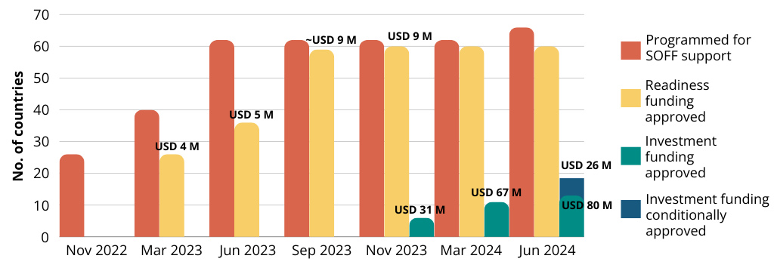
Evolution of SOFF portfolio

Slide 3
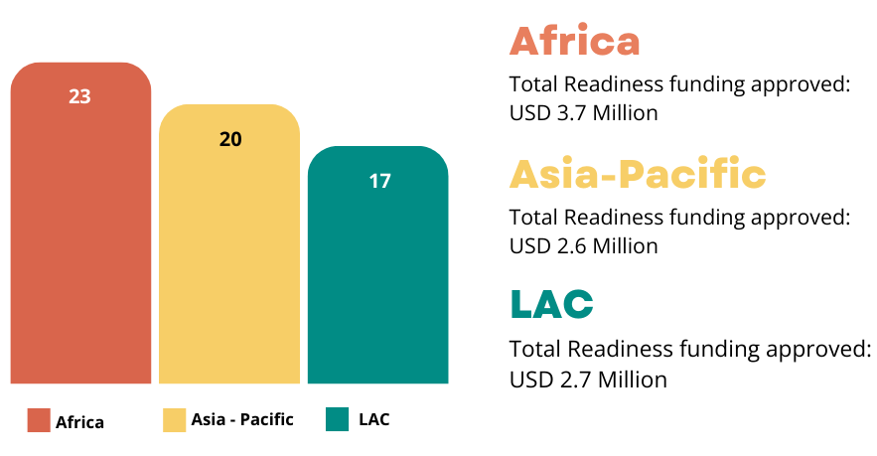
Regional breakdown

Slide 4
13 approved SOFF FRs
Country | Date of approval | IE | Peer advisor | Partner peer advisor | Amount approved (in USD) | Amount disbursed (in USD) | Status
Belize | Nov 2023 | IADB | United Kingdom |  | 864,543 |  | Not yet started
Bhutan | Mar 2024 | UNEP | Finland |  | 4,624,024 | 3,514,453 | Under implementation
Cabo Verde | Mar 2024 | UNEP | Netherlands |  | 3,879,118 | 2,883,272 | Under implementation
Chad | Jun 2024 | WFP | Austria |  | 6,980,083 |  | Not yet started
Ethiopia | Mar 2024 | UNDP | Norway | Finland | 9,956,803 | 6,701,576 | Under implementation
Kiribati | Nov 2023 | UNEP | Australia |  | 11,155,102 | 9,715,184 | Under implementation
Maldives | Nov 2023 | UNEP | Finland | Indonesia | 4,907,326 | 4,149,791 | Under implementation
Mozambique | Nov 2023 | WFP | South Africa |  | 7,892,560 | 5,373,477 | Under implementation
Rwanda | Nov 2023 | UNDP | Finland |  | 3,535,377 | 2,473,185 | Under implementation
Solomon Islands | Mar 2024 | UNDP | Australia |  | 8,488,524 | 5,732,049 | Under implementation
South Sudan | Nov 2023 | AfDB | Austria |  | 2,480,496 |  | Not yet started
United Republic of Tanzania | Mar 2024 | UNDP | Denmark |  | 9,067,504 | 5,272,437 | Under implementation
Uganda | Jun 2024 | IsDB | Netherlands |  | 6,316,536 |  | Not yet started
 |  |  |  | Total | 80,147,997 | 45,815,424 (57%)

Slide 5
5 additional conditionally approved
Country | Date of conditional approval | IE | Peer Advisor | Partner Peer Advisor | Amount (in USD)
Madagascar | Jun 2024 | AfDB | Germany |  | 4,434,771
Malawi | Jun 2024 | UNDP | Norway | Iceland | 3,876,356
Nauru | Jun 2024 | UNEP | Australia |  | 6,194,529
Samoa | Jun 2024 | World Bank | Australia |  | 6,005,375
Timor-Leste | Jun 2024 | UNEP | Finland | Indonesia | 5,756,742
 |  |  |  | Total | USD 26,267,773

Slide 6
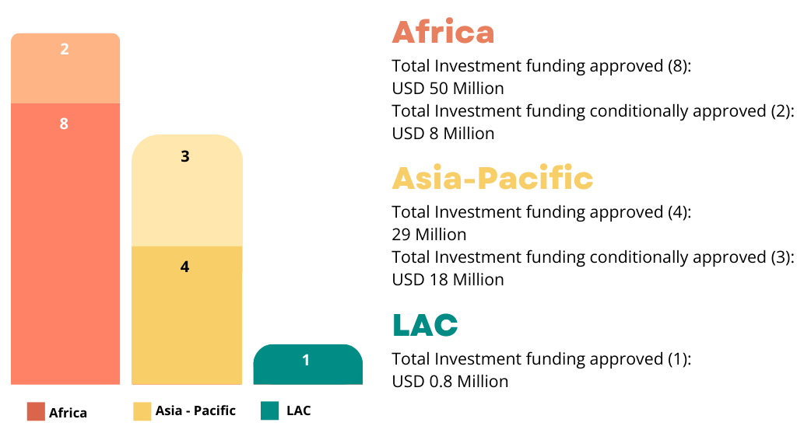
Regional distribution

Slide 7
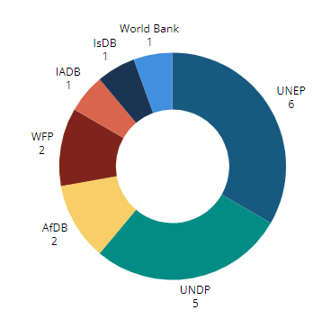
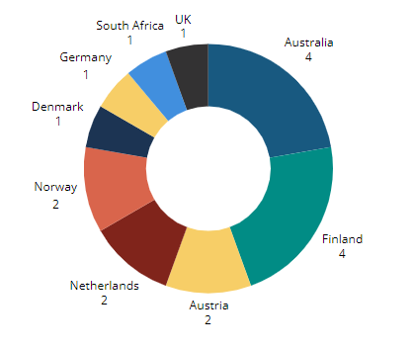
Operational partner breakdown
Peer advisors Implementing entities

Slide 8
Disbursements to date

Slide 9
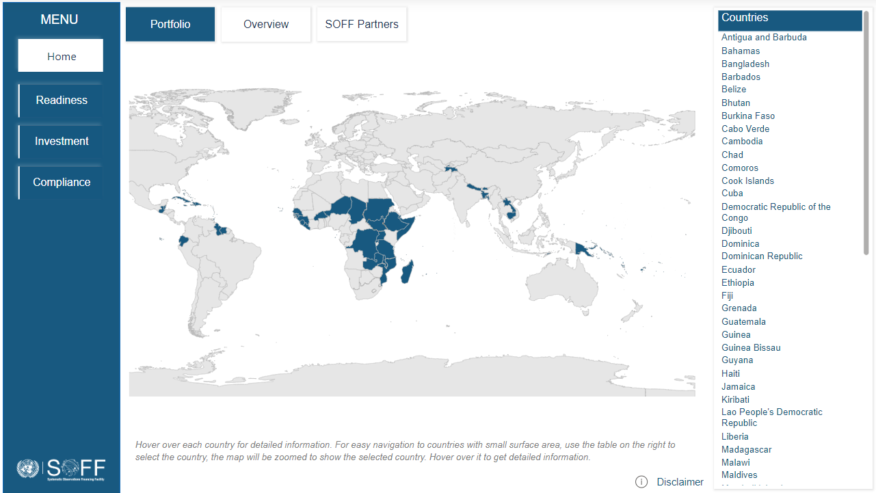
SOFF portfolio and implementation progress

Slide 10
Countries on track to complete Readiness
Country | Peer Advisor | IE | NGA | NCP | CHD
Liberia | Nigeria | AfDB | Completed | Completed | Completed
Fiji | Australia | World Bank | Completed | Completed | Completed
Zambia | United Kingdom | WFP | Completed | Completed | Completed
Nepal | Finland | UNEP | Completed | Completed | Final Stage
Papua New Guinea | Australia | UNDP | Completed | Completed | Completed
Bangladesh | Norway-China | IsDB | Completed | Completed | Completed
Senegal | Netherlands | IsDB | Completed | Submitted | Completed
Cambodia | United Kingdom | World Bank | Completed | Submitted | Completed
Antigua and Barbuda | United Kingdom | UNDP | Submitted- close | Submitted - close | Completed
Guinea Bissau | Portugal | UNEP | Submitted- with Peer | Submitted- with Peer | On track
Sao Tome and Principe | Netherlands | UNDP | Completed | Completed | Completed
DRC | Switzerland | AfDB | Completed | Completed | Submitted
Cuba | Spain | UNDP | Completed | Completed | Final Stage
Marshall Islands | United Kingdom | UNEP | Completed | Completed | On track
Dominican Republic | Spain | WFP | Completed | Submitted -with peer | Final Stage
Micronesia | United Kingdom | UNEP | Completed | Completed | On track
Grenada | Spain | N/A | Submitted | Submitted | Submitted - reviewed, peer adviser to revise and submit 2nd version
Palau | United Kingdom | UNEP | Completed | Completed | On track
Suriname | Netherlands | UNDP | Completed | Submitted | Completed

Slide 11
Submission deadlines for Investment funding requests
 | 10SC (Feb) | 11SC (May)
Readiness - submission of outputs | 31-Jul-24 | 15-Nov-24
Readiness - approval of outputs | 30-Sep-24 | 10-Feb-25
Investment – FR first draft | 18-Oct-24 | 21-Feb-25
Investment - FR final draft | 30-Nov-24 | 5-Apr-25
Steering Committee meeting | 6-Feb-25 | 20-May-25

