Slide 1

Peer Advisor & Implementing Entity Workshop
Session 4: Sharing lesson learned: Learning platforms, SOFF Moodle and Compliance Help desk
9 – 10 October 2024

Slide 2
Consultation on SOFF LearnConnect
SOFF tailored webinars have provided a platform for exchange and sharing on specific topics, scheduled at particular times
CHD community of practice
Announcements and updates from the SOFF Secretariat are primarily circulated via email, as well as technical questions from individual peer advisors
Propose idea to have a platform for learning material repository, sharing between peers and WMO and SOFF Sec, and is accesible to all peer advisors at anytime
Having the SOFF LearnConnect on WMO’s Moodle Education and Training (ETR) platform will allow access to other relevant learning materials and online courses within WMO.

Slide 3
Objective of the platform
To serve as a repository for learning materials that support countries and peer advisors thorough SOFF phases
To function as a hub for discussions and experience sharing
To provide a channel for the SOFF Secretariat to announce updates and communicate with peer advisors

Slide 4
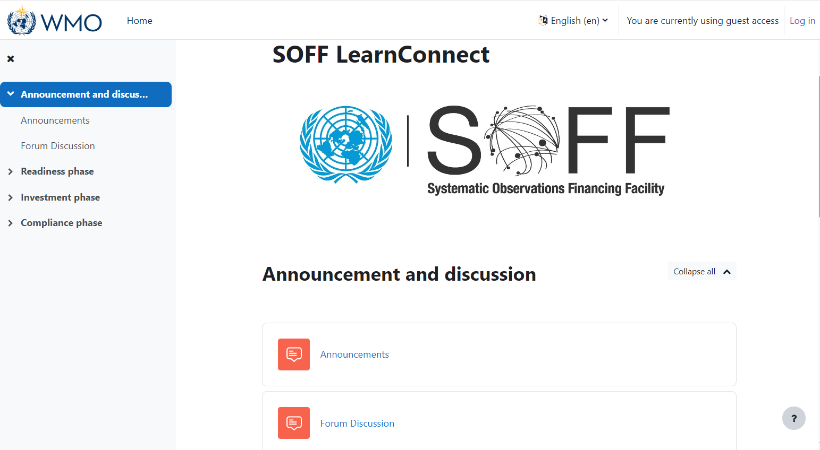
Functional Specifications
SOFF LearnConnect would be open to everyone (unless otherwise agreed to be exclusive for SOFF Peer Advisors).
To contribute to discussions and receive notifications for new posts, Peer Advisors need to create an account on the WMO ETR Moodle and assign it to SOFF LearnConnect.
With an account on the WMO ETR Moodle, Peer Advisors can access other learning materials or online courses on WMO Moodle, such as the WMO Private Public Engagement course.
Course: SOFF LearnConnect | ETRP Moodle Site (wmo.int)

Slide 5
Thank you

