Slide 1
SOFF
Education & Training vs
Collaboration &
WMO Global Campus
Heleen ter Pelkwijk
Notes:
Slide 1;

Slide 2
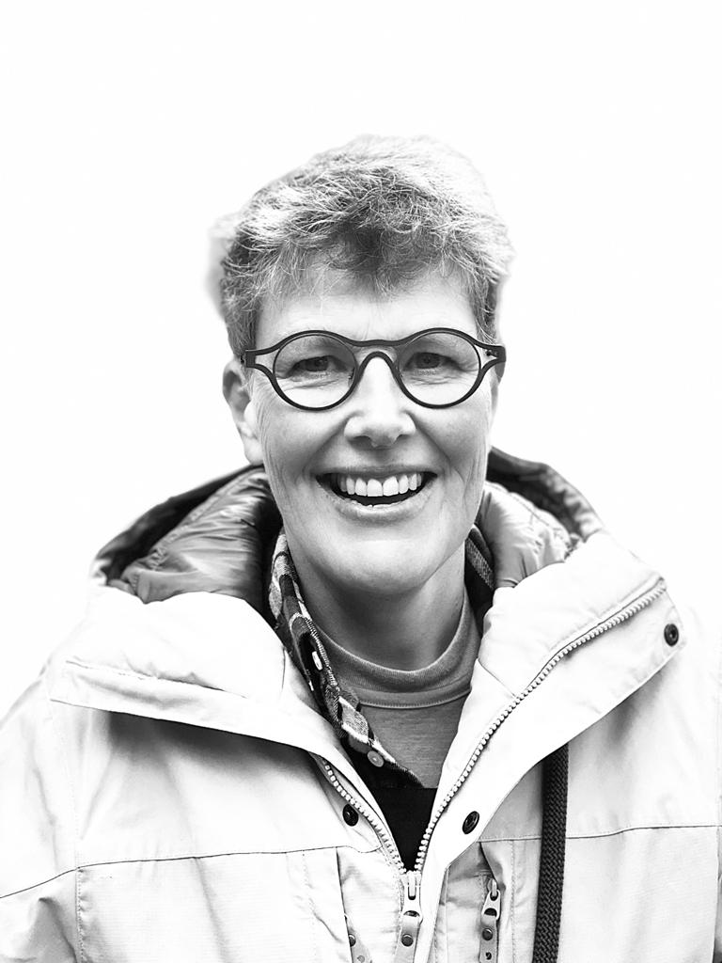
Heleen ter Pelkwijk
Contact; Heleen.ter.Pelkwijk@knmi.nl
Notes:
Slide 2;
Hai everyone, I am Heleen ter Pelkwijk
Sorry for not being able to join you in the Bilt But hope that this way to interact with each other will work out well.
I have been active in multiple Education and Training roles since 2008
I am working in and am supporting the national and international meteorological education and training community in many different way and in the meantime I have gained a lot of experience in providing training for professionals at meteorological institutes.

Slide 3

WMO SOFF Programme
A GAP Analysis / Identification of the Needs. This often includes also Training Needs
A plan is made based on all those needs
The funding is arranged based on this plan.
The plan is being executed
Notes:
Slide 3;
That was why I was asked by the people of our KNMI SOFF peer advisors team to support them with the education and training part of their job. When I asked them a couple of questions about the expected ways of working, availability of re-usable training materials and collaboration within the SOFF programme I learned that the SOFF programma was set up as followed;
#klik#
First a GAP Analysis is done and This often includes also Training Needs
#klik#
2) Then A plan is made based on all those needs
#klik#
3) The funding will be arranged based on this plan.
#klik#
4) And then the plan is being executed by the implementation entities.
In the basis there is absolutely nothing wrong with this approach, but from education & training perspective I have a few considerations I would like to share with you.

Slide 4
Considerations
Many organisation develop and provide more or less the same kind of Education and Training to their supporting countries
Long-Term Sustainability for the produced E&T materials?
The need for Education and Training on GBON related to subjects to continues operation and maintenance of observation networks is much wider than only LDCs and SIDS.
The WMO Global Campus Initiative
Notes:
Slide 4
First;
#klik#
Each SOFF plan hopefully includes a training plan with solutions to learn the staff of the local NMHS how best install, run and maintain the new equipment and networks of their local observation stations in such a way that the quality and availability of essential data will meet the observation standards of GBON. The education and training events are often provided in a classroom and in a on the job format. This is great thing! But think how this most probably will be executed……From my experience I guess is that most probably 20 peer advisors will develop and provide 60 more or less similar education and training packages for the SOFF countries. #klik#
Then please think of the materials which are left after such series of classroom trainings and on the job training tracks. Will that material be long-term sustainable? What i see around me is that those materials will most often consist out of PPTs and documents/readers. These materials are great if you have nothing at all, but you can wonder whether these materials are effective and efficient way to learn new things seen from the view of a new junior who need to become competent to do the job in the nearby future. For learning ideally course participants need to get the time to gain the needed information, Storing and retaining what has been learned, Applying what has been learned to real-world scenarios or specific tasks. Reflecting on the learning process, identifying areas of improvement and become fluent in the application of the new learned skills or knowledge. I think the first steps can be found in old PPT and readers but will this be an inviting way of learning for new employees? And as the rotation of personnel is often going fast in those countries there is definite a need for good sustainable training resources to fill the gap after the SOFF programme ends. #klik#
Did you know that within WMO competency frameworks are set which are defining competency standards, knowledge and skill for personnel installing and maintaining instrumentation, personnel preforming instrument calibration and personnel managing observation programmes and networks? In the last few months, I already have heard multiple countries who already have been questioned by their aviation authorities to prove that their personnel involved with their observation network is competent to do their job and realise what safety problems can be when something unexpectedly goes wrong. This means that Education and training in the GBON related subjects is not only necessary for the least developing countries and small island states, but there is a worldwide need for this type of training materials among the 193 WMO Members. #klik#
Last but not least we, within the Meteorological E&T community, are busy to get WMO Global Campus initiative up and running from which I deeply believe that this initiative should interact with this SOFF Programme and not living next to it.

Slide 5

WMO Global Campus
Collaborative Network
Goal;
To increase the capacity to educate and train professionals within WMO Member states and territories.
Assist closing the capacity gap.
How to achieve?
By increasing collaboration, cooperation and sharing between education and training institutions.
Open Access Resources
Community of Practice
Notes:
Slide 5; #klik#
The Goal of the WMO Global Campus is To increase the capacity to educate and train professionals within WMO Member States and territories and to assist closing the capacity gap within the community.
#klik# #klik# To this end, we are working hard to increase collaboration and sharing of knowledge and materials among Members of our community.
#klik#
The collaborative networks within our community includes WMO RTCs, Universities, NMHSs and Global Training Programs
#Klik#
We are working on Open Access of Resources which includes Tools, courses, webinars, and self-directed online learning modules
#Klik#
And we have a Global Community of Practice in which we are Sharing expertise and knowledge
For this reason I would like to #klik#

Slide 6
Challenge!
Connect the outcomes of this SOFF Programme in Education & Training with
the WMO Global Campus Initiative.
Use the available human AND financial resources in an effective way.
Make sure that those high-quality e-learning materials are widely shared.
Make sure that everyone is aware of these materials and motivate them to (re)use them.
Notes:
Slide 6;
to challenge you as SOFF secretariat, Peer advisors and implementing entities to connect the E&T outcome of this SOFF Programme in Education and training with the WMO Global Campus Initiative and become an active part of our Collaborative Network for the Education and training part of your Programme. #klik#
#klik#
This can be done by; #klik#
Taking this opportunity to make sure that both the available human resources as the financial resources are used in an effective way to develop the needed high quality learning resources one time with help of the community's SMEs AND a specialised instructional designer. #klik#
Make sure that those high-quality learning materials produced are shared widely within SOFF Community and the WMO Global Campus initiative. #klik#
Make sure that everyone is aware of these materials and motivate the full WMO community to (re)use these training materials within the Education and Training efforts they are going to provide.

Slide 7

Collaboration!
Notes:
Slide 7;
As you may understand from my story so far I am a huge fan of taking up these type of education and training challenges in collaboration and not on an individual basis as it is done right now. #klik#
For my feeling that is the only way you can use the scares money and human resources available for education and training in the most optimal way to create and share high quality place and time independent e-learning modules within the community that can support implementation entities and individual Members in their training activities at local level.

Slide 8


The EUMETCAL Programme
TITLE OF YOUR PRESENTATION
A EUMETNET Programme
Notes:
Slide 8;
Now I would like to be very clear. I am not here to promote the EUMETCAL programme! I only want to provide you with a successful example on how you can shape a possible collaboration within the SOFF programme. This example shows how money and resources available for education and training can be used in an effective way within a community like the SOFF Programme in such a way that the jointly created high quality time and place independent e-leaning materials can be re-used worldwide.

Slide 9



PROGRAMME OVERVIEW - GENERAL
Why Eumetcal?
Eumetcal is The EUMETNET Education and Training Collaborative Network of the National Meteorological Services within Europe.
Our Vision
Increase the education and training opportunities for its members.
Prevent members from doing double work
Provide a place to share and re-use training materials
Provide access to high quality training
How ?
A central place where members can ask questions and find answers to all their meteorological education and training related needs
Notes:
Slide 9
EUMETCAL is The EUMETNET Education and Training Collaborative Network of the National Meteorological Services within Europe
#klik
The goal of this collaboration is to increase the education and training opportunities for its Members and as we are all in the same kind of business, we want to prevent our members, mostly trainers, from doing double work.
#klik
We want to reach this by providing a place to share and re-use training materials which will then lead to less time, money and effort for even more education and training. Next to that we also do our best to make sure that the community will invest into the provision of high- quality training in order to make this model work more effective.
#klik
The Eumetcal programme facilitates this with a central place where members can ask questions and find answers to all their meteorological education and training related questions
EUMETCAL is a collaboration network under the umbrella of the WMO Global Campus.

Slide 10
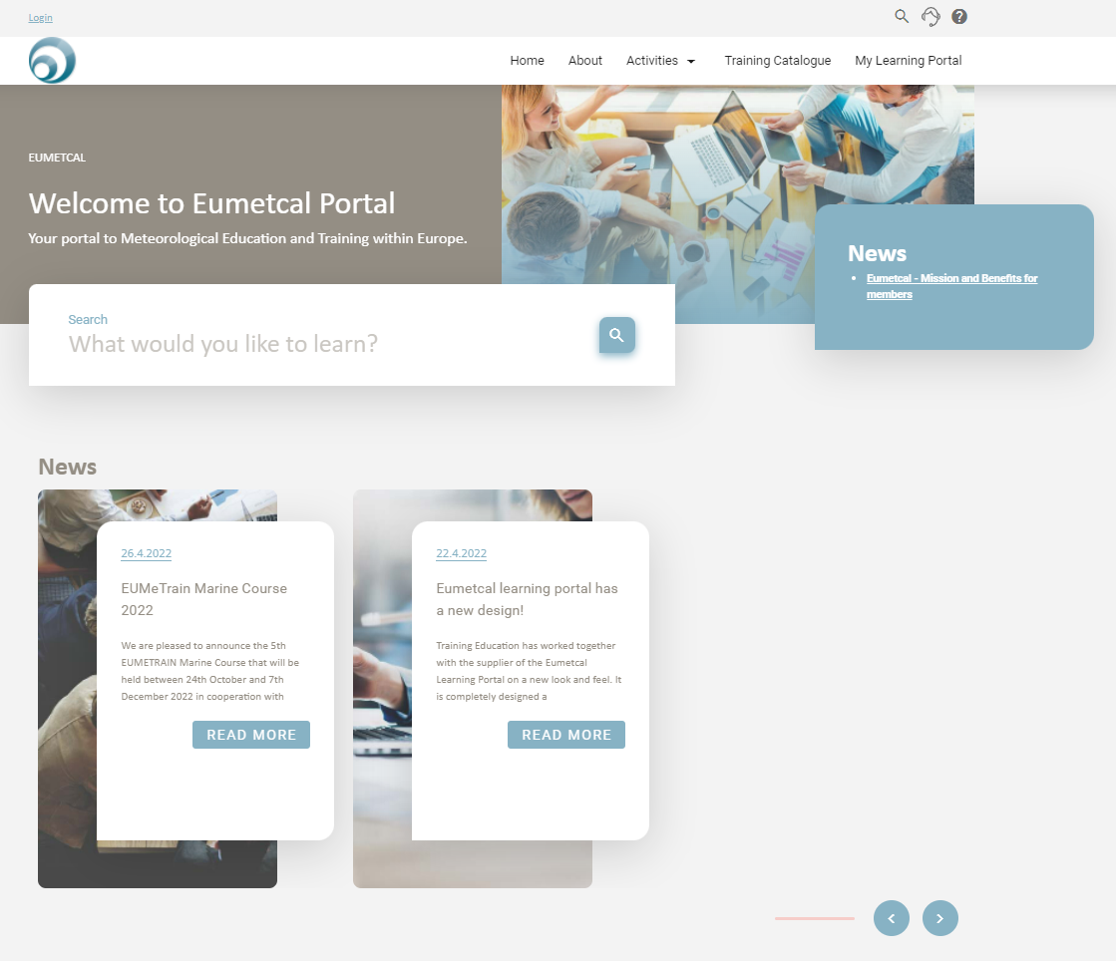







EUMETCAL Set-up I
…the eumetcal.eu homepage
Announcement of events
News and information
Facilitation of collaboration
Aims:
To intensify the collaboration among the members in the area of E&T.
…tools and accompanied support
Tools for online learning courses
Technical support
Aims:
To give people access to tools that enable them to provide high quality and cost-effective trainings
Notes:
Slide 10
the Eumetcal’s central place can be split into two parts
#klik
…. part one…. a good infrastructure plus the associated support for the members to be able use the tools for their own training at home and in the collaboration projects. This infrastructure consist out of a learning portal Eumetcal.eu where you can easily find, share and exchange learning events and material and a couple of online tools trainers can use during the training they provide.
EUMETCAL delivers these services locally in Europe but makes sure that when appropriate the announcement of events are shared within the WMO Global Campus initiative.
Zul just has shared the SOFF learning portal which could serve as the SOFF’s learning portal and can be used for many of the here mentioned functions. Please use it!

Slide 11
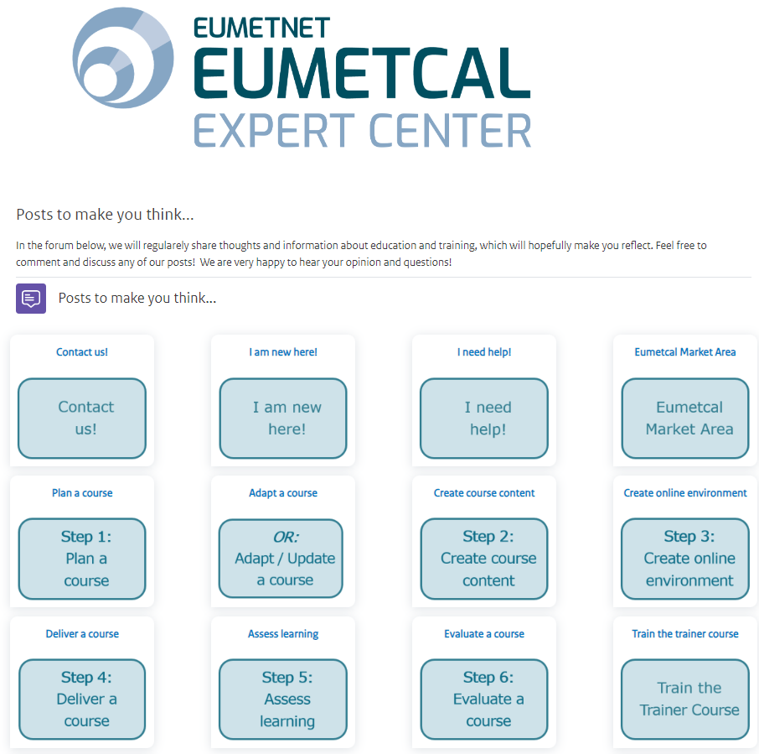

EUMETCAL Set-up II
…an Online Expert Center
Forum for exchange
Market area for collaboration
Inputs, resources and examples
Aims:
To build an active trainer community that will share its knowledge.
To support members in E&T issues.
…training opportunities for Trainers
Interactive hands-on webinars
On-demand coaching sessions for a specific group of trainers
Individual meetings and support
Aims:
To help trainers to increase their skills and capabilities related to online or blended learning courses.
Notes:
Slide 11;
Next to the infrastructure that we offer, there is also a service for all the trainers in the community.
Within our community we usually work with professionals who have no background in education and training apart from what they have experienced themselves in an earlier moment in life. Therefore we have 2 Instructional Designers who support the EUMETCAL trainers to take the step from the traditional classroom training to blended or online training formats.
We do this in 2 ways: #klik#
First of all, we have the Online Expert Center. The idea of this expert center is that trainers or other people responsible for E&T can find resources about how to develop, design and deliver online and blended training.
#klik#
The other offering is the training opportunities for the trainers. We offer interactive hands-on webinars, on-demand coaching sessions or also individual meetings and support. The aim is to help the trainers to increase their capabilities in designing, developing and delivering online and blended training courses so that we will get high quality learning material.
We do all this work for the EUMETCAL Programme with 4 people working in total 2,25 FTE with a lot of in-kind support f our EUMETCAL Members.

Slide 12

PROGRAMME OVERVIEW
The thoughts behind this set-up
Effective self-paced online learning materials of a good quality
- facilitates (re)use of those materials by others
- has the potential to reach a large group of people
Work done at local level can be used by the whole community
ALL members should be enabled and motivated to take their share in this collaboration
Notes:
Slide 12
The thoughts behind this set up are that
#klik
Effective self-paced online learning materials of a good quality facilitate the (re)use of those materials by others and (#klik) has the potential to reach large groups of users.
#klik
A lot of the work that needs to be done is already done at local level and we want to leverage that work to the wider community
#klik
And last but not least by offering this basic Eumetcal set-up to the full community you enable ALL members to take their own share in this collaboration

Slide 13
PROGRAMME OVERVIEW
The EUMETCAL Programme
facilitates the EUMETCAL Community to collaborate and to prepare & share high quality learning opportunities & materials among each other.
This means;
Most work needs to be done by subject matter experts & trainers from the Members of the community.
The EUMETCAL Programme supports this work with;
- Tools
- Educational Knowledge & Skills
- Activities
Notes:
Slide 13
So the EUMETCAL programme facilitates the EUMETCAL Community to collaborate in the area of education and training and to prepare & share high quality learning opportunities and materials among each other. #klik#
This means that EUMETCAL is not like a company you can go to to ask to deliver a finished training product to your target audience BUT (#klik#) a community in which subject matter experts and trainers of Members, work together on creating training materials supported by the EUMETCAL programme with tools, educational knowledge & skills and activities like hackathons to make sure that the learning opportunities being created are effective, of a good quality.

Slide 14
Inspiration of what can be done in collaboration
WMO Public Private Engagement (PPE);
https://etrp.wmo.int/course/view.php?id=277
Electrical Phenomena module;
https://360.articulate.com/review/content/02b2a682-e7d7-4d7e-9b66-07edcfdf42e3/review
Determine and Communicate Risks of Heavy Precipitation Using Ensemble Prediction Systems;
https://360.articulate.com/review/content/d406da61-3b77-41d5-98b2-cdc1dc4e6577/review
We also share our materials with other communities' LMSs using LTI connections when asked for
Notes:
Slide 14;
Here some inspiration work that has been done within the EUMETCAL collaboration. These are review links so that makes things easier to step through them to show you different contents.
The WMO has created some beautiful materials on Public Private engagement. We don’t want to redo that so we why have linked this material to our EUMETCAL portal so our community can find these materials easily
Then MeteoSwiss and KNMI have decided together that a series of e-learning modules was needed to cover the BIP-M requirements for optical en electrical phenomena. Here you have a quick view of a module delivered by Dorothe from KNMI and our EUMETCAL Instructional designer Fabienne werder.
Last but not least we organise hackathons to jointly work with subject matter expert and trainers from the community on learning materials. Here you see a module that we were able to produce during one of the hackathons in 2023 with the support of KNMI, SMHI and MetEireann.
When asked for we also share our materials with the LMS systems from other communities.The EUMeTrain satellite training modules our ID helped to design and we are hosting on our portal are for instance shared with the EUMETSAT LMS and used for training activities in Africa
(I am going to provide a very quick tour through these materials)
If you want to see more ..... at the end of the presentation I will add a slide with direct links to these modules.

Slide 15
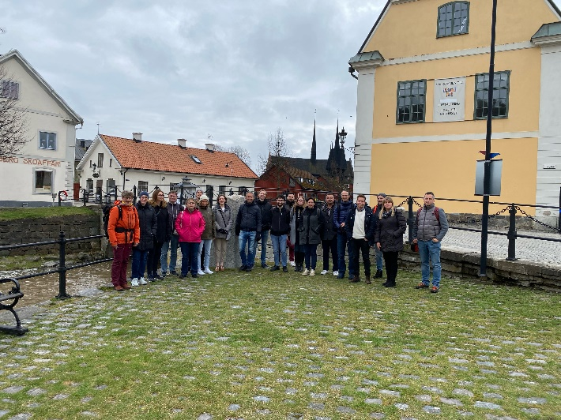
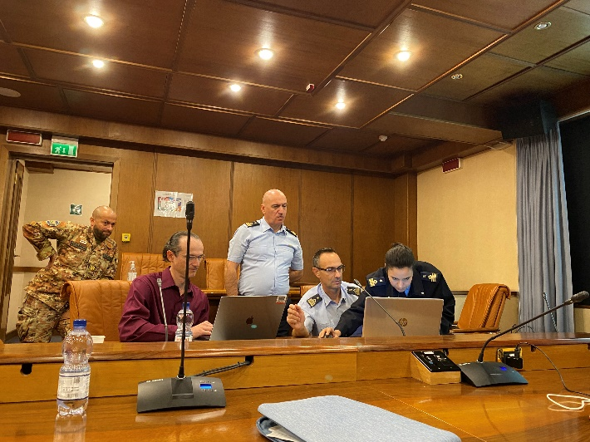
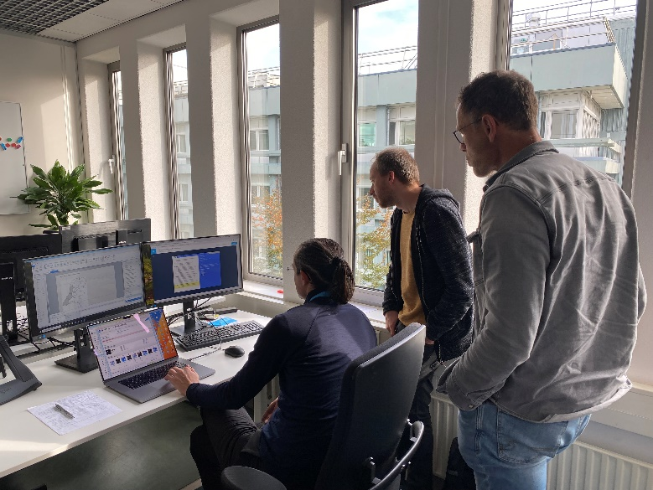
Hackathon / individual support actions are Successful!
E-learnings on
Optical Phenomena - Polar stratospheric clouds and noctilucent clouds
Mountain Wave Turbulence for Aviation
Determine and Communicate Risk Using EPS
Determine Warning Levels Based on Impacts
Space Weather Decision Support for Aviation
E-GAFOR
H-SAF
Basic satellite course;
      - Identify surface features
      - Identify cloud types and their characteristics
      - Identify and interpret atmospheric phenomena
Electrical Phenomena
Notes:
Slide 15;
We found that especially organising Hackathon activities in which we jointly work for one week with, subject matter expert, trainers and instructional designers to create learning materials are a very effective way of creating effective learning materials. Compared to the normal way of working we get loads of work done in a relative short period of time
The 3 hackathons we did last year has resulted in 5 e-learning packages and the individual support that our instructional designers provided to Member Organisations during the past two years has resulted in 6 extra e-learnings.

Slide 16

Collaboration!
Notes:
Slide 16;
Hope this example have made you curious enough to be motivated to invest in collaboration in Education and Training within this SOFF programme and that you will
#klik#
Use the available time left to discuss how this could be done

Slide 17
Please feel free to contact me if any questions pop-up or need help in a later stage. I am very happy to help you think how we can change our way of working for the benefit of our full WMO community
Contact; Heleen.ter.Pelkwijk@knmi.nl

Slide 18
Additional information!

Slide 19

“Where can I find the WMO Global
Campus? How can I join?”
The WMO Global Campus is all around us, including all WMO Members that offer education and training services.
You do not need to join in any official way.
You will be a part of it whenever you use the resources it offers and make your own contributions to the initiative.

Slide 20

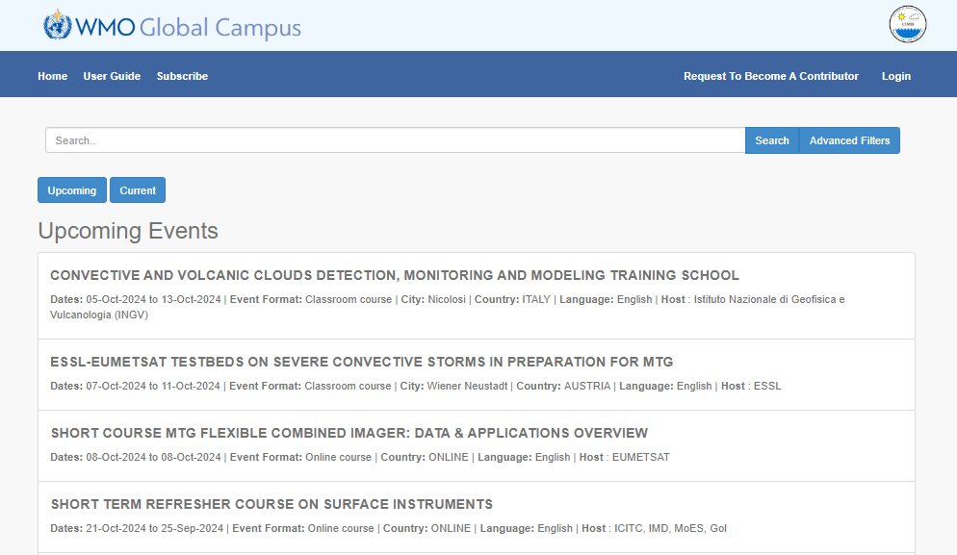
Calendar of Events
Provides information on courses and other learning opportunities in all WMO regions.
Users can subscribe to receive alerts when new events are added.
https://learningevents.wmo.int

Slide 21

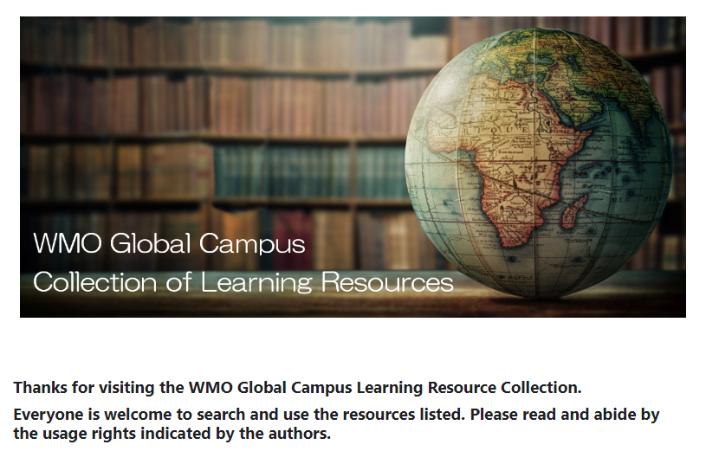
WMO Global Campus Collection of Learning Resources
Searchable collection of shared learning resources.
The resources will be useful for both training providers, to aid in the creation of courses and course materials, and individual learners
https://etrp.wmo.int/course/view.php?id=346#section-0

Slide 22
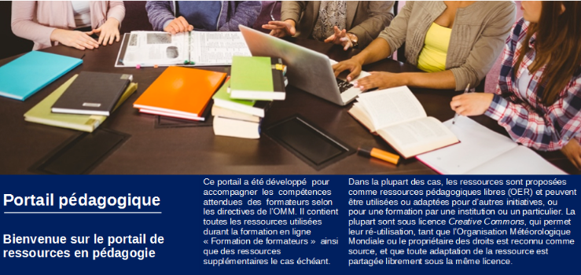
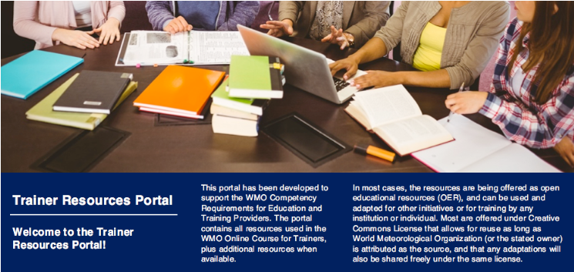
Trainer Resources Portal
Developed to support the WMO Competency Requirements for Education and Training Providers.
Available in English and French.
Spanish version is in preparation.
English - https://etrp.wmo.int/course/view.php?id=30
French - https://etrp.wmo.int/course/view.php?id=136

Slide 23
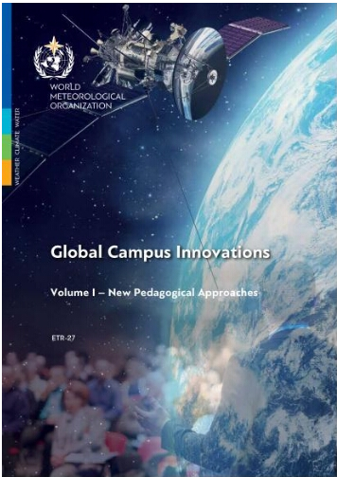
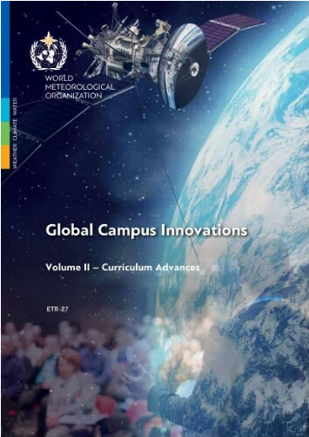
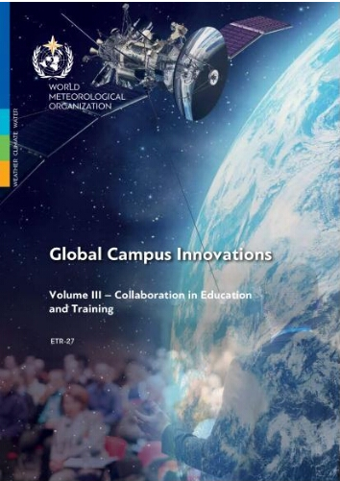
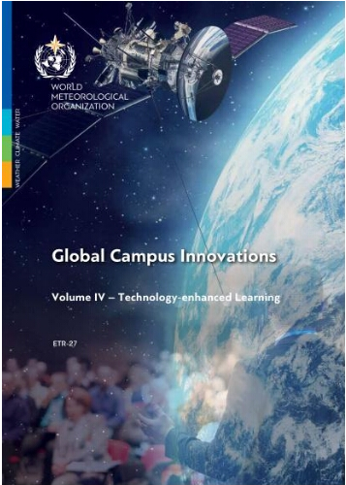
WMO Global Campus Innovations
Volume I – New Pedagogical Approaches
Volume II – Curriculum Advances
Volume III – Collaboration in Education and Training
Volume IV – Technology-enhanced Learning
https://library.wmo.int/records/item/35791-global-campus-innovations?offset=1
https://library.wmo.int/records/item/57235-global-campus-innovations?offset=2
https://library.wmo.int/records/item/57242-global-campus-innovations?offset=3
https://library.wmo.int/records/item/57245-global-campus-innovations?offset=4

Slide 24
Tools and Resources
COMET Translation Resource Center https://www.meted.ucar.edu/education_training/lesson/1293#.WMp4fOSQFvC
African Satellite Meteorology Education and Training (ASMET) https://www.meted.ucar.edu/communities/asmet/
Workbook on the Application of Conceptual Models in Weather Forecasting for South America (Spanish) https://crf.smn.gob.ar/course/view.php?id=16
And more…

Slide 25
Links to recent e-learning materials in the EUMETCAL Catalogue
The EUMETCAL portal; https://Eumetcal.nl
Since January 2023 we have been able to make available;
Collaboration with EUMeTrain has resulted in the launch of three self-paced e-learning modules that are part of the Basic Satellite Course
  1. Identify surface features.
  2. Identify cloud types and their characteristics.
  3. Identify and interpret atmospheric phenomena.
  These three modules cover three of the seven enabling skills that support the WMO Competency Frameworks related to the use of satellite data by operational meteorologist
The Determine and Communicate Risk Using EPS e-learning module
The Optical Phenomena - Polar Stratospheric Clouds and Noctilucent Clouds . e-learning module
The Mountain Wave Turbulence for Aviation e-learning module
The “Determine Warning Levels based on Impacts” e-learning module
The “Space Weather Learning Pathway” e-learning module
The "Electrical Phenomena" e-learning module
A link to the WMO Public Private Engagement e-learning
A link to external “H-SAF training material” to our learning portal.
We would like to thank the EUMeTrain Programme, Met Éireann, SMHI, DWD, M-NAV, MetNo, ItAF, MeteoSwiss, KNMI, the WMO and the CIMA Foundation for making this work possible.

