Slide 1

Peer Advisor & Implementing Entity Workshop
Session 1: Reflections on the process of moving from SOFF Readiness to Investment Phase
Good practices in observing network design and the GBON national contribution plan
9 – 10 October 2024

Slide 2
Best practice
Full consideration of all modules in NCP+
Module 1. GBON National Contribution Target
Module 2. GBON business model and institutional development
Module 3. GBON infrastructure development
Module 4. GBON human capacity development
Module 5. Risk Management
Module 6. Transition to SOFF investment phase
Long-term view to compliance phase
  Consideration of phasing, sustainability, co-investment, NMHS capacity – institutional and human
TA: GBON Tech Regs – horizontal resolution
TA: Guidance on instrumentation, maintenance &
calibration, WIS 2.0

Slide 3
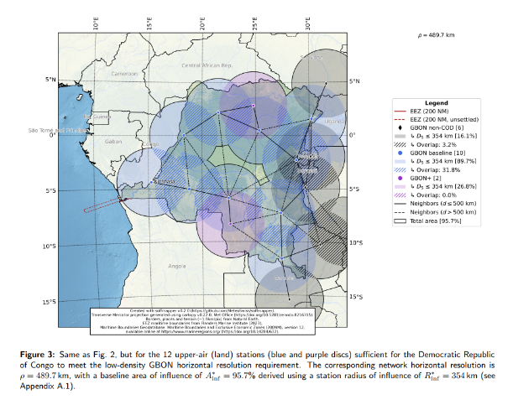
Module 1
National contribution target
Good practice
Many methods, all acceptable, to look at horizontal resolution
Poor practice
Tendency to push limits in asking for more stations – sustainable in compliance phase?
NGA Dem Rep Congo, MeteoSwiss

Slide 4
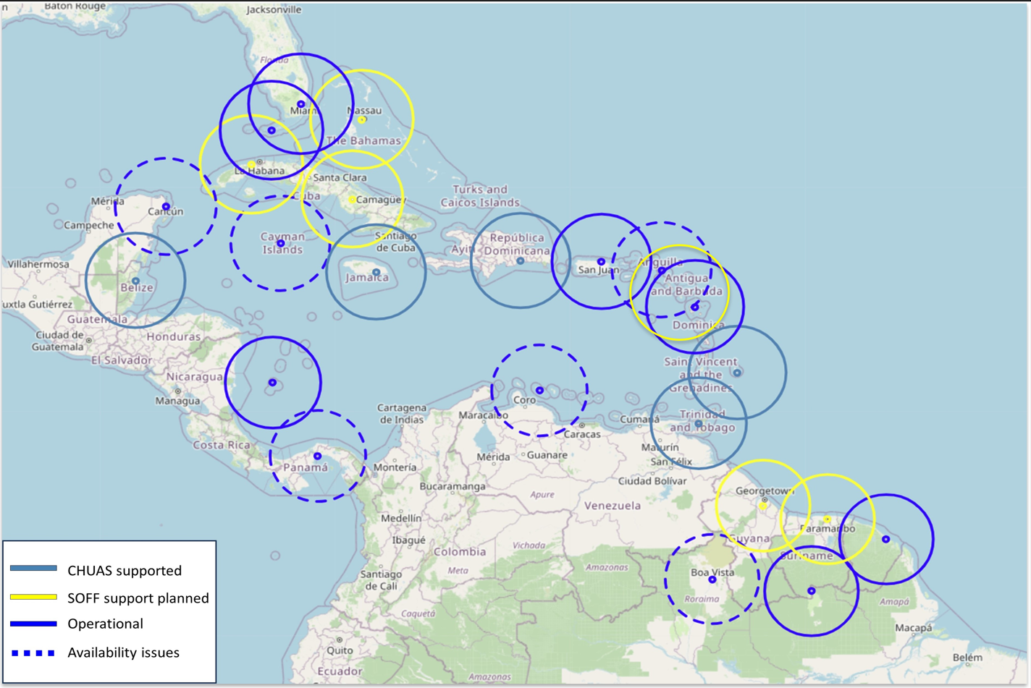
Module 1
Regional / national contribution target
Good practice
Caribbean upper air stations – generally good self-organization in balancing national capacity, ambition, consideration of existing commitments
Working to formalize through WMO Regional Association

Slide 5
Module 1
National contribution target
Good practice
Comprehensive analysis and leveraging of parallel investments in infrastructure
Station investment in Pacific through CIS-Pac 5
Upper air stations in Africa through ASECNA

Slide 6
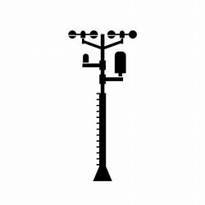





Module 3
Infrastructure development
GBON station compliance
Availability ≥80%
Timeliness <5%
Quality <5%
Security
Power
Comms
Comms
WIS2 node
Station
Data
processing
centre
WMO
Information
System
Global NWP
centre
Consumables
Regular maintenance and calibration
Human and institutional capacity to support the infrastructure
WIGOS
Data Quality
Monitoring
System
WDQMS

Slide 7
Module 3
Infrastructure development
GBON compliance: Taking and sharing of quality data, appropriate to the development context / country capacity, not necessarily your standard solution
Instrumentation
Operations and maintenance plan
Reasonable approaches to calibration
  considering human/institutional resource
  at minimum, field verification kits and spares, with regular calibration of the kit
Accelerating transition to WIS 2.0 implementation
  multiple implementation models: private, public, cloud, regional

Slide 8
Institutional and human capacity
An area where best practice could/should emerge from sharing amongst peers, IEs, and beneficiary countries
Staffing levels required
  Retention problems – constant training need
Institutional capacity for long-term compliance: procurement, management
Potential phased approach
Inconsistencies in the approaches taken by peer advisors in the above

Slide 9
Areas for improvement for Readiness
General
Inclusion of relevant experts on specific topics from peer advisor during the development of readiness phase outputs
Peer advisors propose solutions based on own experience – sharing and learning needed to understand all proposed solutions
Need to prepare cost:benefit assessment of different options per country – for example on calibration

Slide 10
Areas for implement in Readiness output design
National Gap Analysis
Include coordinates for the newly installed stations, even if they are still tentative
Ensure alignment of the proposed improved stations with metadata stations in OSCAR/Surface. This is critical for our SOFF-funded stations database, as sometimes more than one station shares the same name
Ensure the affiliation of improved stations to GBON, without waiting for the investment phase to begin
National Contribution Plan
Assess the effectiveness and efficiency of various options for calibration: through the National Metrology Institution, Calibration Lab operated by NMHS, and Regional Instrument Centres
Comprehensive assesment on the other ongoing projects/initiatives, particularly for those related to meteorological observations and data exchanges
Coordinated technical trainings with other neighboring SOFF countries, where possible

