Slide 1

Peer Advisor & Implementing Entity Workshop
Introduction and objectives of the workshop
9 – 10 October 2024

Slide 2
Objectives
Fostering collaboration between the peers and IEs
Reflections on the process of moving from Readiness to Investment phase
Documenting lessons learned from the first 3 rounds of Investment funding requests
Discussion of the process moving forward

Slide 3
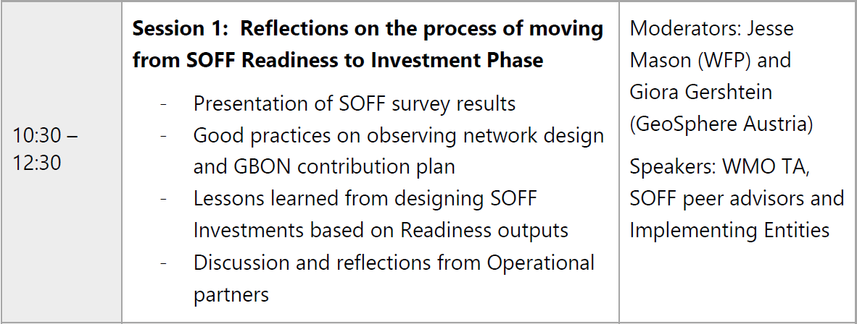
Agenda

Slide 4
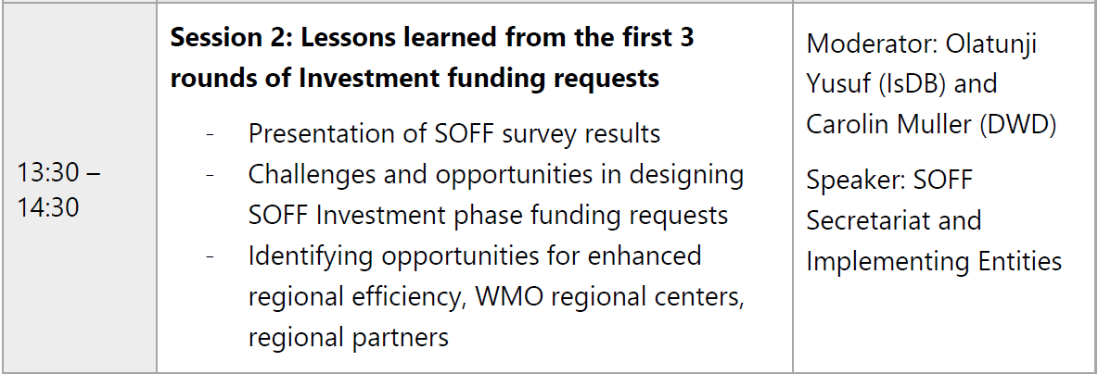
Agenda

Slide 5
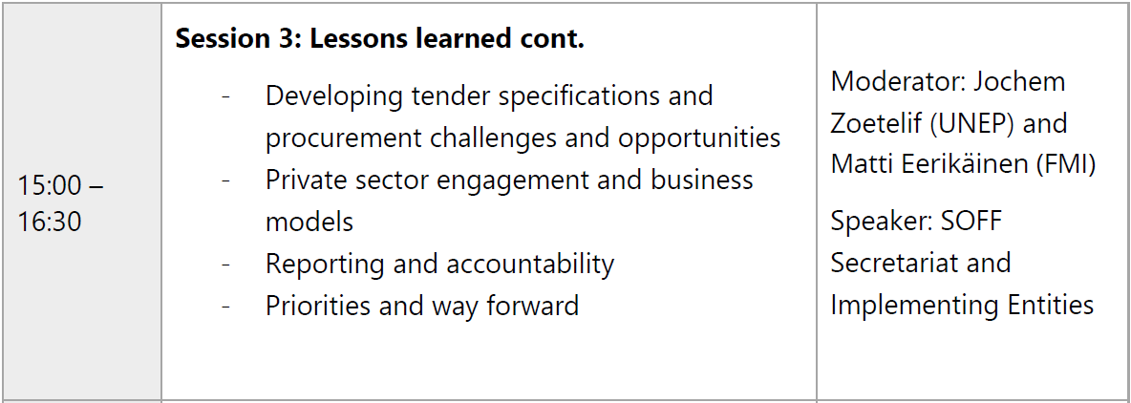
Agenda

Slide 6
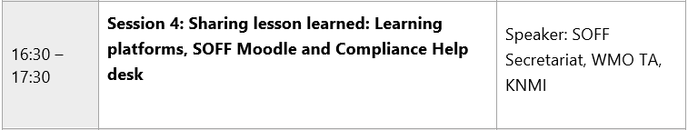
Agenda

Slide 7
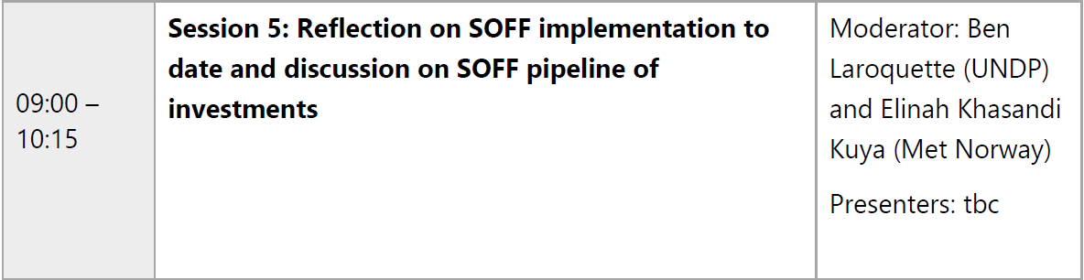
Agenda

Slide 8
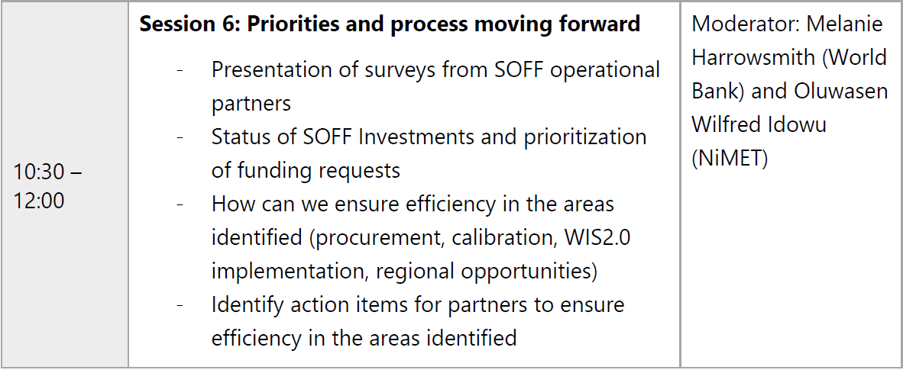
Agenda

Slide 9
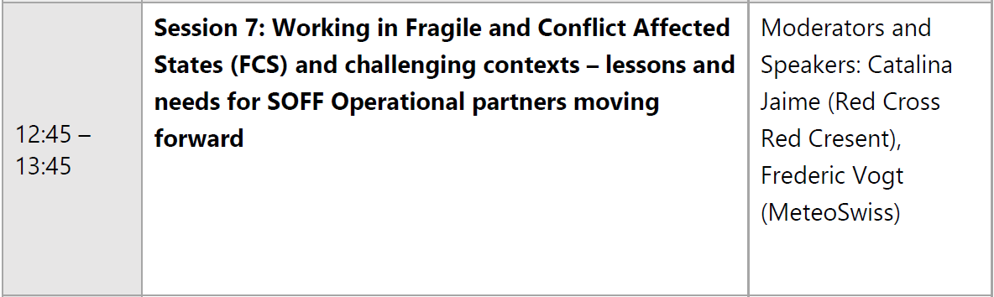
Agenda

Slide 10
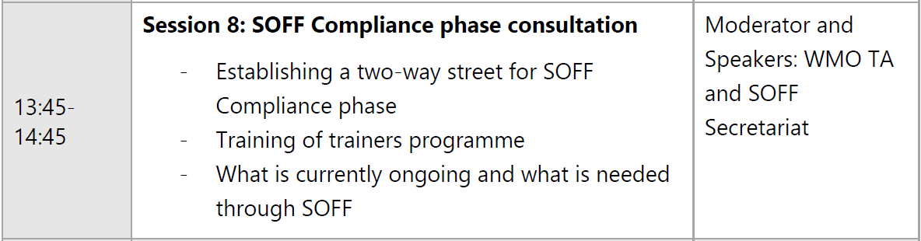
Agenda

Slide 11
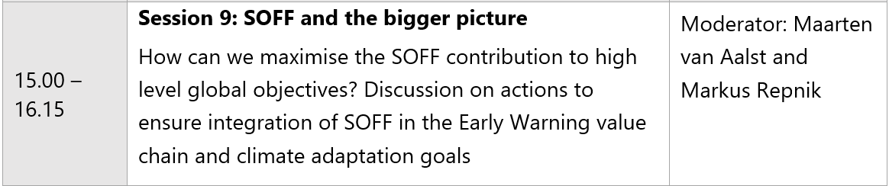
Agenda

Slide 12
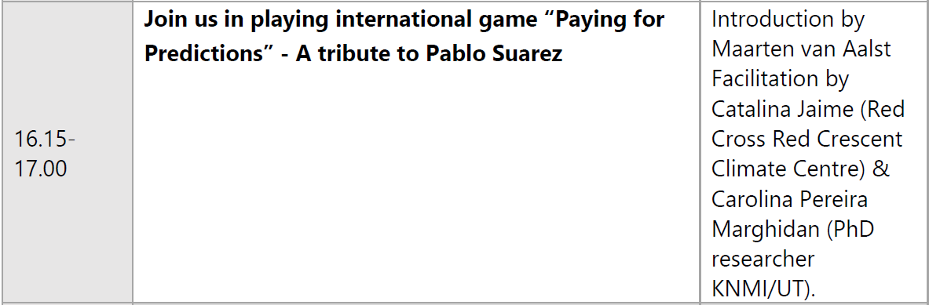
Agenda

Slide 13
Wrap up
Concrete outcomes of the meeting document
Lessons learned to bring to new SOFF Investments
Strengthen community of SOFF Operational partners for enhanced sharing and learning in the future

Slide 14
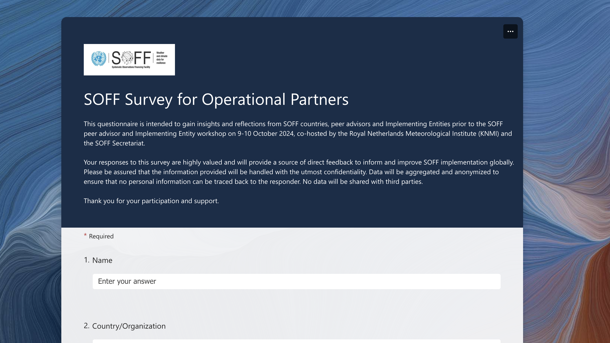

Slide 15
Feedback from countries
Readiness phase
How would you rate the collaboration with your peer advisor?
How would you rate the collaboration with your Implementing Entity?
A⁺
A

Slide 16
Readiness phase
Positive aspects
Partnership and collaboration Ground truthing Knowledge transfer
Challenges
Tight timelines Responsiveness Logistics
Lessons learned
Timing matters Capacity building is not “one-size-fits-all” Speaking the same language

Slide 17
Feedback from countries
Investment phase
How would you rate the collaboration with your peer advisor?
How would you rate the collaboration with your Implementing Entity?
A
A⁺

Slide 18
Investment phase
Improvements
Improved funding request template and guidance Longer window for funding request development Contingency planning Faster disbursement of funds
Challenges
Capacity of the NMHS and executing entity Lengthy administrative processes Limited choice of IEs

